Slide 1
Animal Behavior

Slide 2


What is behavior?
A behavior is anything an organism does in response to a stimulus
Behavior patterns have an adaptive value to increase chances of survival (natural selection)

Slide 3
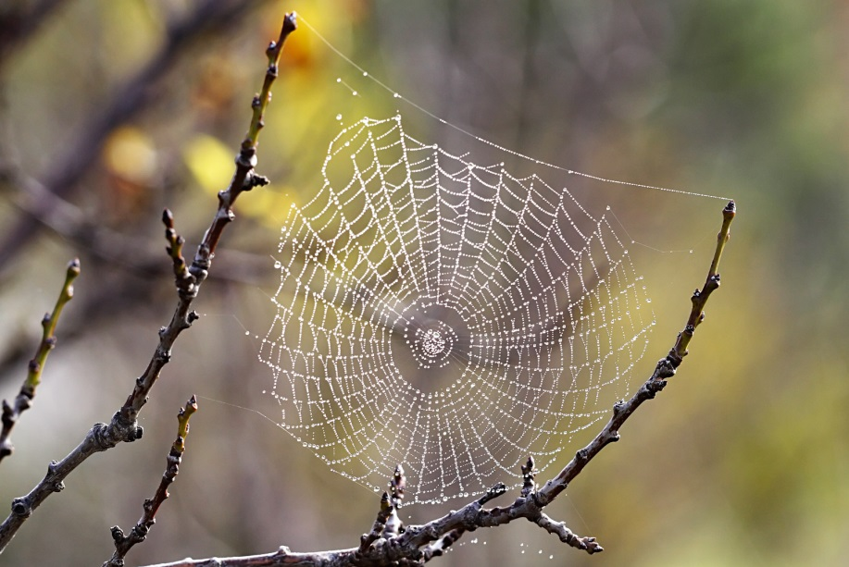
Innate Behavior
(AKA Inherited Behavior)
Represents a behavior that is genetically programmed
Organisms know how to react to a situation without ever encountering that stimulus before
Spiders know how to spin a web to survive without ever being taught

Slide 4
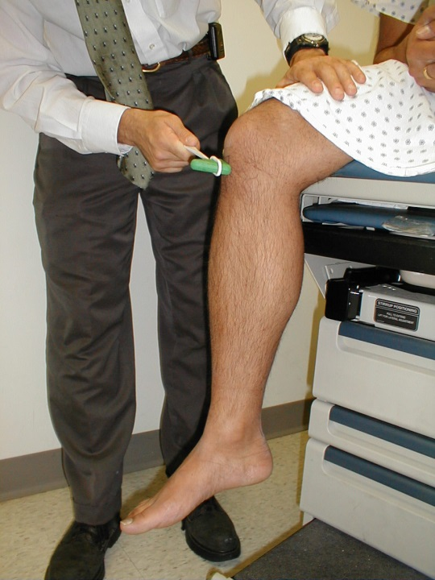
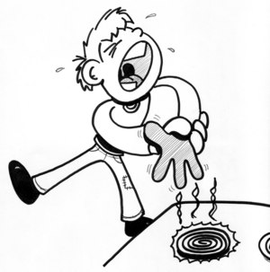
Innate Behavior
1. Reflex: a simple automatic response that involves no conscious control
Can be beneficial in a “flight or fight” response
Controlled by hormones

Slide 5
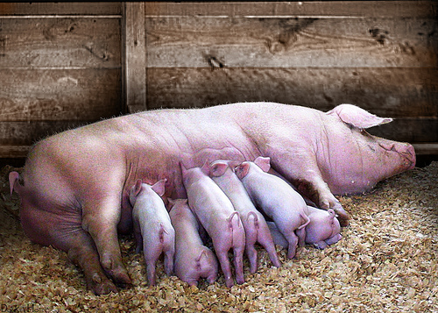
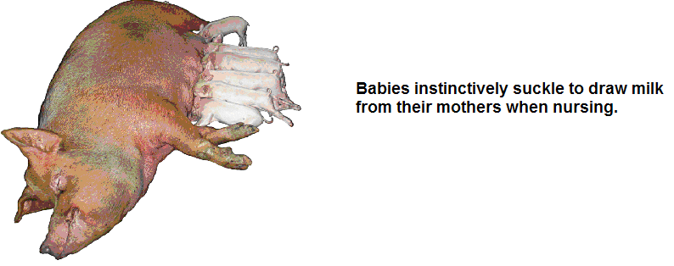
Innate Behavior
2. Instinct: a complex pattern of behavior to help you react to a stimulus
Takes more time and thought than a reflex

Slide 6
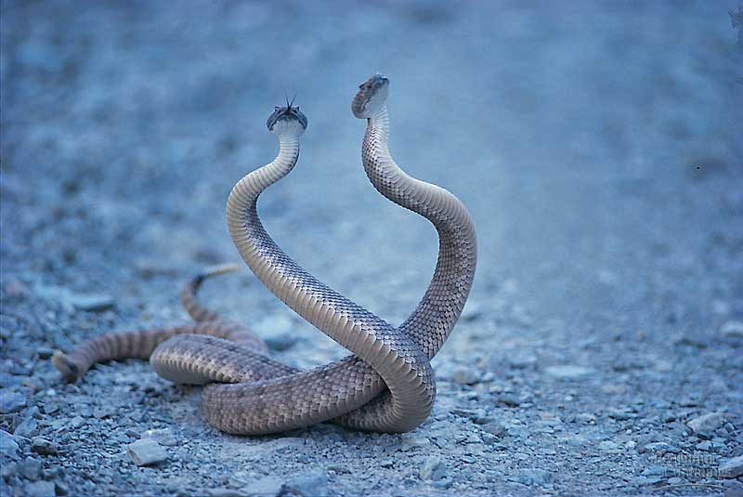
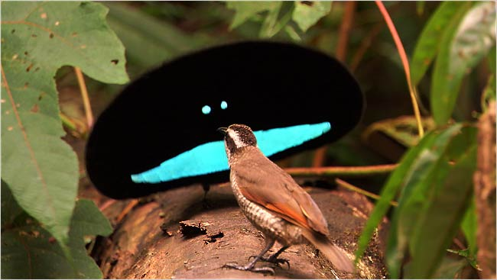
Innate Behavior
3. Courtship behavior: carried out before the male and female partners mate
Allows for recognition of the same species

Slide 7
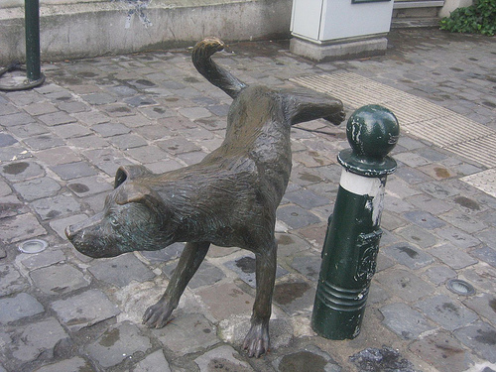
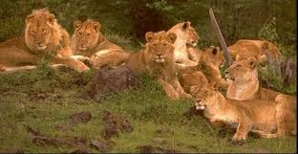
Innate Behavior
4. Territoriality: the defense of a physical space
Meant to reduce conflict and competition by marking off habitat and resource space
Pheromones are chemical signals used to “mark” a territory

Slide 8
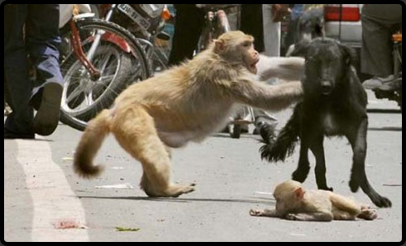
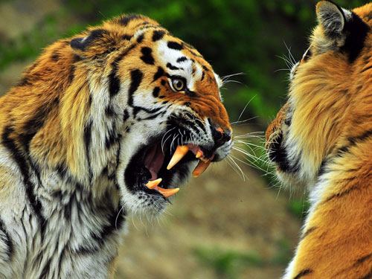
Innate Behavior
5. Aggressive Behavior: the means by which an animal defends its territory
Can be used to protect food and water resources or young offspring

Slide 9
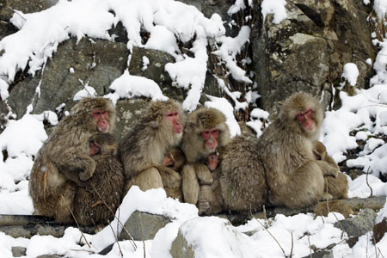
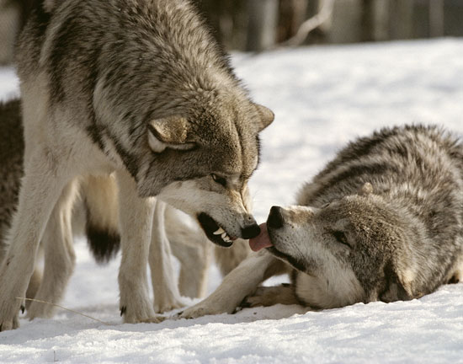
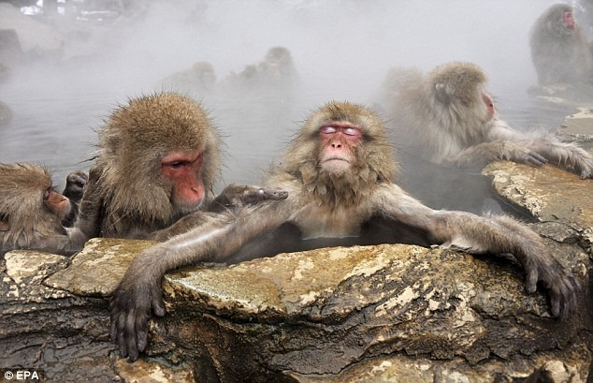
Innate Behavior
6. Dominance Hierarchy: a form of social ranking within a group
Formation of the hierarchy is innate, but individuals must learn their position

Slide 10
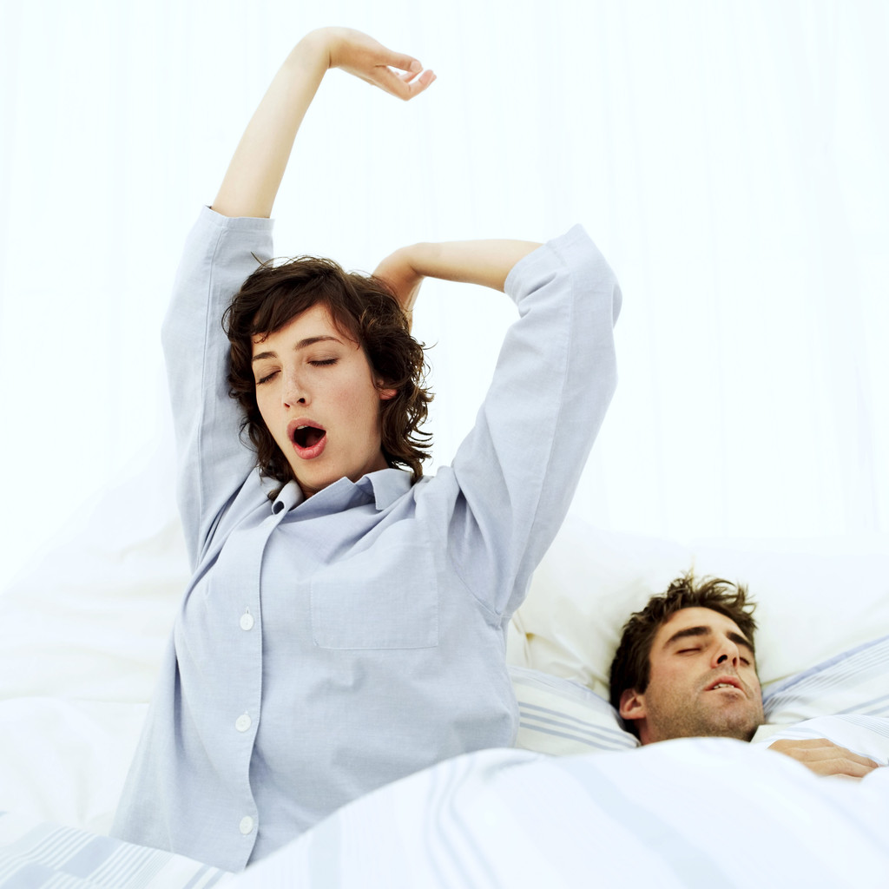
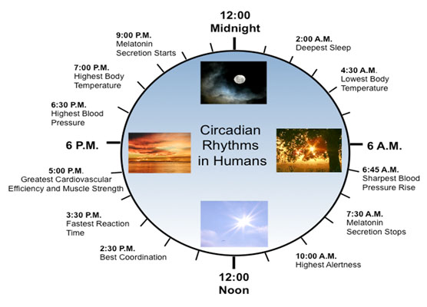
Innate Behavior
7. Circadian Rhythm: behavior based on a 24 hour cycle

Slide 11
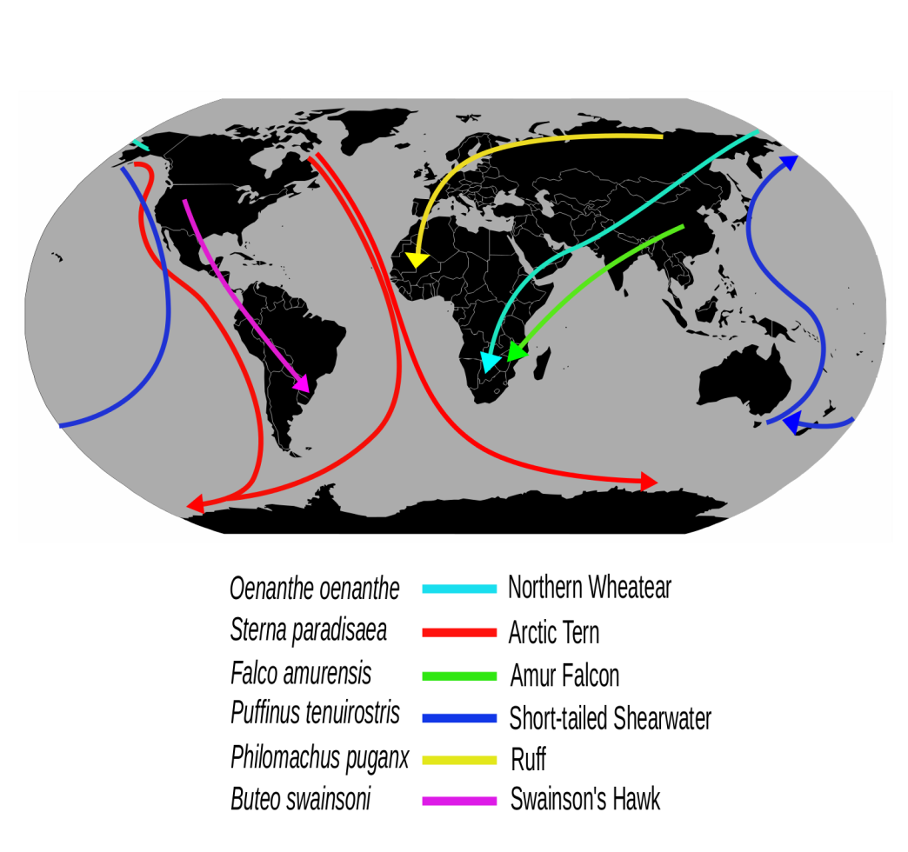
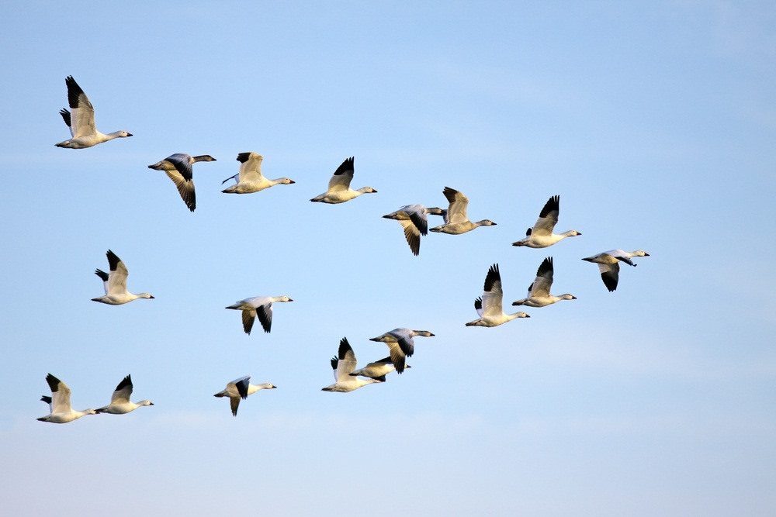
Innate Behavior
8. Migration: behavior that occurs seasonally or yearly, stimulated by changes in day length
Navigation results from the learned behavior of geographical cues

Slide 12
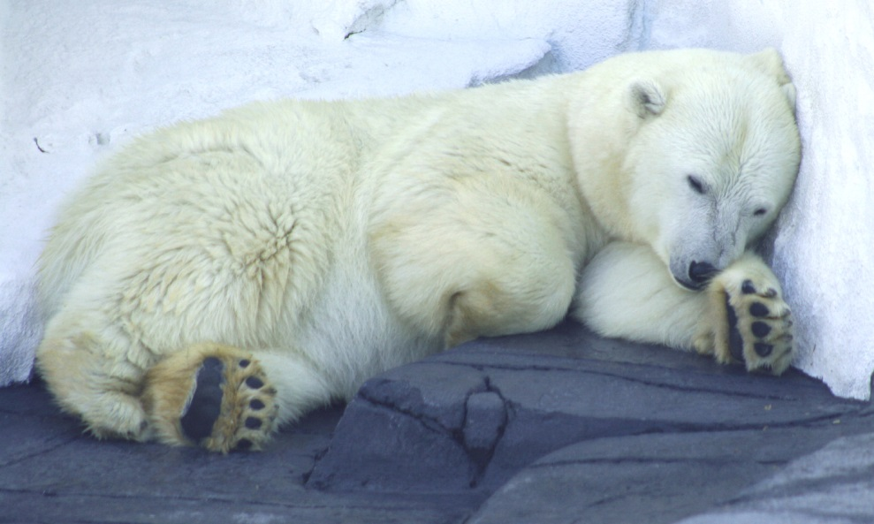
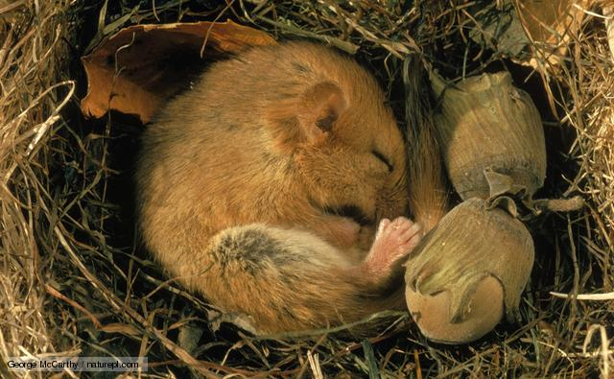
Innate Behavior
9. Hibernation: reduced metabolism during very cold temperature change
Results in lower body temperatures and less activity to conserve body fat
Occurs in small rodents, and some large
mammals

Slide 13
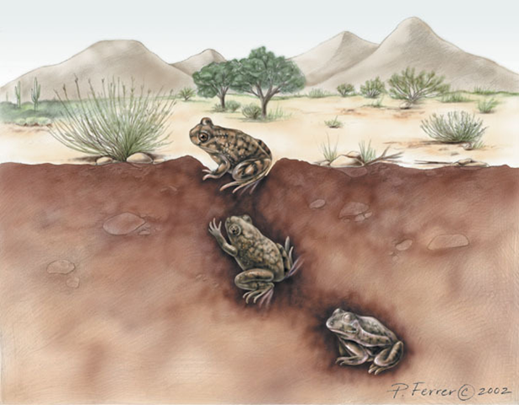
Innate Behavior
10. Estivation: reduced metabolism during very hot temperature change
Periods of inactivity due to high heat and arid conditions
Occurs in reptiles, fish,
birds, and some
invertebrates

Slide 14
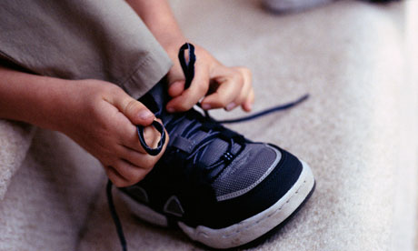
Learned Behaviors
Behaviors that are modified through practice or experience
Often taught through social activity with others or repeated experience with a stimulus

Slide 15

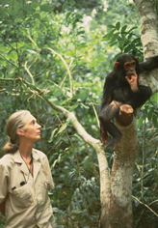
Learned Behavior
1. Habituation: not responding to a repeated stimulus

Slide 16
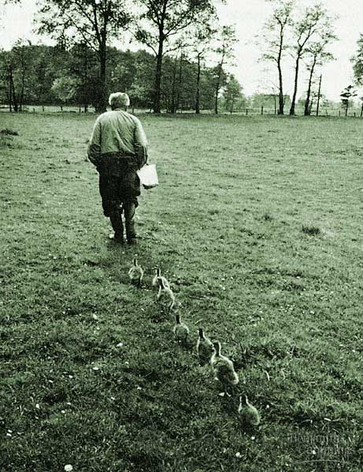
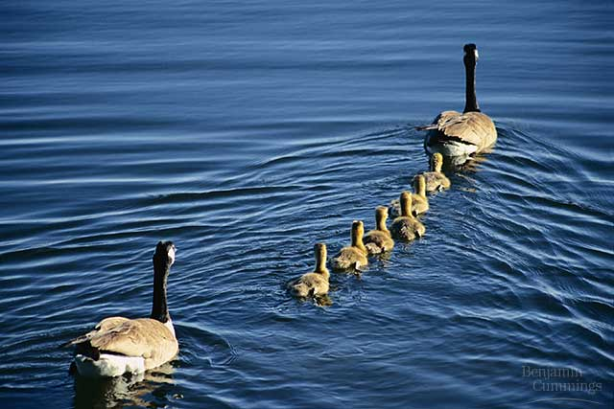
Learned Behavior
2. Imprinting: forming a social attachment during a critical period
Usually associated with birds

Slide 17
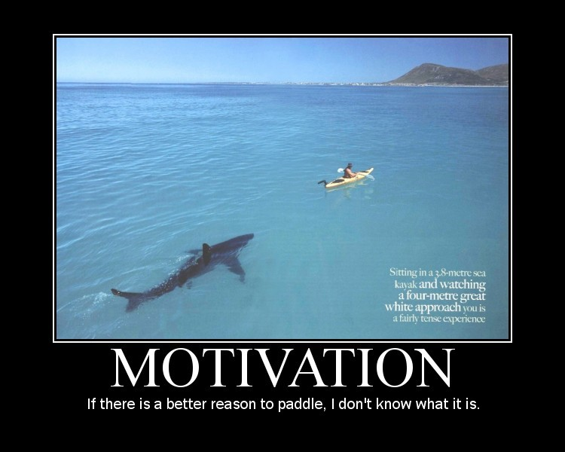
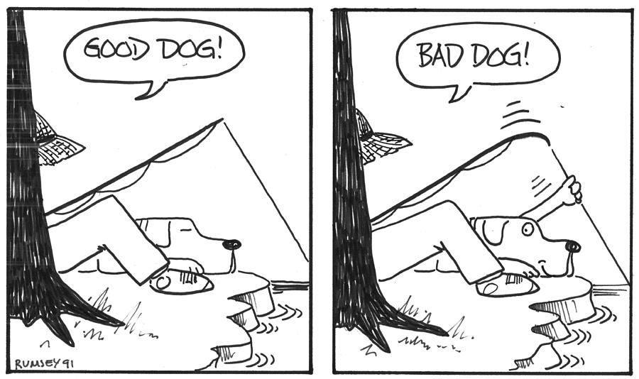
Learned Behavior
3. Operant Conditioning: (aka Trial and Error) learning that results from receiving a reward/punishment for a particular response
Can be related to motivation, an internal need that causes action

Slide 18
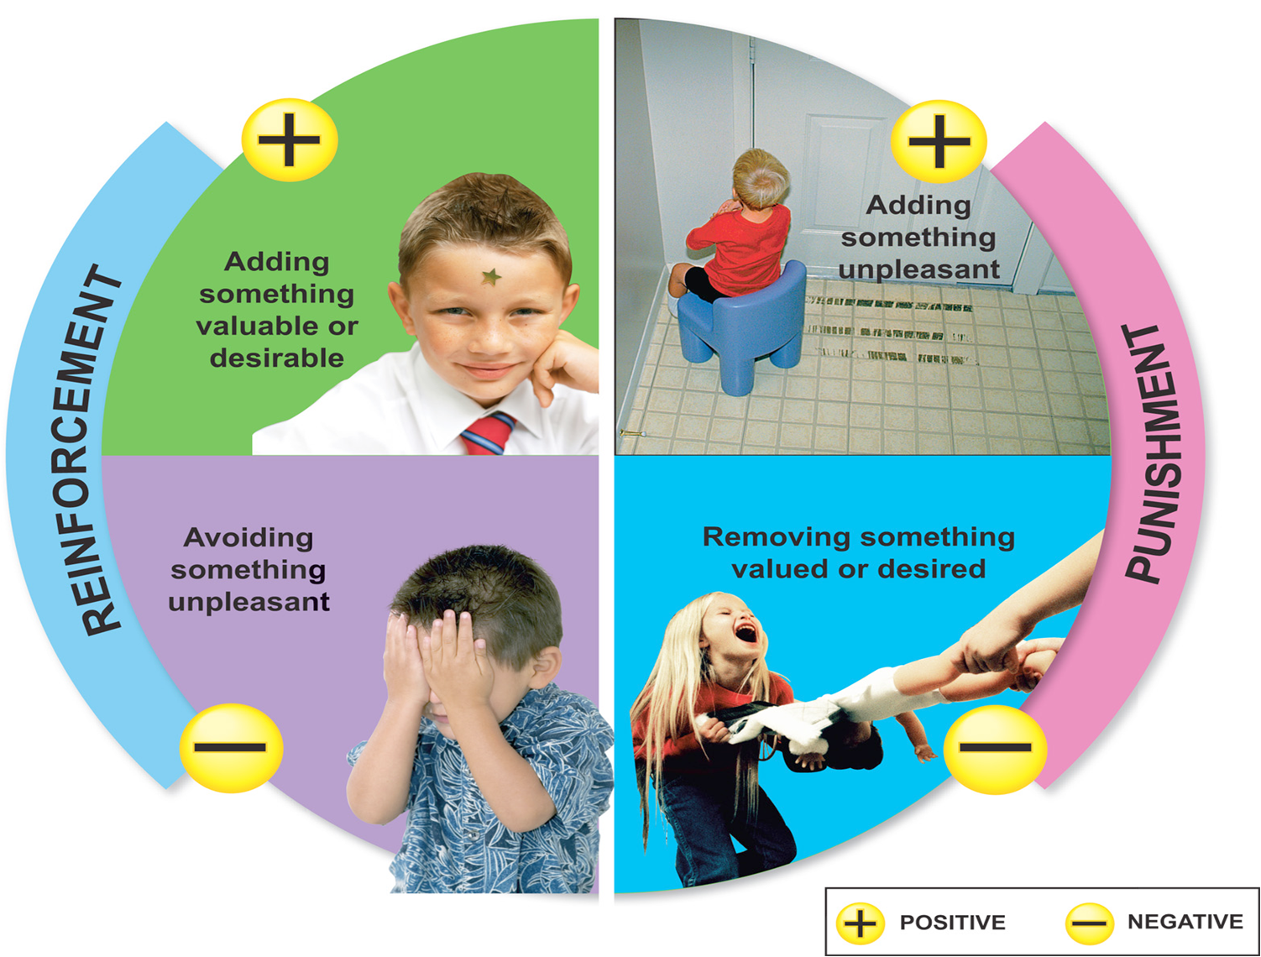
Operant Conditioning Diagram

Slide 19
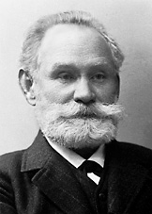
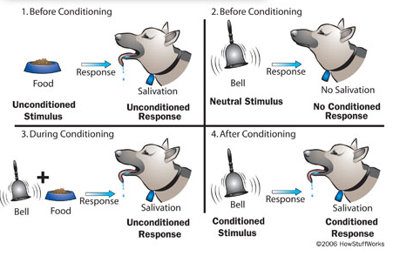
Learned Behavior
4. Classical Conditioning: learning to respond to a stimulus that would not normally produce that response
Ivan Pavlov’s Experiment

Slide 20
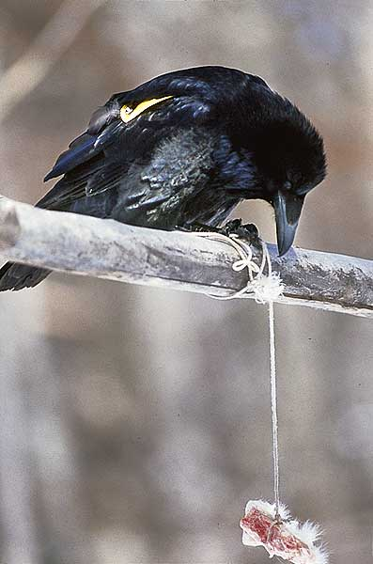

Learned Behavior
5. Insight: learning where an organism uses prior experience in order to respond to a new situation

