Slide 1
Bacteria
Classification, Identification, and Human Impact

Slide 2
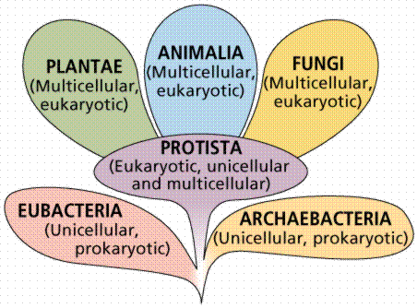
Kingdoms of bacteria
Two of the six kingdoms of classification are represented by bacterial cells.
Bacteria are
unicellular,
prokaryotic cells with
simple cell structures
The two groups of bacteria
vary mostly by where they live

Slide 3
Kingdoms of bacteria
Until the 1970’s 5 classification kingdoms were recognized by the scientific community: plants, animals, fungi, protists, and a bacterial group called “monera”
In the 1970’s a group led by Carl Woese discovered that the DNA among bacteria cells formed 2 very different groups
This developed our current 6 classification system which can also be divided into 3 larger categories called domains: Eukarya, Eubacteria, and Archaea.

Slide 4
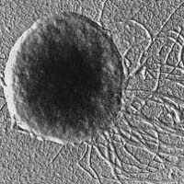
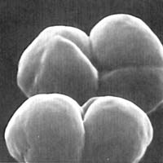
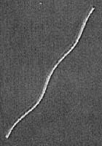
Kingdoms of bacteria
The domain and kingdom Archaea actually represents a group that aren’t technically bacteria
Archaea look like bacterial cells and store their DNA in the same circular structure but are otherwise very chemically different

Slide 5
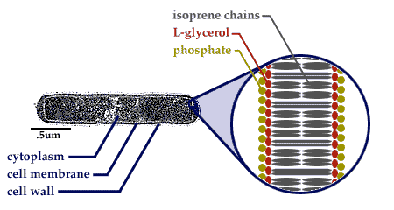
Kingdoms of bacteria
One major difference between Archaea and Eubacteria cells is the structure of the cell wall/membrane
Normal cells (including eukaryotic cells) have a phospholipid cell membrane structure
Archaea cell membranes are made instead of a carbon based isoprene chain structure

Slide 6
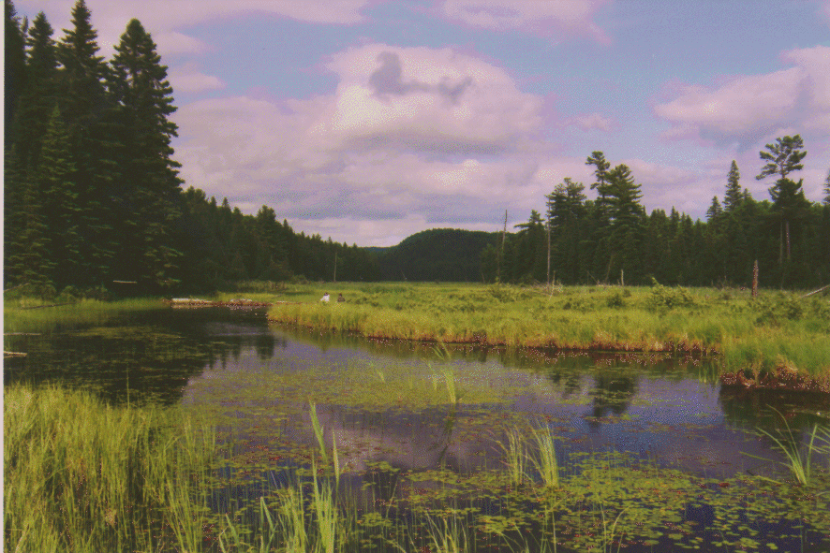
Kingdoms of bacteria
Archaea are best known for their ability to survive in extremely harsh environments
Methanogens live in swamps
Halophiles live in salty areas
Thermophiles live in extreme temperatures

Slide 7
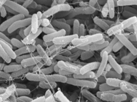
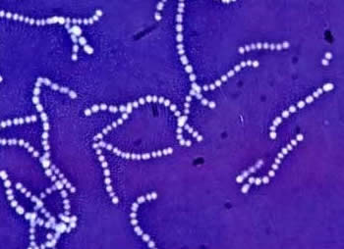
Kingdoms of bacteria
Eubacteria are found just about anywhere normal living conditions exist and have various modes of nutrition
Heterotrophic eubacteria get their food from different sources and may be considered parasitic
Example: E.coli and streptococcus

Slide 8
Kingdoms of bacteria
Autotrophic eubacteria often make their own food using photosynthesis
Example: Cyanobacteria

Slide 9
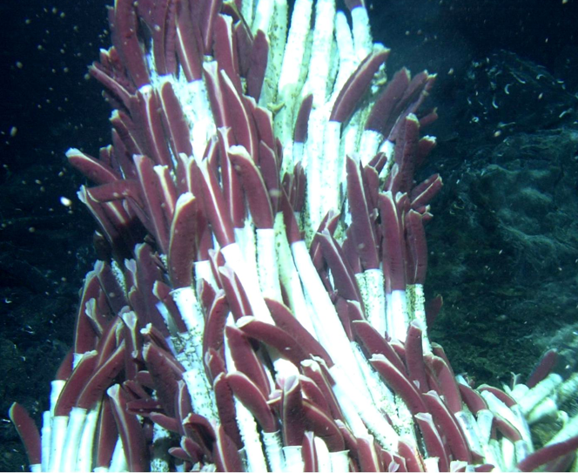
Kingdoms of bacteria
Some eubacteria are autotrophic and are able to make their own food without light using inorganic compounds in a process called chemosynthesis
12H₂S + 6CO₂ → C₆H₁₂O₆ (carbohydrate) + 6H₂O + 12S

Slide 10
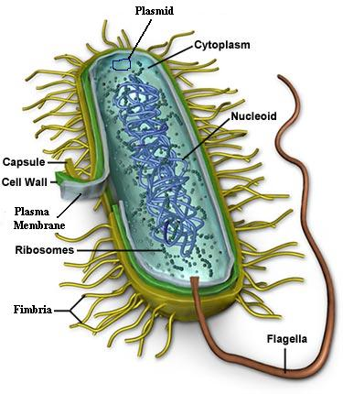
Characteristics of eubacteria
NO NUCLEUS (meaning they are prokaryotic)
DNA is stored in a circular
form called a plasmid
Contains a cell wall made of
peptidoglycan surrounded by
a capsule
Uses flagella or cilia for movement

Slide 11
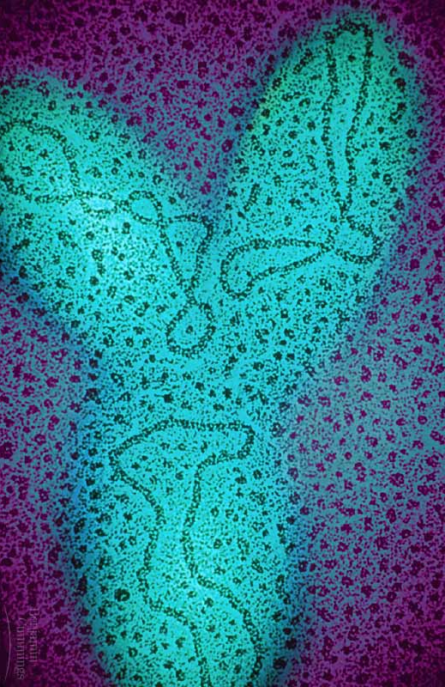
Characteristics of eubacteria
Plasmid: Circular DNA structure
Flagella attached to assist in movement

Slide 12
Identification of bacteria
Gram staining is a technique used to classify groups of bacteria cells based on the thickness of their cell wall.
Gram positive (+) results will stain the cell purple

Slide 13
Identification of bacteria
Gram negative (-) results will stain the cell pink

Slide 14
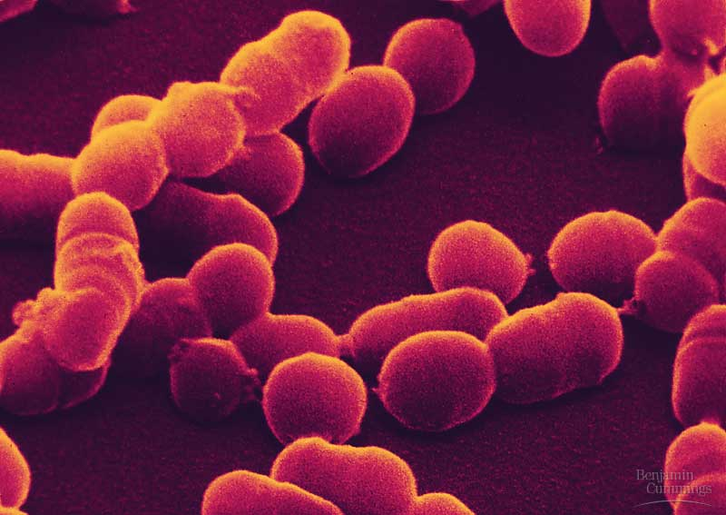
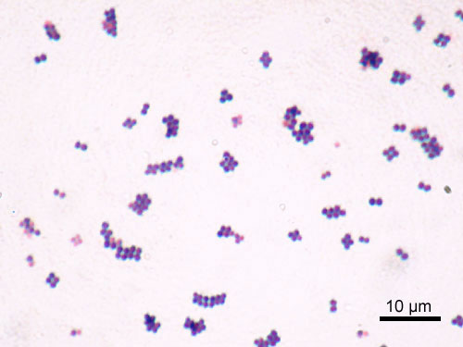
Identification of Bacteria
Bacteria are also classified and named based on the shape of the cell.
Spheres of bacteria are called coccus

Slide 15
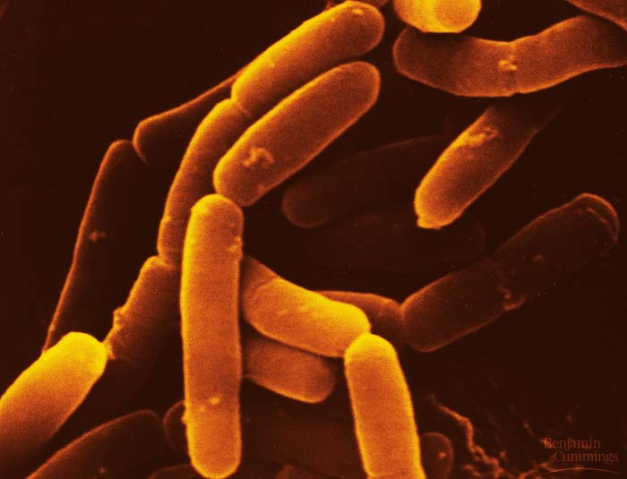
Identification of bacteria
Rod shaped bacteria are called bacillus

Slide 16
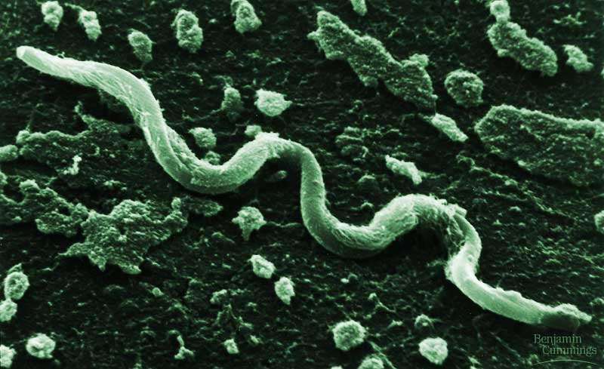
Identification of bacteria
Spiral shaped bacteria are called spirilli

Slide 17
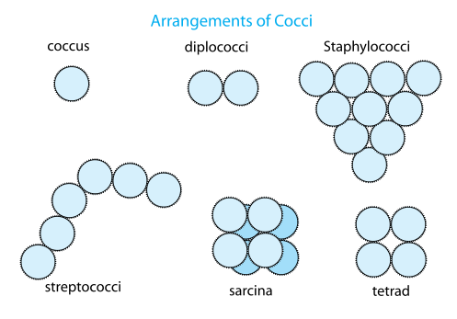
Identification of bacteria
In addition to their shape, growth patterns are also used to classify and name bacterial cells
Diplo = growth in pairs
Strepto = growth in chains
Staphylo = growth in groups or clusters

Slide 18
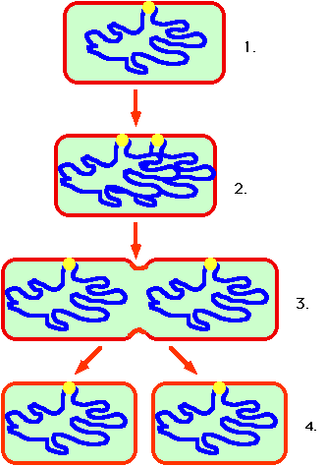
reproduction
Bacteria can use multiple methods of reproducing depending on environmental factors
Asexual reproduction
occurs through
binary fission

Slide 19
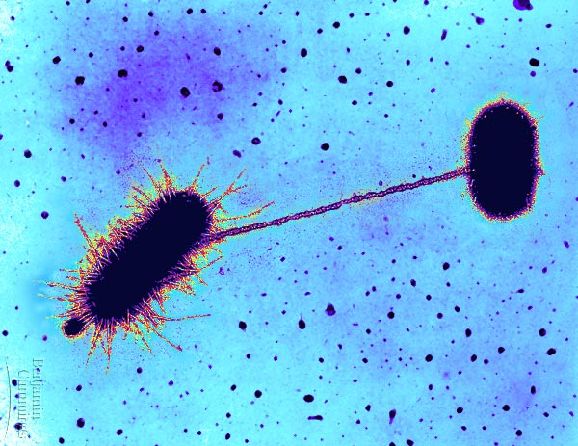
reproduction
Sexual reproduction occurs through conjugation
Sexual reproduction
increases genetic variety
to help a population
survive in adverse
conditions

Slide 20
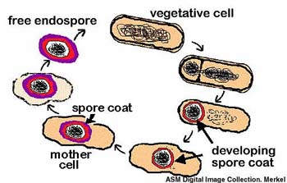
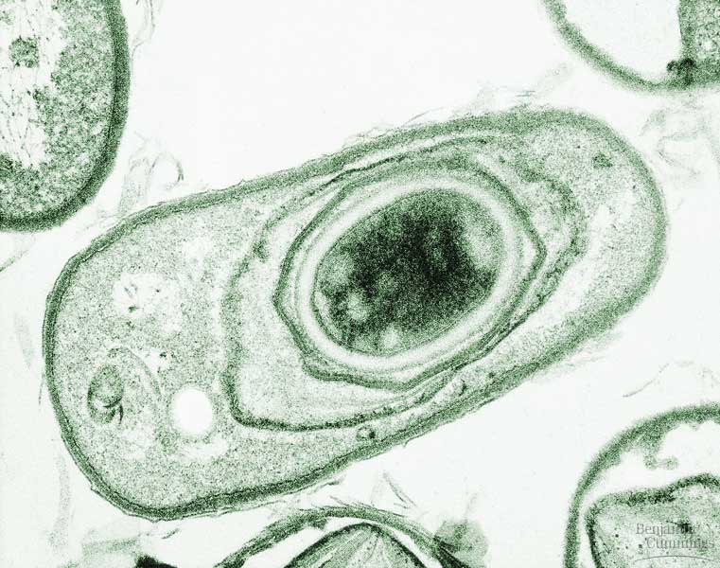
adaptations
Bacteria have the ability to form an extra layer of protection against their environment in adverse conditions called an endospore
Endospores protect the
cell’s DNA so it can survive
for years until conditions
are normal again.

Slide 21
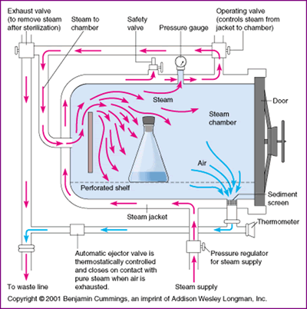
adaptations
Only sterilization will destroy bacterial cells and endospores
“sterile” means the
absence of all
microorganisms
High heat is the most
effective method of
sterilization
First developed by
Louis Pasteur

Slide 22
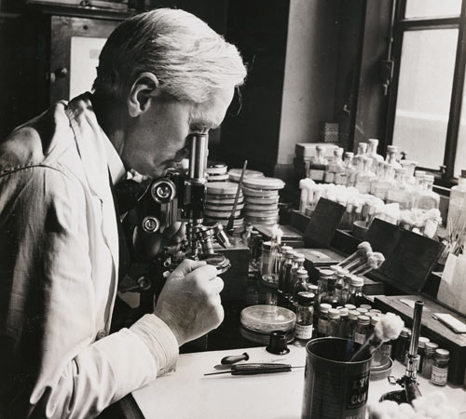
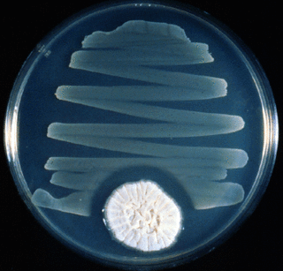
applications
With a better understanding of microorganisms scientists began to develop methods of combating disease caused by microorganisms
In 1928 Alexander Fleming discovered that mold had accidentally grown in one of his petri dishes of bacteria and that the mold growth was actually inhibiting the growth of the bacteria

Slide 23
Applications
This discovery by Fleming marked the first discovery of an antibiotic treatment that could be used to fight bacterial diseases.
The antibiotic discovered by Fleming is a common mold called Penicillium that inhibits bacterial growth

Slide 24
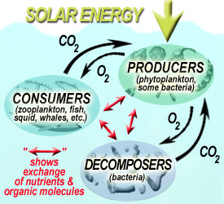
applications
Bacteria are found in all environments and therefore have developed relationships with the organisms and the environments that they live in.
Bacteria decompose dead,
organic material to be recycled
into the Earth and back through
the food webs

Slide 25
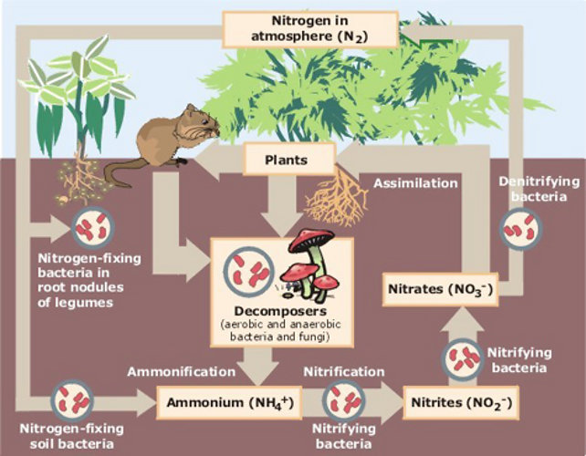
applications
Bacteria are used in the Nitrogen cycle during nitrogen fixation that converts N₂ into nitrates

Slide 26
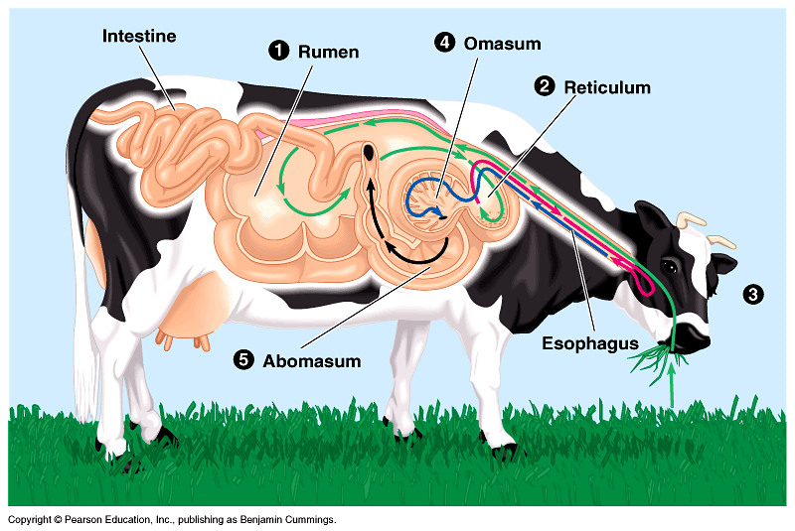
applications
Most digestive systems contain various bacteria that help us break down the food we eat (without them we would not be able to digest plant material!)
Cows rely on bacteria
to break down and
absorb tough plant
material

Slide 27
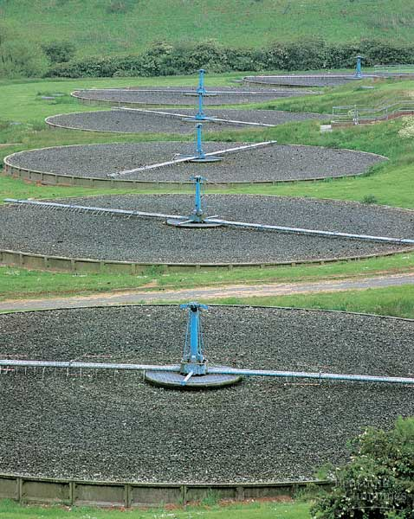
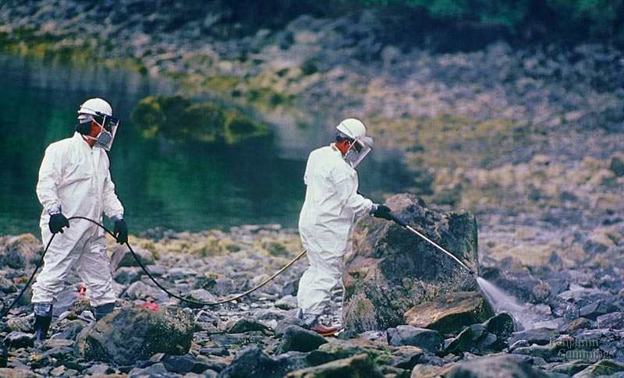
applications
Cyanobacteria play a vital role in the production of oxygen in the atmosphere
Recently bacteria have been used to help clean up damage from oil spills and sewage

Slide 28
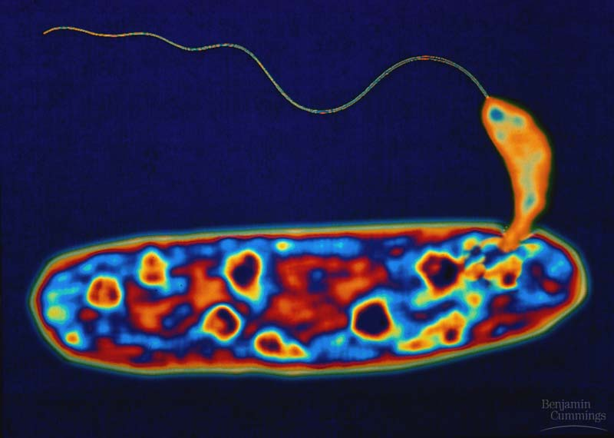
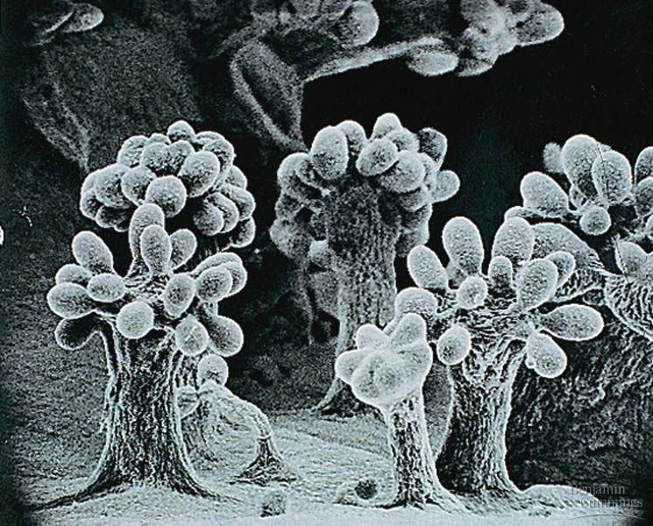
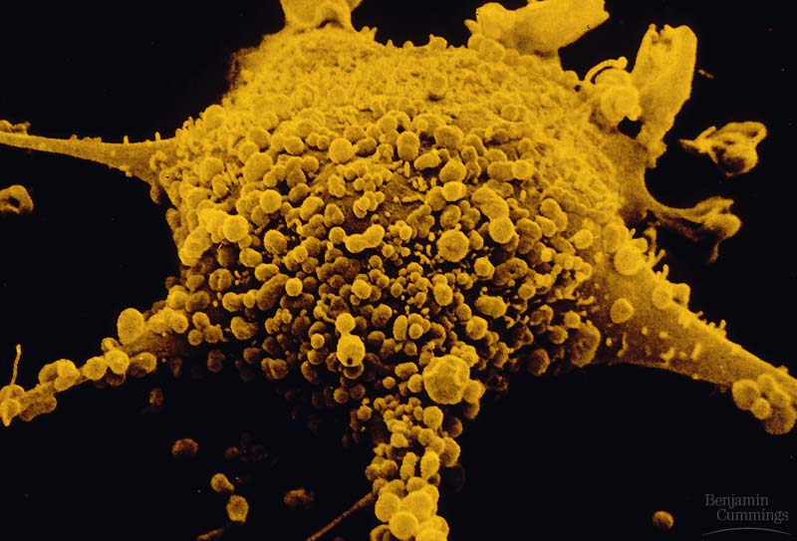
How do you prevent disease?
Wash your hands properly
Cover your nose and mouth when you sneeze or cough
Stay at home when you’re sick

