Slide 1
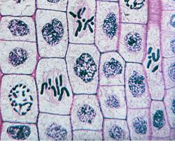
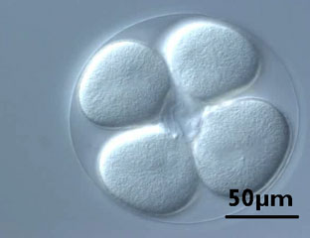
Cell Growth & Division
Prokaryotic and Eukaryotic Cell Division

Slide 2
What limits cell size?
1. Amount of DNA : if the cell becomes too large it may not have enough DNA to control normal cell functions.
2. Cell Transport : the larger the cell, the more difficult it becomes to regulate cell transport and maintain homeostasis.
3. Surface Area to Volume Ratio : the volume of a cell increases faster than the surface area putting stress on the cell membrane and slowing down cell processes.

Slide 3
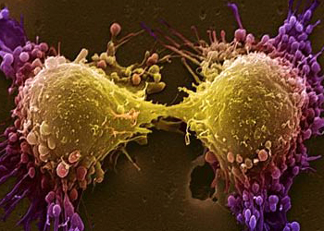
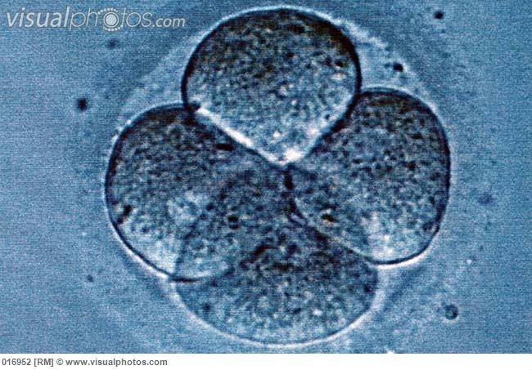
What must a cell do?
In order for the cell to survive when it gets too large it must:
DIVIDE or DIE

Slide 4
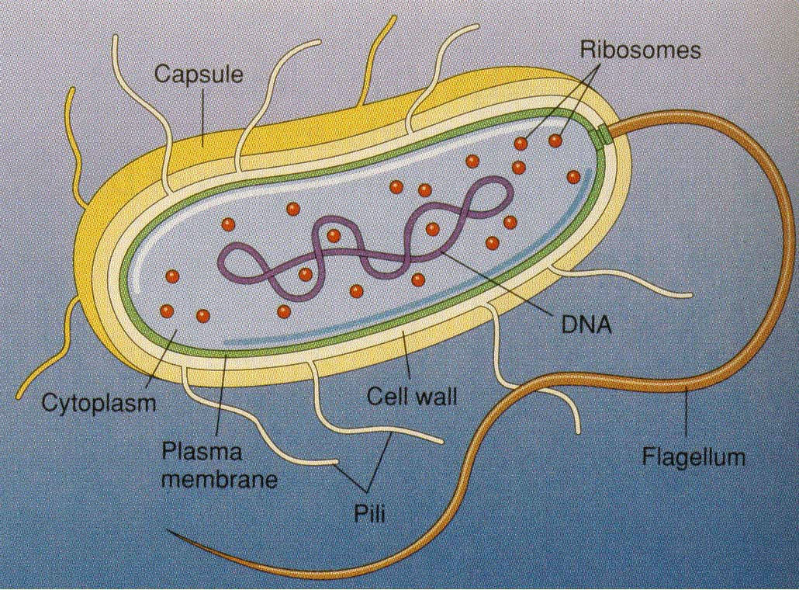
Prokaryotic Cell Division
Remember:: Prokaryotic cells are different from Eukaryotic cells because they do NOT have a nucleus.
Because there is no nucleus
in prokaryotic cells the DNA
floats freely in the cytoplasm in
a circular structure called a
plasmid.

Slide 5
Prokaryotic Cell Division
Asexual Reproduction: reproduction that requires only one parent or source of DNA
this creates an identical copy of the parent
Binary Fission: the type of asexual
reproduction that creates new
bacterial cells

Slide 6
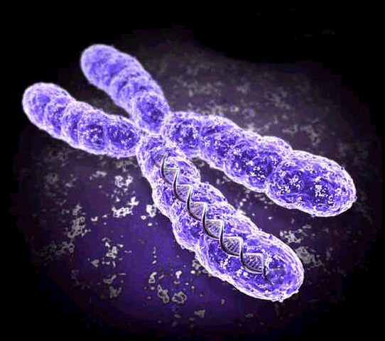
Eukaryotic Cell Division
Remember:: DNA in eukaryotic cells is found in the nucleus.
DNA is organized into structures called chromosomes.
In order for a eukaryotic cell
to divide into 2 identical new
cells the nucleus must dissolve
and the chromosomes must
be copied.

Slide 7
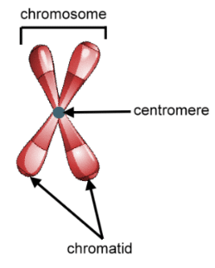
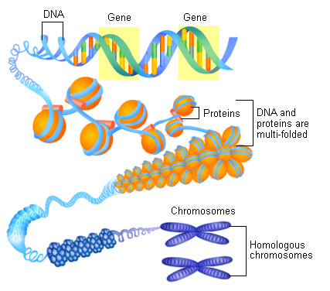
Eukaryotic Cell Division
Chromosomes are made of DNA wrapped around a protein called a histone.
Before cell division, after the
DNA has been copied, the two
copies come together to form an
X shape held together in the middle
by a centromere.
Each copy is called a chromatid.
Together the two copies are called sister chromatids.

Slide 8
Eukaryotic Cell Division
All organisms have a specific number of chromosomes
Example: Humans have 46 chromosomes and Bananas have 22 chromosomes.
Chromosomes are only visible
during cell division. Usually they
are uncoiled thin strands called
chromatin.

Slide 9
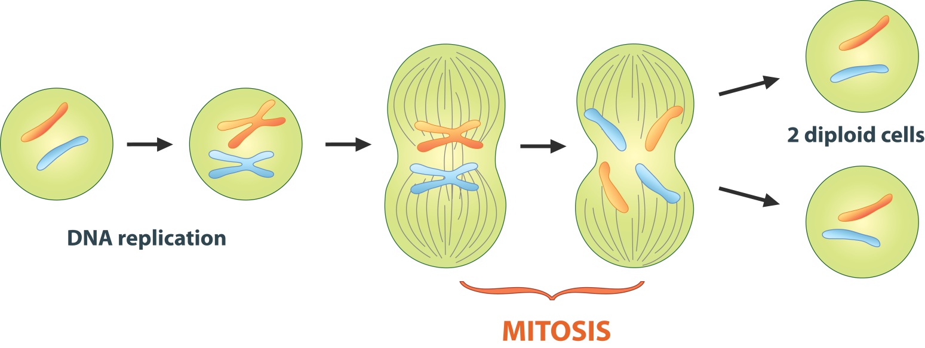
Eukaryotic Cell Division
Cell Cycle: the process by which a eukaryotic cell divides to form two new eukaryotic cells called “daughter cells”
Daughter cells are identical to the parent cell meaning it is a form of asexual reproduction.

Slide 10
Eukaryotic Cell Division
Stages of the Cell Cycle:
Interphase: preparation for cell division
Mitosis: division of nuclear material (chromosomes)
Cytokinesis: division of material outside of the nucleus (cytoplasm and organelles)

Slide 11
Cell Cycle
Interphase (longest stage of cell cycle)
G₁ – initial growth to normal size
S – synthesis of DNA (makes a copy)
G₂ – growth to 2x the normal size

Slide 12
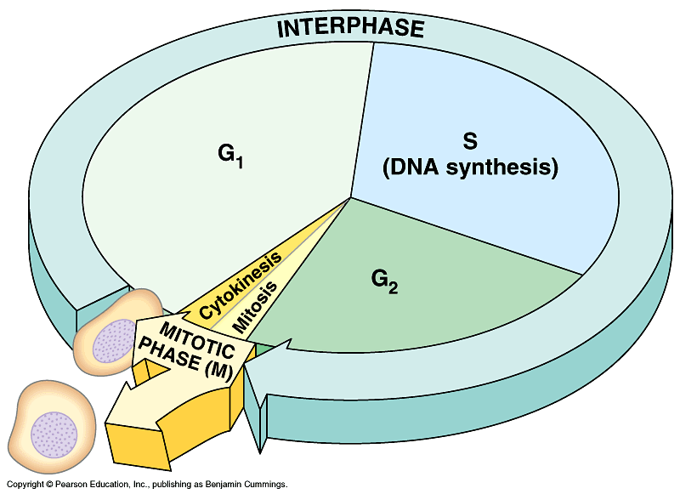
Cell Cycle
M phase
Mitosis – nuclear division
Cytokinesis – cytoplasmic division

Slide 13
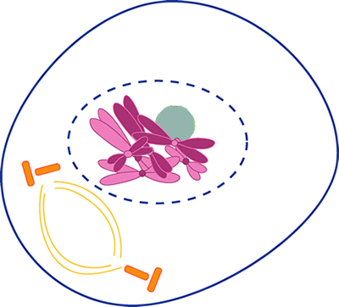
Phases of Mitosis
Prophase
Chromatin coils into visible chromosomes
Nuclear membrane starts to disappear
Spindle fibers start to form
Centrioles move to
opposite ends of the cell

Slide 14
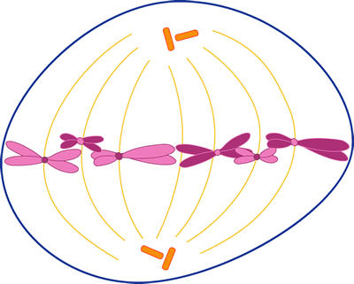
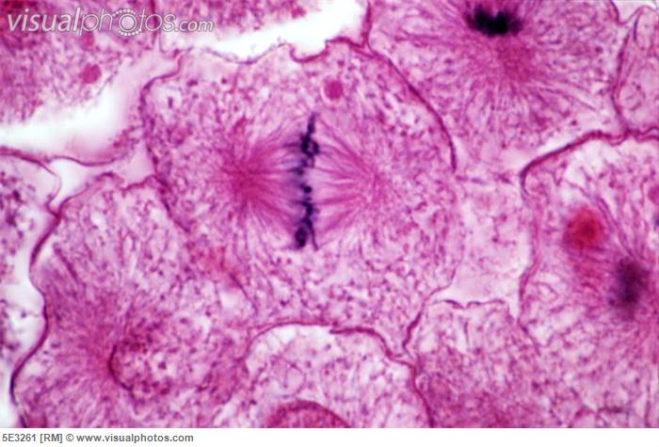
Phases of Mitosis
2. Metaphase
Chromosomes line up at the center of the cell
Spindle fibers attach to the centromeres

Slide 15
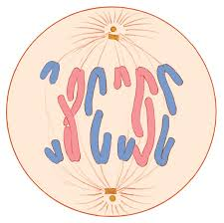
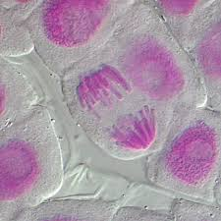
Phases of Mitosis
Anaphase
Centromeres pull apart
Sister chromatids are pulled to opposite ends of the cell

Slide 16
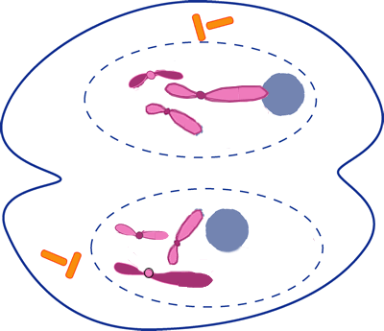
Phases of Mitosis
Telophase
Cell has 2 complete sets of chromosomes
Spindle fibers disappear
Nuclear membrane
reappears
Chromosomes start to
uncoil back into chromatin

Slide 17
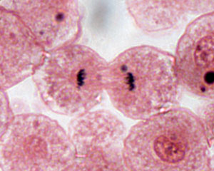
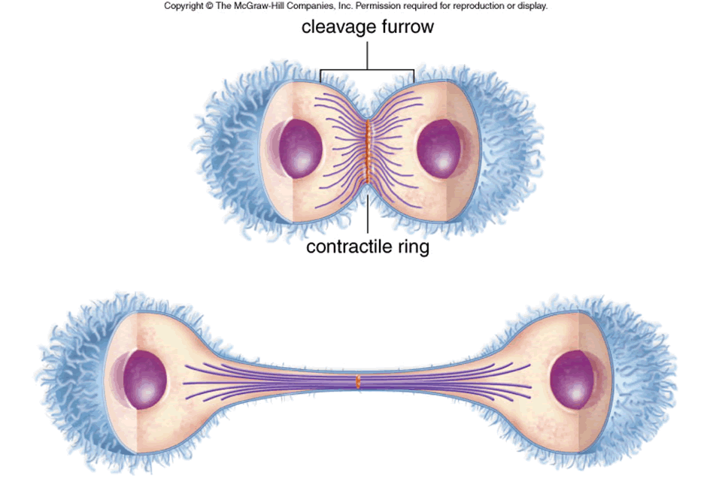
Cytokinesis
Cytokinesis marks the complete separation of the cytoplasm and cell barriers (cell membrane or cell wall) into new cells

Slide 18
Cell Division Video
During cell division chromosomes are easily visible with even simple light microscopes
Videos of cell division show the continuous motion and the precision of the mitosis process
Video of actual cell division using a microscope

Slide 19
Cytokinesis
Animal Cells
Cleavage furrow forms at
middle of cell
Cytoplasm underneath
pinches in forming 2 new
daughter cells

Slide 20
Cytokinesis
Plant Cells
Vesicles form a cell plate
at equator
Cell plate grows into the
existing cell wall forming
2 new cells

Slide 21
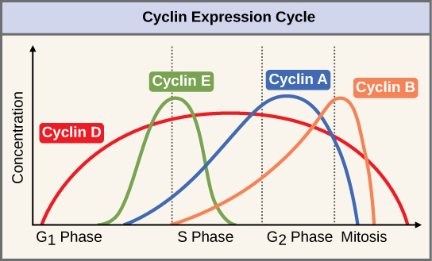
Cell Cycle Control
What limits cell division?
The cell cycle is controlled by proteins called cyclins.
Cyclins activate enzymes called cyclin dependent kinase that control different parts of the cell cycle

Slide 22
Cell Cycle Control
Cell growth is also affected by environmental changes.
Contact inhibition occurs when the cell senses that all of the space around it has been taken up so there is no more room to grow.
Cell division stops when
there is no more room for
new cells.

Slide 23
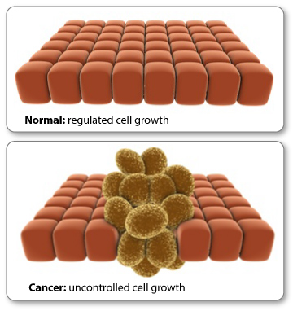
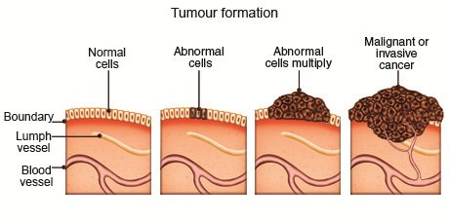
Cancer
Cancer is defined as uncontrolled cell growth.
Cancerous cells have cyclins that have been altered and no longer regulate cell cycle changes or no longer exhibit contact inhibition.

Slide 24
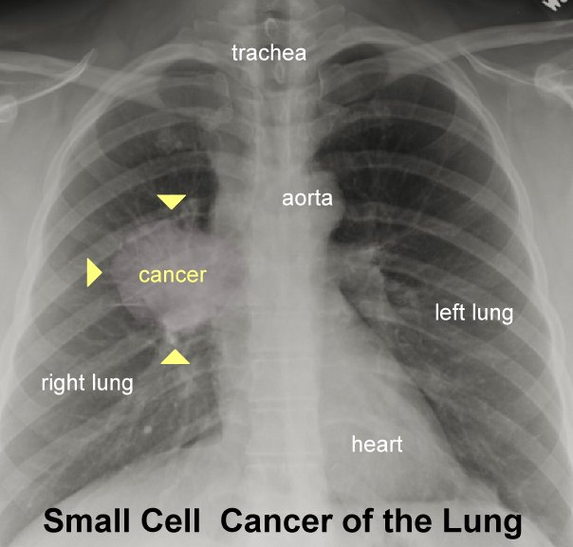
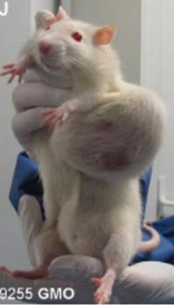
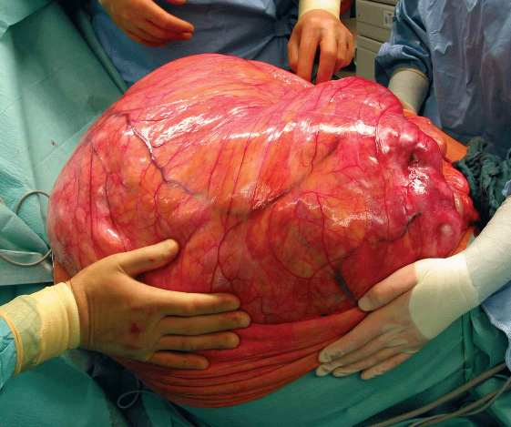
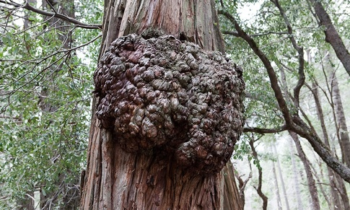
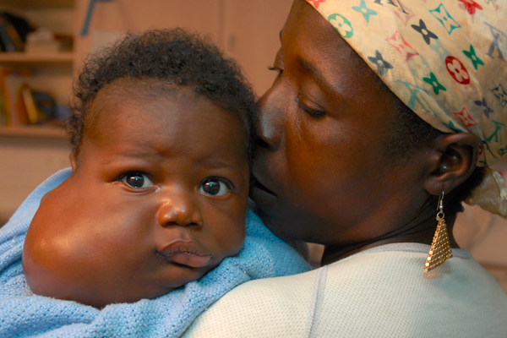
Cancer

Slide 25
Cancer
Environmental factors like cigarette smoke, pollution, and radiation exposure are all known to damage the genes that control the cell cycle and increase the risk of cancer.
Daily exercise, healthy diet and staying away from known carcinogens can help to reduce the risk of cancer.

