Slide 1
Cell Transport
Plasma Membrane Structure
Passive & Active Transport

Slide 2
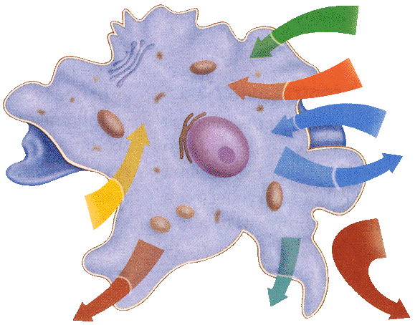
Plasma Membrane
The plasma membrane regulates what passes through and maintains homeostasis by:
Being selectively permeable meaning:
only selected
materials can
enter/leave the cell

Slide 3
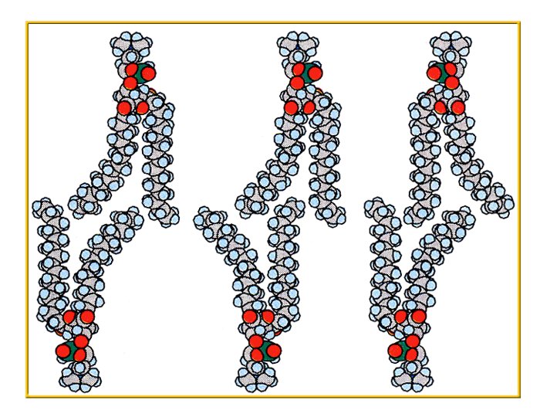
Plasma Membrane Structure
Phospholipid Bilayer: Two layers of phospholipids back to back.
Polar “heads” face out;
they are hydrophilic
Nonpolar “tails” face inward; they are hydrophobic.
Water outside the cell
Water inside the cell

Slide 4
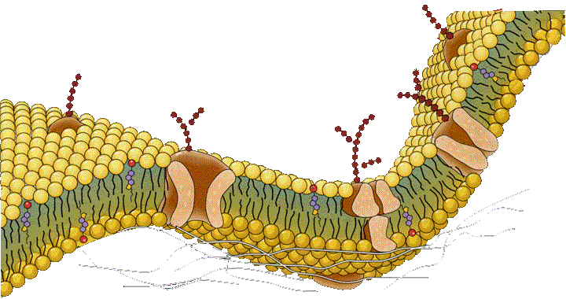
Fluid Mosaic Model
The membrane is called this because it is fluid=*flexible & free floating
and mosaic= *scattered with different proteins.

Slide 5
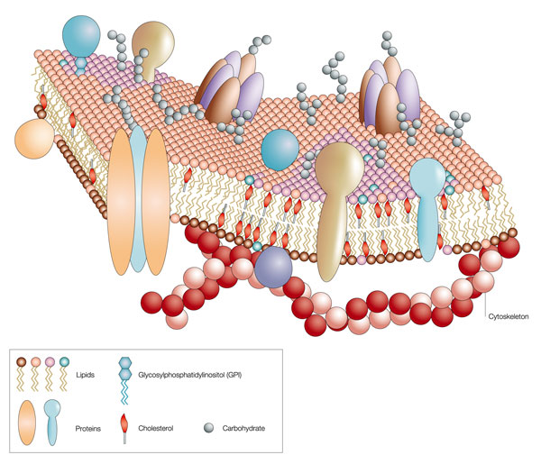
Transport Proteins
Proteins that may require energy (active) or may not require energy(passive) to move substances across the plasma membrane.

Slide 6
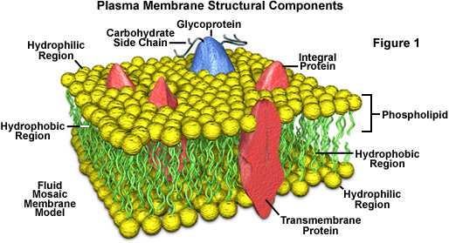
Integral Proteins
Channel- are like bridges into the cell
Carrier- are like gates and use energy
Receptor- are docks for molecules to attach to
Marker- are like name tags for cell recognition

Slide 7
Integral Proteins

Slide 8
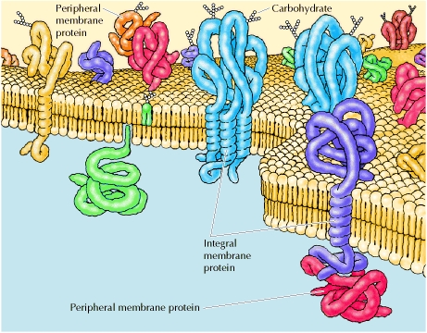
Peripheral Proteins
Attach temporarily for chemical reactions.

Slide 9
Cell Transport: Passive
Particles move from HI to LOW
Does NOT require energy
3 Types:
Diffusion→ particles move from high to low areas
Osmosis→ diffusion of water across a membrane

Slide 10
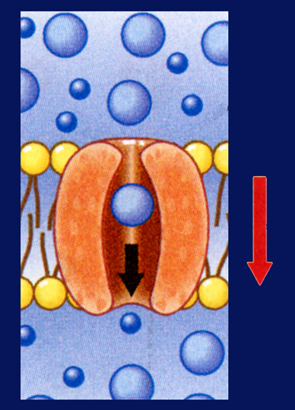
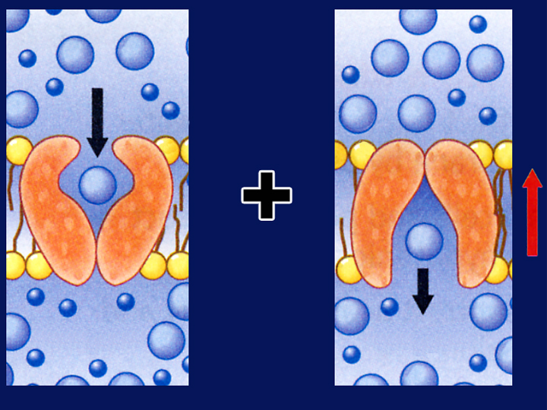
Cell Transport: Passive
Facilitated Diffusion→ uses proteins to allow large molecules to pass across the cell membrane

Slide 11
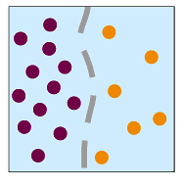
Diffusion
Particles move from high to low areas of concentration. This occurs when there is a concentration gradient (one area is more concentrated).

Slide 12
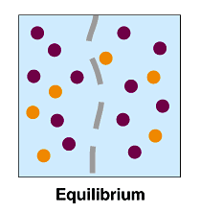
Diffusion
Continues until equilibrium is reached.

Slide 13
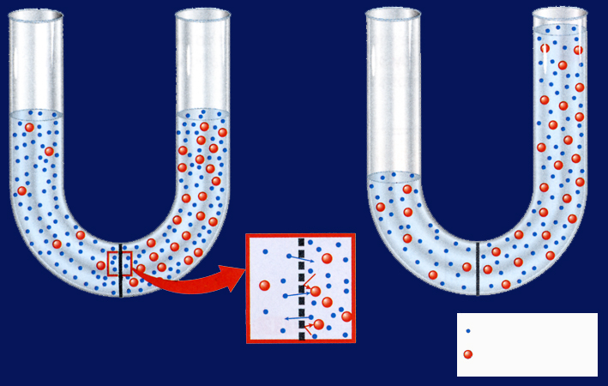
Osmosis
Osmosis is diffusion of water across a membrane; it occurs when there is a more concentrated area on one side of a membrane.

Slide 14
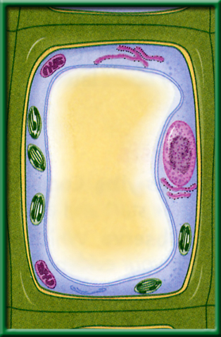
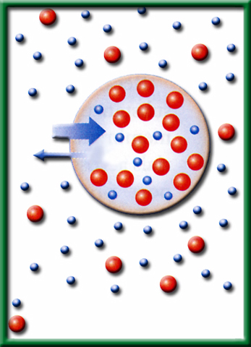
Osmotic Solutions
Hypotonic solutions are LOW strength.
Water moves INTO the cell.
Animal cells may burst (cytolysis) plant cells become swollen (turgid).

Slide 15
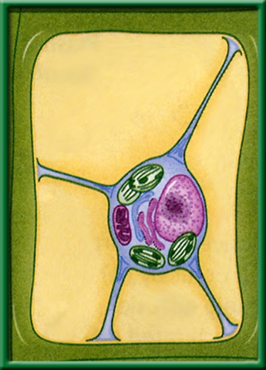
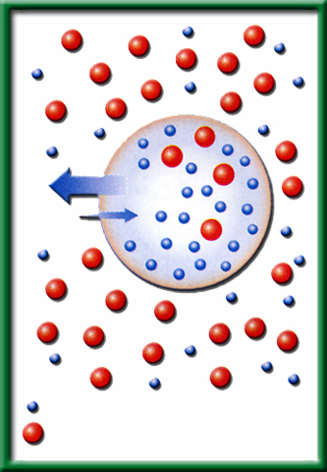
Osmotic Solutions
Hypertonic solutions are HIGH strength solutions.
Water moves out of the cell.
Animal cells shrivel and plant cells become flaccid(plasmolysed).

Slide 16
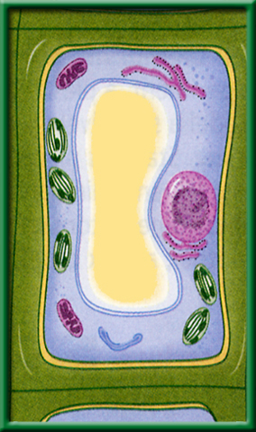
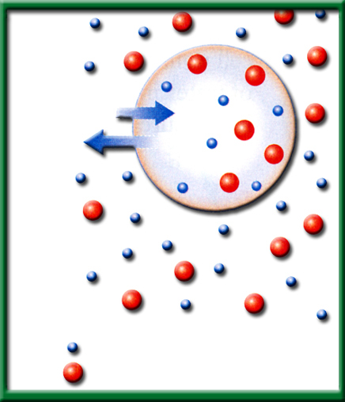
Osmotic Solutions
Equal concentration on both sides of the cell.
NO net movement of water.
Animal and plant cells maintain their normal shape.

Slide 17
Cell Transport : Active
Movement from LOW to HI
Requires ENERGY
3 Types:

Slide 18
Active Transport
Pumps→ proteins use energy to push molecules across the cell
Endocytosis→ large particles are engulfed by cell membrane and become vacuoles
Exocytosis: large particles leave the cell

Slide 19
Endo and Exocytosis

Slide 20
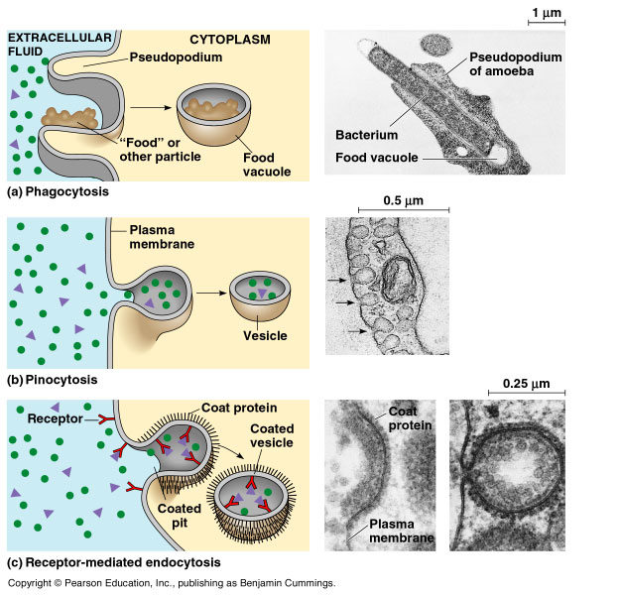
Endo- and Exocytosis
Endocytosis: process of taking material into the cell through pockets in the membrane
Exocytosis: when large amounts of material are released from the cell

