Slide 1
Classifying Life’s Diversity
Classification and naming techniques

Slide 2
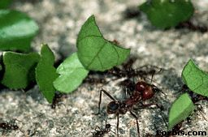
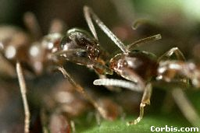
Field of Study
Classification is the grouping of objects or information based on similarities
Taxonomy: study of the classification of organisms
←
Leaf Cutter Ants
vs.
Argentine Ants
→

Slide 3
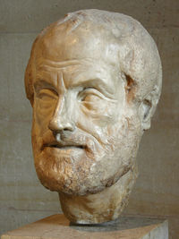
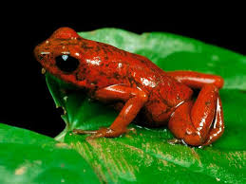
History
Aristotle (384-322 B.C.) came up with the first system with 2 groups- plants and animals.
It obviously ignored anything microscopic.
It grouped all organisms into plants and animals
It grouped animals into two categories: those with blood and those without. He also grouped them into three categories according to how they moved.

Slide 4
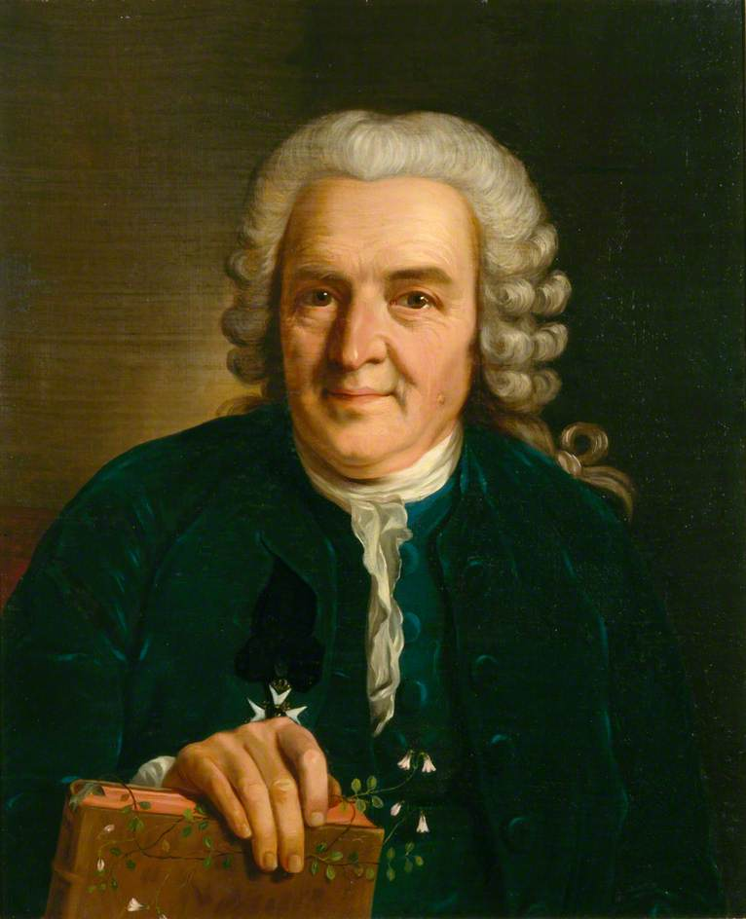
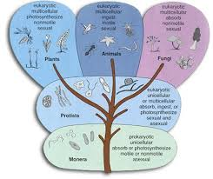
History
Carolus Linnaeus(1707-1778) revised Aristotle’s classification system to include new discoveries about the relationship between organisms
Developed a system to name organisms
Looked more closely at evolutionary relationships

Slide 5
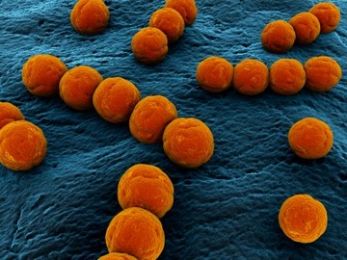
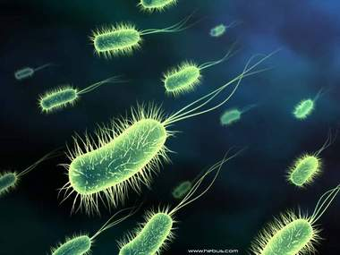
Linnaeus’ 5 Kingdoms
Monera
Unicellular (single celled)
Prokaryotes (no nucleus)
Example: bacteria

Slide 6
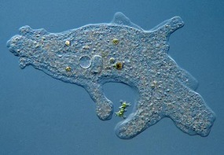
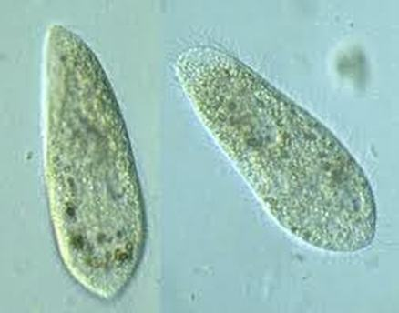
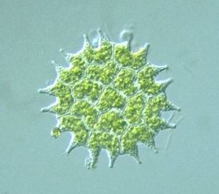
Linnaeus’ 5 Kingdoms
Protista
Unicellular
Eukaryotic (with a nucleus)

Slide 7
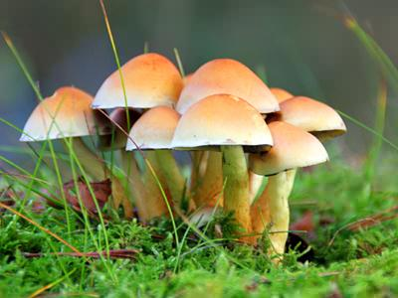
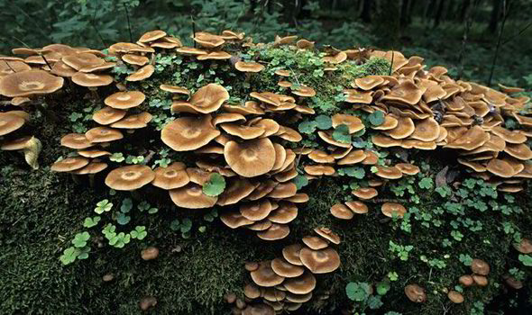
Linnaeus’ 5 Kingdoms
Fungi
Multicellular
Heterotrophic (consumers)
Contain a cell wall

Slide 8
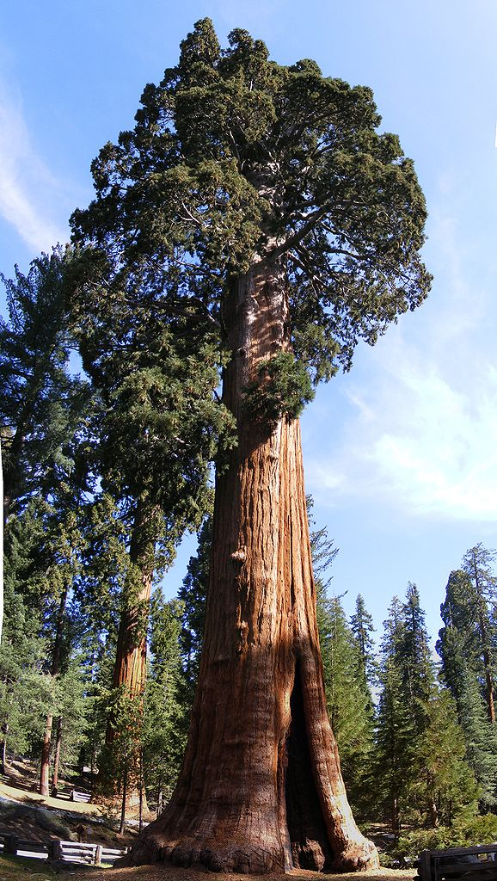
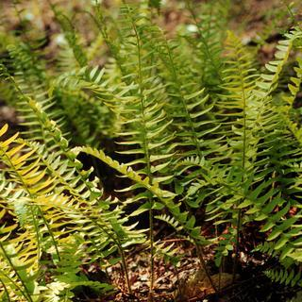
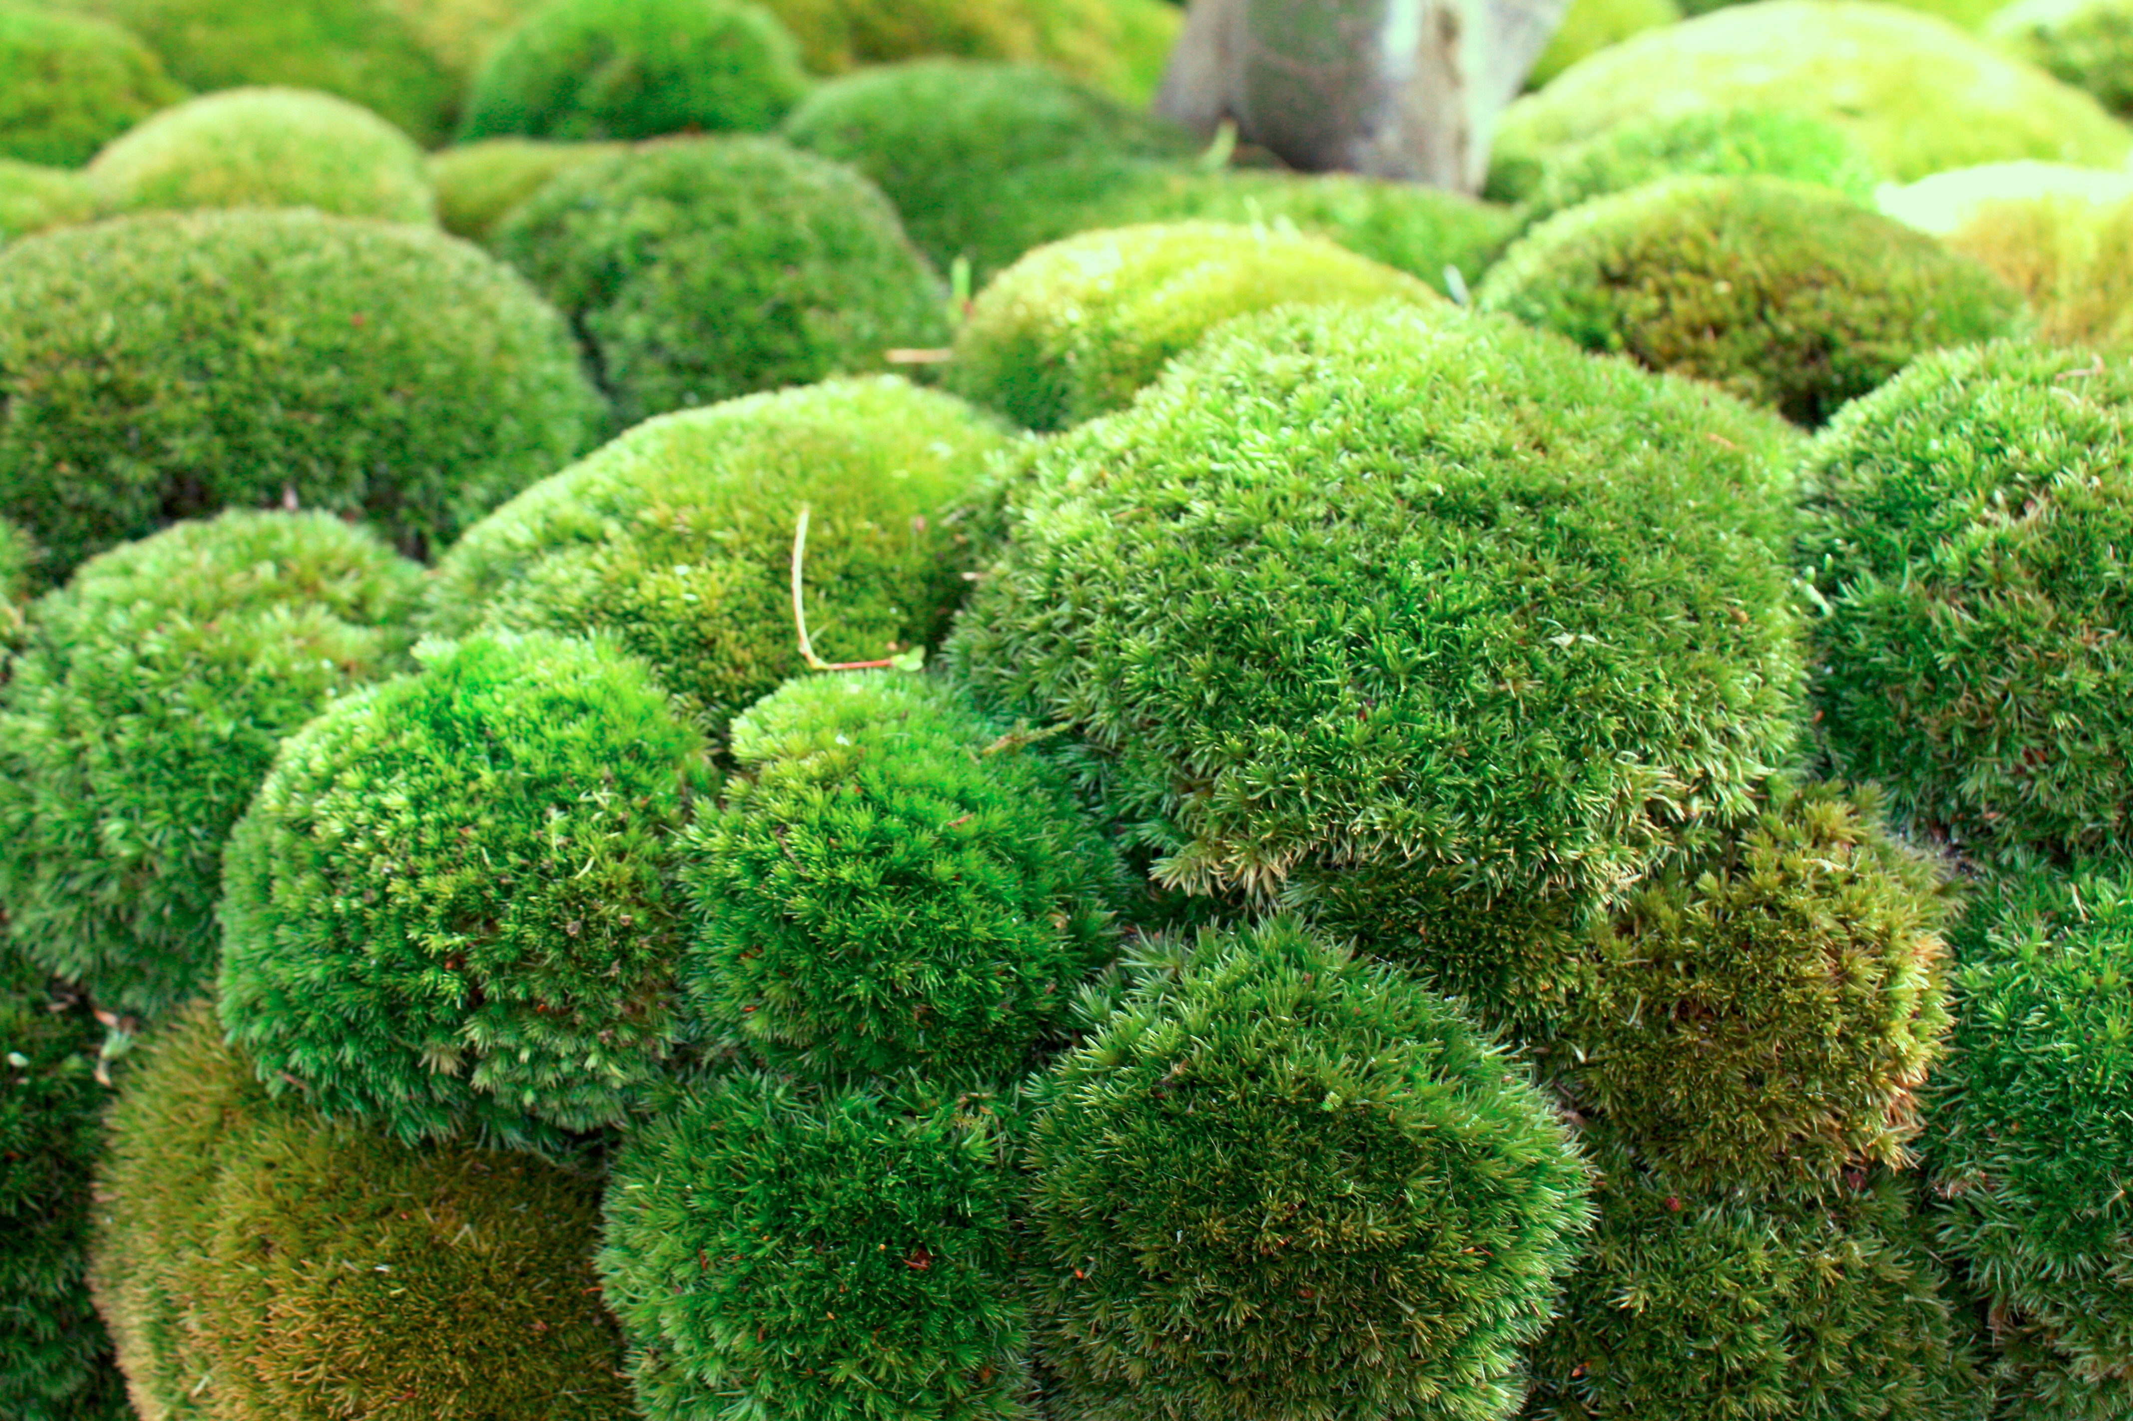
Linnaeus’ 5 Kingdoms
Plantae
Multicellular
Autotrophic
Containing a cell wall

Slide 9
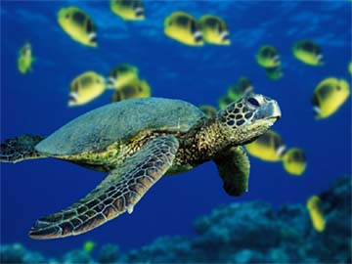
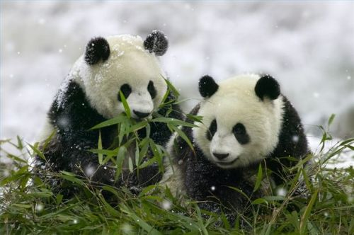
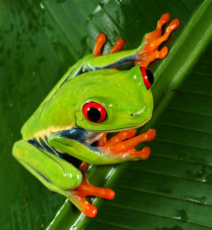
Linnaeus’ 5 Kingdoms
Animalia
Multicellular
Heterotrophic
No cell wall

Slide 10
Scientific Naming
Common name: used in everyday speaking
Example: Cat
Scientific name:
universally accepted by
all scientists
Example: Felis domesticus

Slide 11
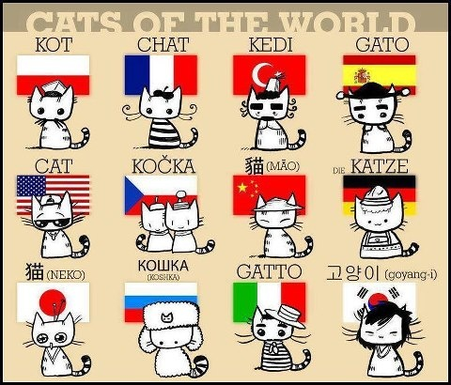
Scientific Naming
Scientific names were developed to reduce confusion over common names that varied between regions or across languages
Latin, as a dead language
used throughout science,
was chosen as a universal
common ground

Slide 12
Scientific Naming
Linnaeus developed rules for naming organisms using binomial nomenclature (meaning 2 names)
The name must be in Latin
The first name must always be capitalized
The second name must always be lowercase
The whole name must be underlined if written (or italicized if typed)

Slide 13
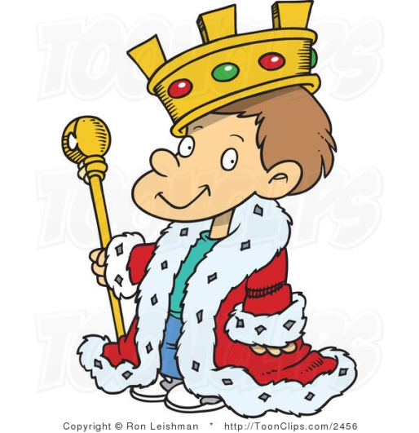
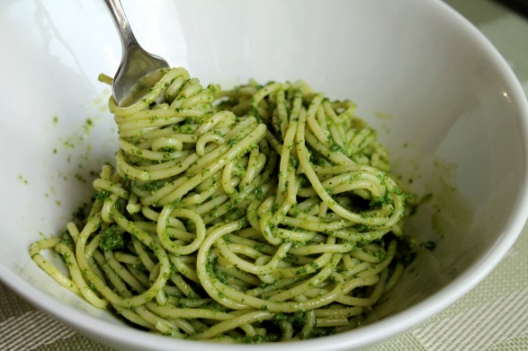
Classification Categories
In addition to his naming system, Linnaeus also created levels of organization to categorize organisms according to their relationships.
Kingdom
Phylum
Class
Order
Family
Genus
Species
Categories began at very broad relationships (kingdom) and then became very specific (species).
Need help remembering them?
“King Phillip Came Over For Green Spaghetti”

Slide 14
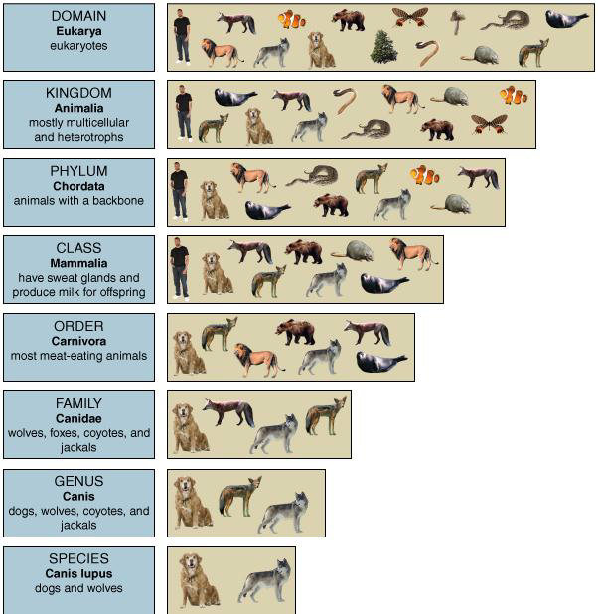
Classification Categories
As new information is presented and new organisms are discovered scientists may have to adjust their definition or arrangement of groups.
Example: Canis lupus domesticus (domesticated dog) represents a subspecies of Canis lupus.

Slide 15
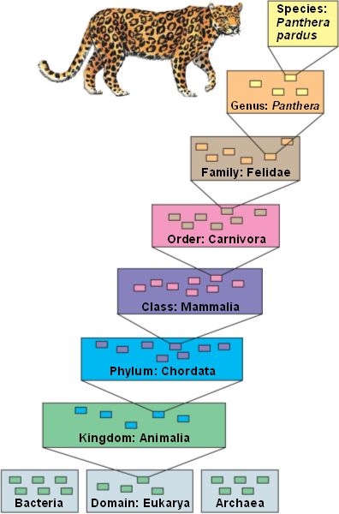
Classification Categories
Linnaeus used the two most
specific categories to assign names
using binomial nomenclature.
What 2 groups are used
in binomial nomenclature?
Genus and species

Slide 16
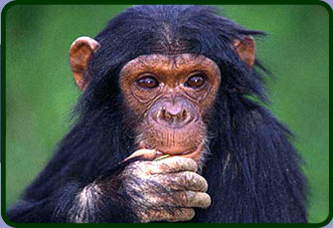
 | Human | Chimpanzee | Domestic Cat
Kingdom | Animalia | Animalia | Animalia
Phylum | Chordata | Chordata | Chordata
Class | Mammalia | Mammalia | Mammalia
Order | Primates | Primates | Carnivora
Family | Hominidae | Pongidae | Felidae
Genus | Homo | Pan | Felis
Species | Sapiens | Troglodytes | Familiaris

Slide 17
How do we classify?
Scientists observe:
Evolutionary history (phylogeny)
Developmental stages (embryology)
Similar chemistry (DNA, amino acids)
Behavioral patterns (courtship rituals)

Slide 18
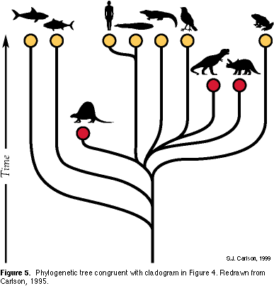
How do we classify?
Phylogenetic Classification
Organisms that share a common ancestor would also share an evolutionary history. The more recent the ancestor the more closely linked the two species are.

Slide 19
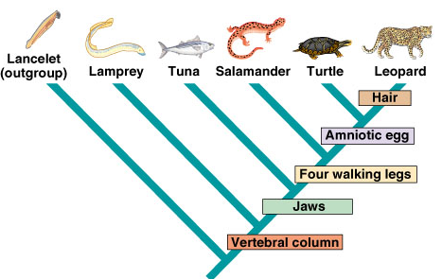
Cladistics
shows how many organisms diverged from a common ancestor
uses the idea of
derived traits to make a
branching diagram called
a cladogram

Slide 20
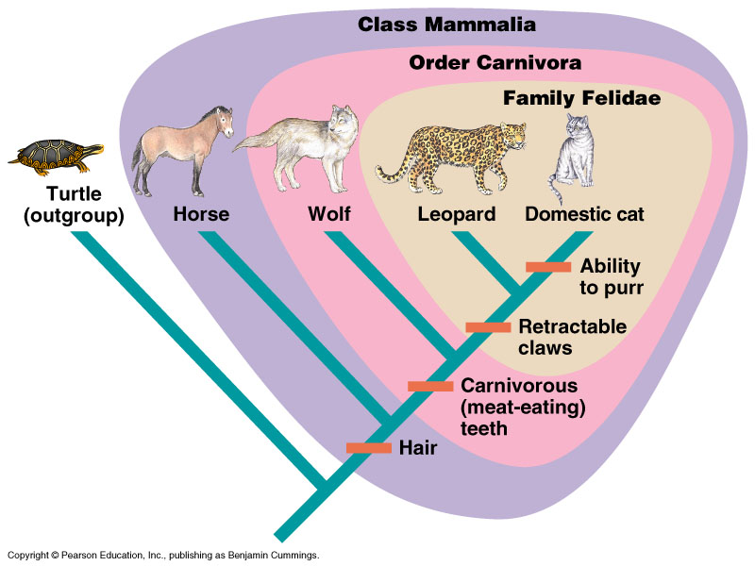
Cladistics

Slide 21
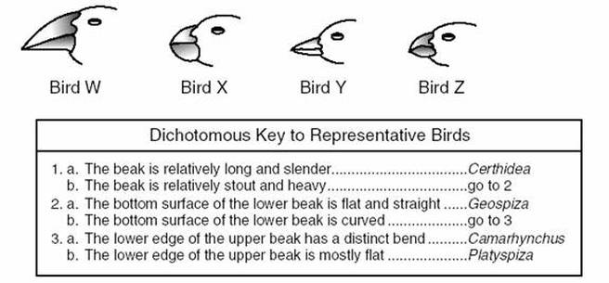
Organism Identification
If scientists encounter an unknown organism, a method of identifying the organism is done by using a dichotomous key.
The key uses both general and specific physical characteristics to eliminate options.
Each key consists of a series of questions with two options or pathways for each characteristic.
The pathway ends when you have reached a scientific name that identifies the organism you are studying.

Slide 22
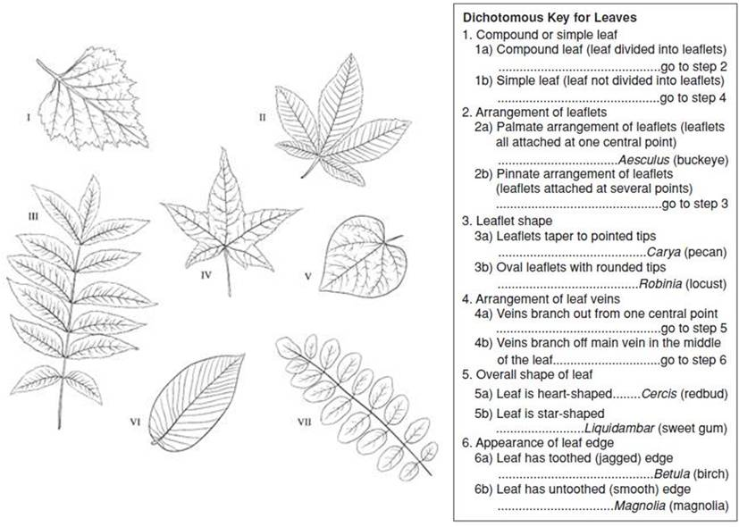
Organism Identification

