Slide 1
Community Interactions & Population Dynamics

Slide 2
Community Interactions
Symbiosis: a relationship where two organisms live closely together
Can take on many different forms including competition, predation, or other interactions that benefit or harm other species involved

Slide 3
Types of Symbiosis
Mutualism: relationship where both species benefit
(ex: flowers and insects)
Commensalism: one member benefits and the other is neither helped nor harmed (ex: barnacles)
Parasitism: one member benefits and the other is harmed (ex: tapeworms)

Slide 4
Population Dynamics
Principles of Population Dynamics study the change in size of a population over time due to environmental factors that increase or decrease population size.
Change in population = (births-deaths) + (immigration-emigration)

Slide 5
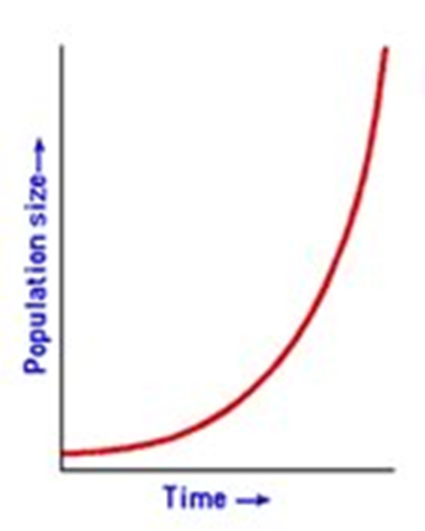
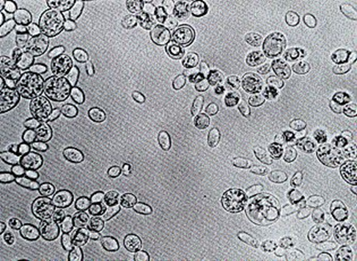
Population Dynamics
Exponential Growth
Reproduction occurs at a constant rate
Growth is unlimited
Forms a J-shaped curve

Slide 6
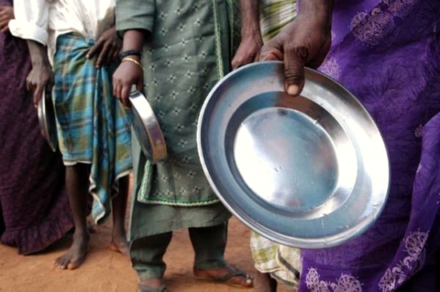
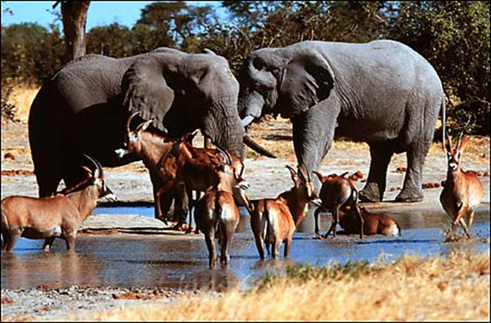
Population Dynamics
Limiting Factors: factors that cause population growth to decrease
Examples:
Amount of nutrients
(food, water, etc.)
Competition
Predation
Disease (Parasitism)

Slide 7
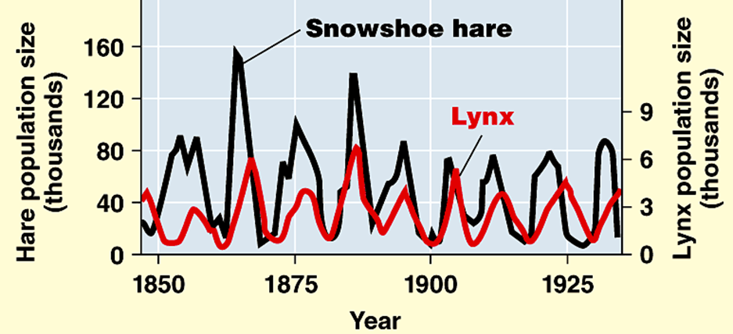
Population Dynamics
Density Dependent Factors: factors that depend on the number of organisms in a population
Examples:
competition, predation,
parasitism, resource availability

Slide 8
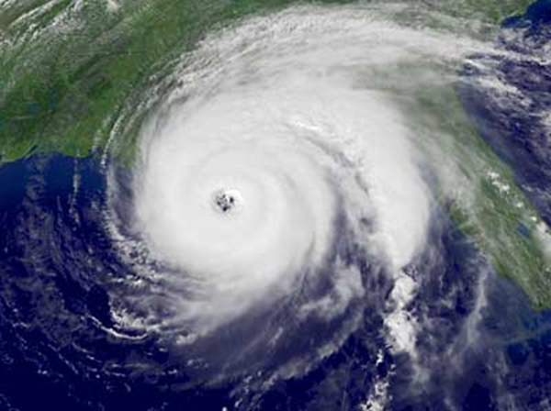
Population Dynamics
Density Independent Factors: factors that affect a population in the same way no matter what size the population is
Examples:
Weather, Natural disasters,
Human activities

Slide 9
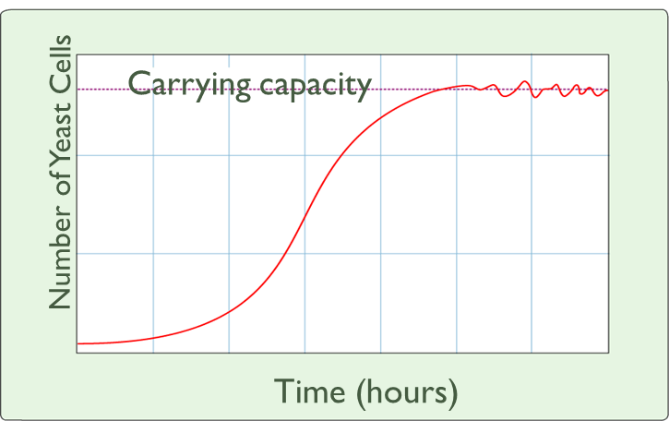
Population Dynamics
Logistic Growth
Growth slows as less resources become available
Carrying capacity: maximum number of organisms the ecosystem can hold
Forms a S-shaped
curve

Slide 10
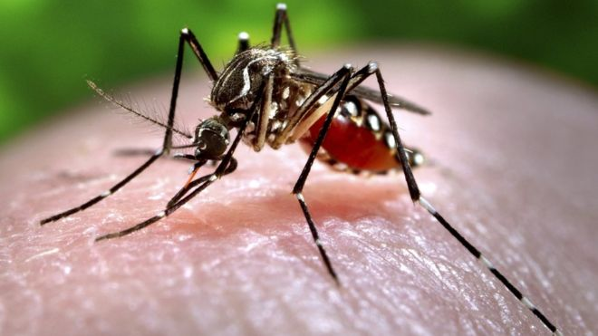
Types of Population Growth
Rapid Life-history
Population size changes quickly and often
Organisms have small body sizes, mature rapidly, reproduce early and have a short life span
Males live less than 10 days, Females can live up to 8 weeks.
Mature females can lay up to 300 eggs every 3 days

Slide 11
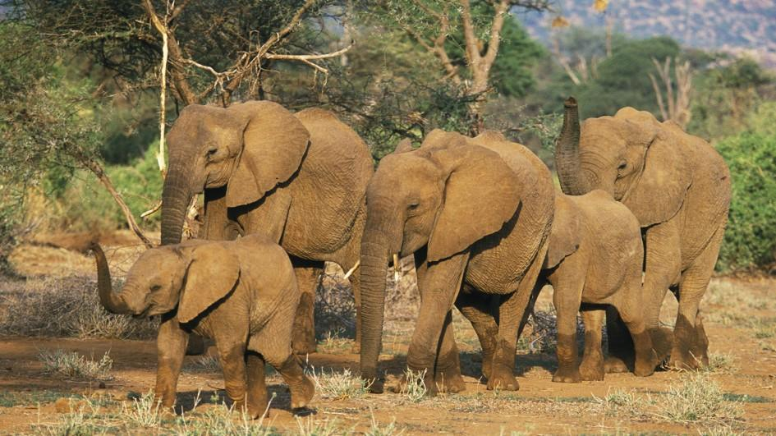
Types of Population Growth
Slow Life-history
Maintain population size near carrying capacity
Organisms have large bodies, mature and reproduce slowly
Can live up to 70 years
Gestation period from 18-22 months

Slide 12
Limits to Population Size
Predation
Predator-prey relationships cause frequent population changes
Healthy predation encourages natural selection in prey populations and maintains appropriate population sizes within the habitat

Slide 13
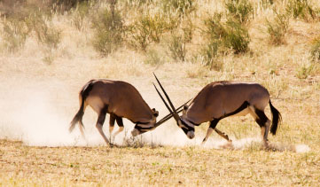
Limits to Population Size
Competition
Increases with population size
Encourages natural selection
Prevents negative consequences of large populations such as crowding and stress

Slide 14
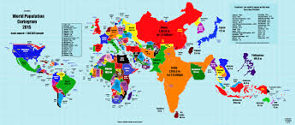
Human Population
Demography is the study of population growth characteristics
Considers factors like: geographic distribution, population density and growth rates

Slide 15
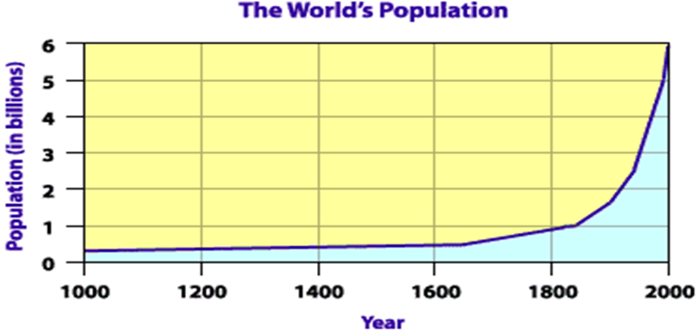
Human Population
The human population remained relatively stable until approximately 500 years ago
Advances in medicine, agriculture and technology have increased humans rate of survival
Today the human population is above 6 billion and still growing exponentially

Slide 16
Population Statistics
The four factors that can change population size are births, deaths, immigration and emigration
Birth rate: number of organisms born into a population over a given period of time (usually a year)
Death rate: number of organisms in a population that died over a given period of time (usually a year)

Slide 17
Population Statistics
Growth rate: the change in a population over a given period of time taking into account births, deaths, and migration numbers
Growth rate = 0 (population size remains the same)
Growth rate = + (population size increased)
Growth rate = -- (population size decreased)
As a population reaches carrying capacity, growth rate becomes closer to 0

Slide 18
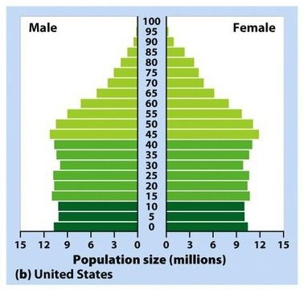
Population Statistics
Sometimes demographers are interested in sub groups of a population such as gender and age. Information about these sub groups may be represented in a graph called an age structure diagram.

Slide 19
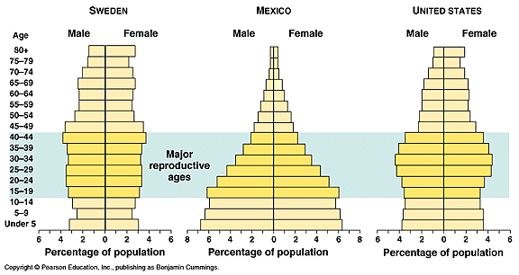
Population Statistics
Information about gender and age can help scientists predict future growth of the population.
Demographers may focus on females within their reproductive age range to determine the fertility of the population which predicts the average number of children born to women in their child-bearing years.

Slide 20
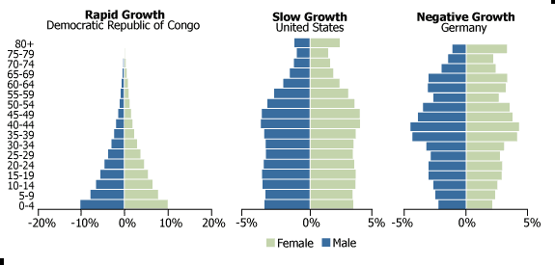
Population Statistics

Slide 21
Population Statistics
While age structure diagrams can predict population growth based on fertility and life expectancy, it does not take into account mobility influenced by migration patterns.
Migration: is the movement of individuals into or out of a population.

