Slide 1
DNA & Protein Synthesis

Slide 2
What is DNA?
DNA is a type of organic compound called a nucleic acid
There are only two types of nucleic acids discovered so far: DNA and RNA
DNA stands for DeoxyriboNucleic Acid

Slide 3
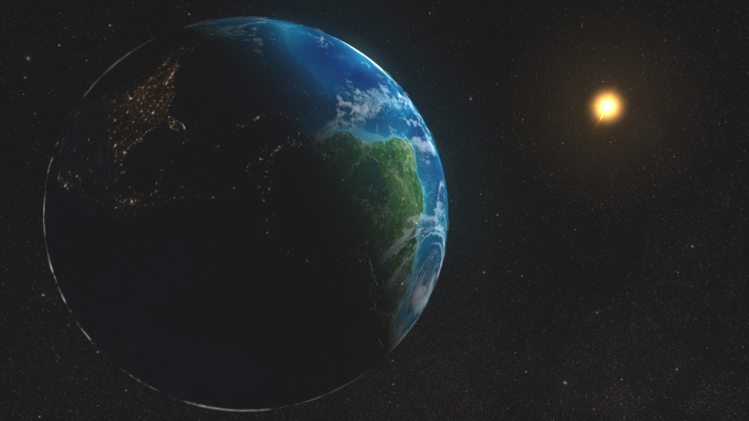
Interesting DNA Facts
DNA is really long!
The total length of DNA present in one adult human → is the equivalent distance from the earth to the sun and back.
This equals approximately
299,195,741,400 meters (185,911,614 miles)

Slide 4
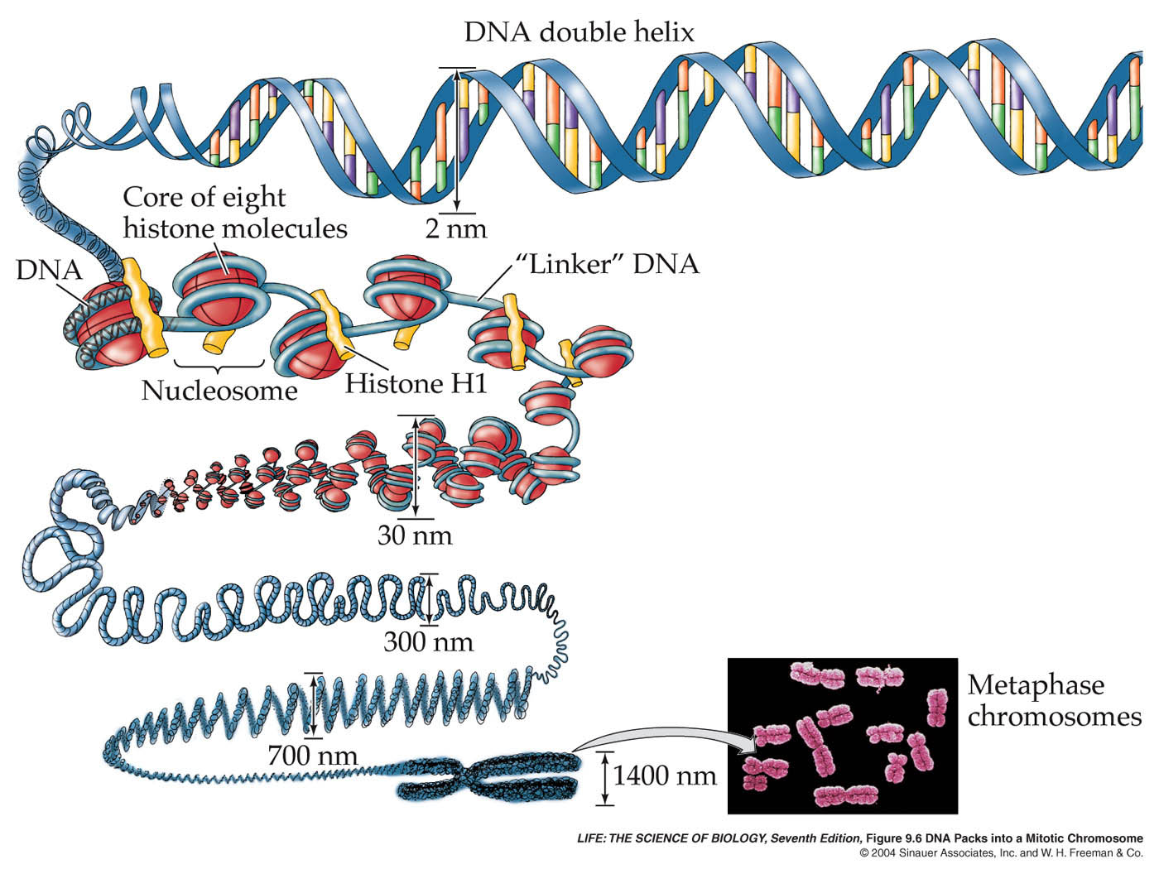
Interesting DNA Facts
How does it fit in our bodies?
By packing itself very tightly using coils of DNA to form chromatin and chromosomes.

Slide 5
DNA Components
DNA is made of long chains of nucleotides
each nucleotide has 3 parts:
1. deoxyribose sugar
2. phosphate group
3. nitrogenous base

Slide 6
DNA Components
there are 4 possible nitrogen bases:
the purines: Adenine
and Guanine
the pyrimidines: Cytosine and Thymine

Slide 7
DNA Structure
the nucleotides combine by dehydration to form 2 long chains held together by covalent bonds

Slide 8
DNA Structure
the 2 chains are joined together by hydrogen bonds between the bases

Slide 9
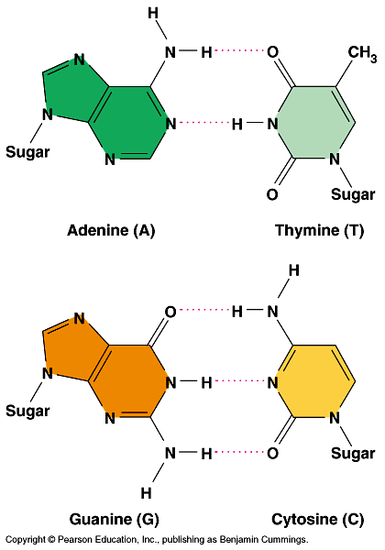
DNA Structure
the 2 bases that are bonded are called a base pair
Base Pairing Rules:
A pairs with T
and
G pairs with C

Slide 10
DNA Structure
Chargaff’s rule states that the DNA of any organism must contain equal amounts of
A & T and C & G
Ex: If a strand of DNA is 15% G, how much of the DNA is made of A, C, and T?
15% G = 15% C → total 30%
70% left → A & T = 35% each

Slide 11
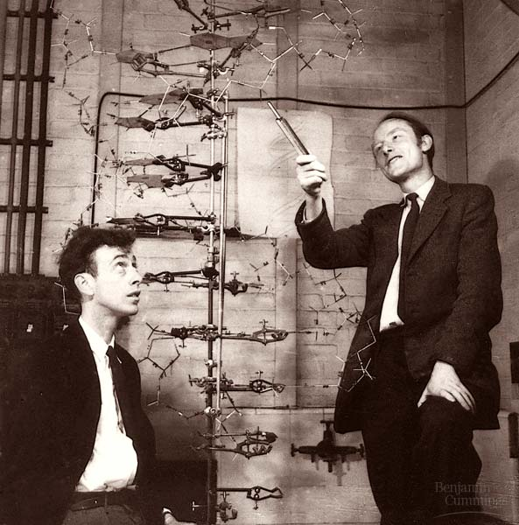
DNA Structure
Watson & Crick determined the shape of the DNA molecule was a twisted ladder, or a double helix

Slide 12
R. Franklin
Rosalind Franklin (1950’s): studied DNA using a technique called x-ray diffraction.
Her work was key to Watson & Cricks work

Slide 13
DNA Structure
The sides of the ladder are made of sugars and phosphates, and are held together by covalent bonds
The rungs of the ladder are made of nitrogen base pairs, and contain hydrogen bonds

Slide 14
DNA Replication

Slide 15
DNA Replication
The copying of a DNA strand is called replication
When does copying of DNA occur?
Before cell division
(S phase of interphase)

Slide 16
DNA Replication
There are multiple enzymes responsible for replication:
Helicase – breaks the hydrogen bonds between the 2 nucleotide strands
→ this uncoils & unzips the DNA
→ each strand is now a template

Slide 17
DNA Replication

Slide 18
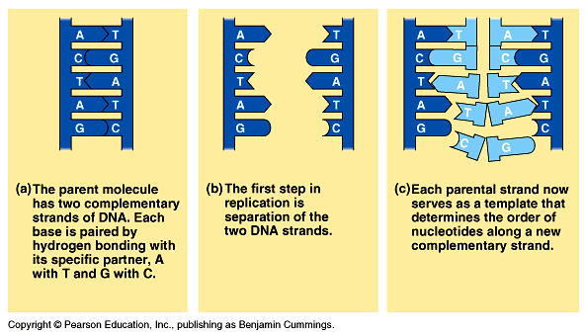
DNA Replication
DNA Polymerase helps free nucleotide bases pair to the original strands

Slide 19
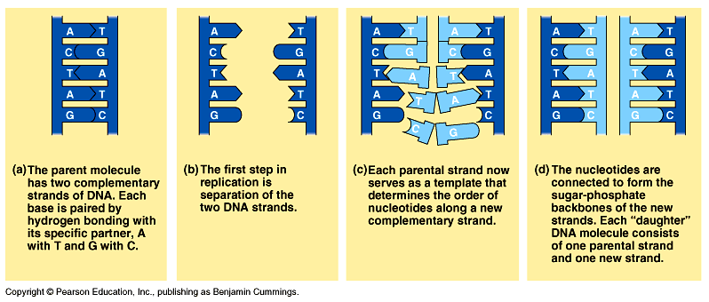
DNA Replication
DNA Ligase “glues” the new nucleotide strands together

Slide 20
DNA Replication
Example problem: Write the complementary strand produced by replication of the following DNA strand.
AATGCTAGCCGT
TTACGATCGGCA

Slide 21
DNA Replication
Each new DNA molecule is made of one old side and one new side
→ this is called semiconservative replication
→ the 2 new DNA molecules are identical

Slide 22
Comparing DNA & RNA
DNA
2 strands
Deoxyribose sugar
N bases: A, G, C, T

Slide 23
Comparing DNA & RNA
RNA (ribonucleic acid)
1 strand
Ribose sugar
N bases: A, G, C, U
(Uracil)

Slide 24
Transcription

Slide 25
Transcription
Transcription is the process of making an RNA copy of a portion of DNA
Why does the cell need to transcribe the DNA?
the DNA cannot leave the nucleus

Slide 26
Transcription
The steps for transcription are similar to replication:
RNA polymerase uncoils & unzips a portion of DNA
RNA nucleotides pair with one of the DNA strands

Slide 27
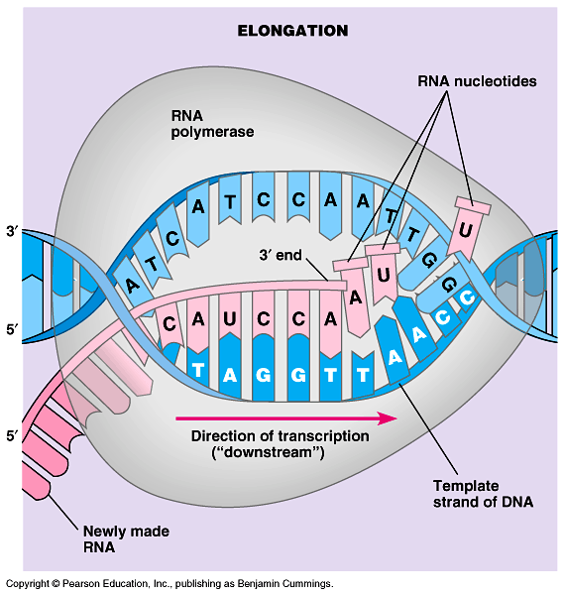
Transcription
A single strand of messenger RNA is produced

Slide 28
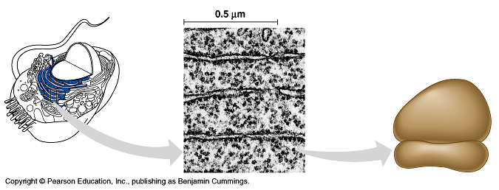
Transcription
The mRNA carries the copied information to the ribosome out in the cytoplasm
Ribosomes are made up of proteins and ribosomal RNA or rRNA

Slide 29
Transcription
Example problem: Write the mRNA strand produced by the transcription of the following DNA strand.
AATGCTAGCCGT
UUACGAUCGGCA

Slide 30
Genetic Code
The genetic code is the sequence of nitrogen bases along one strand of DNA
The sequence determines how proteins are made
Proteins are long chains of amino acids

Slide 31
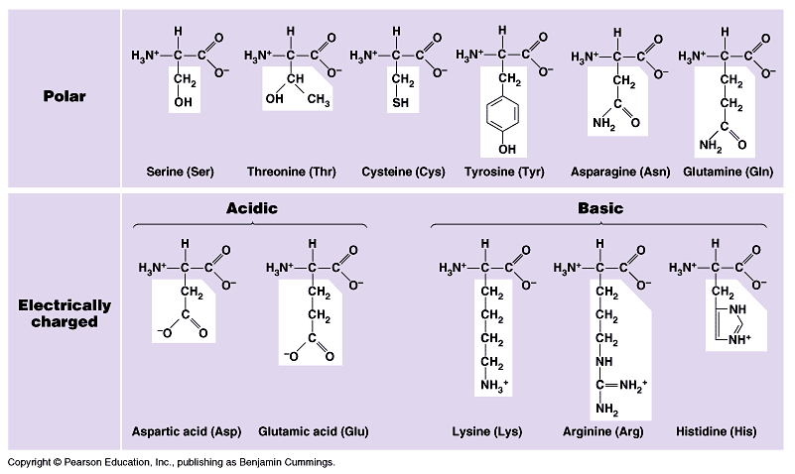
Genetic Code
There are 20 different amino acids

Slide 32
Genetic Code
A sequence of 3 bases provides the code for an amino acid and is called a codon
64 codons are in the genetic code:
61 are amino acids
3 are stop codons

Slide 34
Genetic Code
There can be more than one codon for an amino acid
The genetic code is universal because the codons represent the same amino acids in ALL organisms

Slide 35
Protein Synthesis

Slide 36
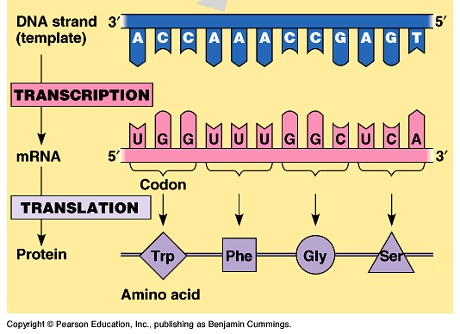
Protein Synthesis
Two Stages of Protein Synthesis:
Transcription (DNA → RNA)
Translation (RNA → amino acids)

Slide 37
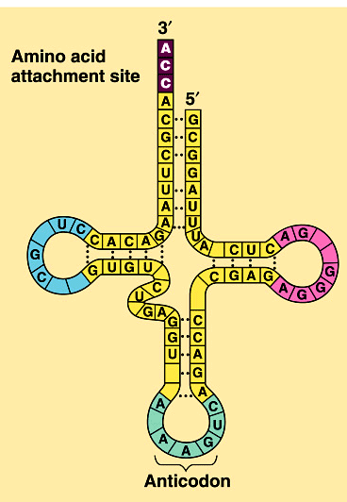
Translation
Translation is the process that converts mRNA into a sequence of amino acids
Transfer RNA (tRNA) brings amino acids from the cytoplasm to the ribosome

Slide 38
Translation
Steps to Translation:
The start codon of the mRNA attaches to the ribosome
A tRNA molecule brings a specific amino acid
The tRNA anticodon pairs with the mRNA codon

Slide 39
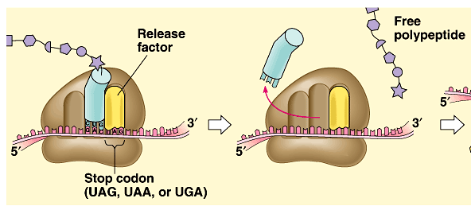
Translation
The mRNA slides along the ribosome, forming a polypeptide chain
Translation ends with a stop codon on the mRNA

Slide 40
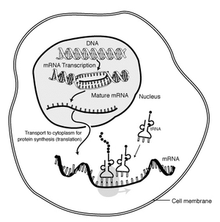
The Big Picture

Slide 41
Mutations

Slide 42
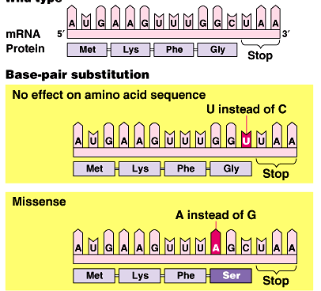
Gene Mutations
Mutations are permanent changes in the DNA sequence
A point mutation is a change in a single base pair
→This may
or may not affect
the protein

Slide 43
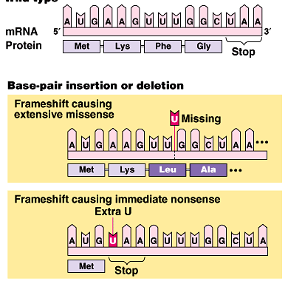
Gene Mutations
A frameshift mutation occurs when a single base is added or deleted from DNA
→Every codon
after the mutation
is different

Slide 44
Gene Mutations
What’s the difference to your cell? Which is worse?
Point Mutation
GCATTG → GCAATG
MY DOG SKIP → ME DOG SKIP
Frameshift Mutation
GATTACAGC… → GTTACAGCA…
MY DOG SKIP → MD OGS KIP

Slide 45
Causes of Mutations
Mutagens are any agents that cause a change in the DNA sequence.
If a single body cell is mutated, this can result in cancer
If a reproductive cell is mutated, this can result in a “mutated” offspring (having a new physical trait)

Slide 46
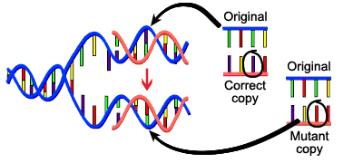
Causes of Mutations
Spontaneous mutations: mistakes that occur during replication
Notes:
Seriously though, some other examples would be blue eyes, genetic disorders like sickle-cell.

Slide 47
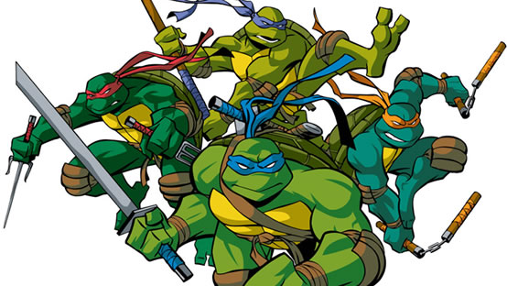
Causes of Mutations
Environmental Agents: exposure to radiation (X-rays, gamma rays, UV rays) or certain chemicals
Notes:
Often these types of mutations if in body cells cause cancer, and if in sex cells can cause birth defects.

