Slide 1
Theories on the origins of Life
History and development of life on Earth

Slide 2
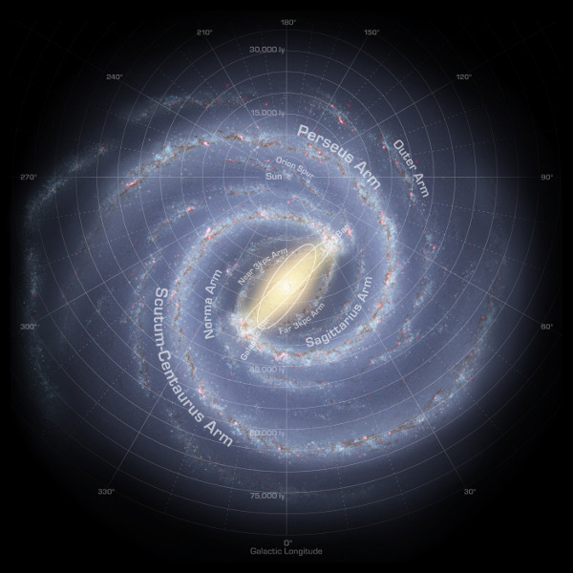
Development of the Earth
The formation of the Milky Way galaxy that we inhabit occurred approximately 12 billion years ago.
At approximately 4.5 billion years ago our solar system began to form on the Orion spur of the Milky Way Galaxy
You are here

Slide 3
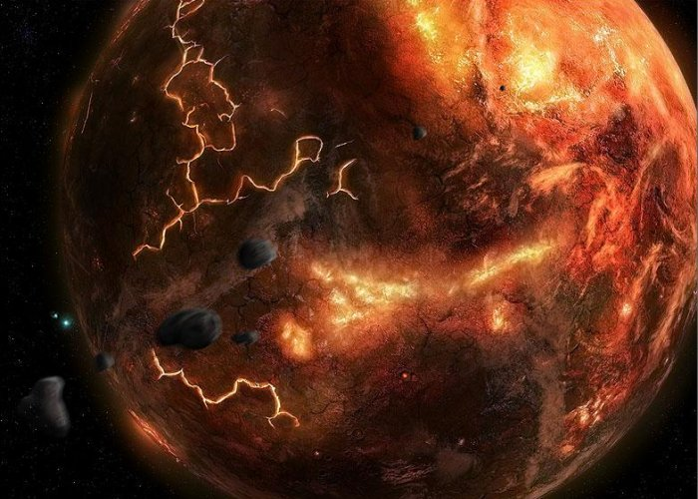
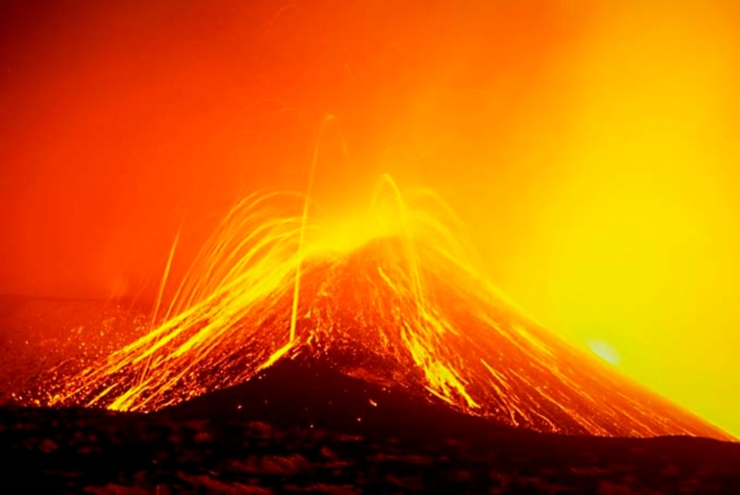
Development of the Earth
When the Earth first formed it was made of debris from the development of the star (the Sun) at the center of solar system
The early Earth had a molten surface and an atmosphere made of Hydrogen, Cyanide, Carbon Dioxide, Carbon Monoxide and Nitrogen (No Oxygen!)

Slide 4
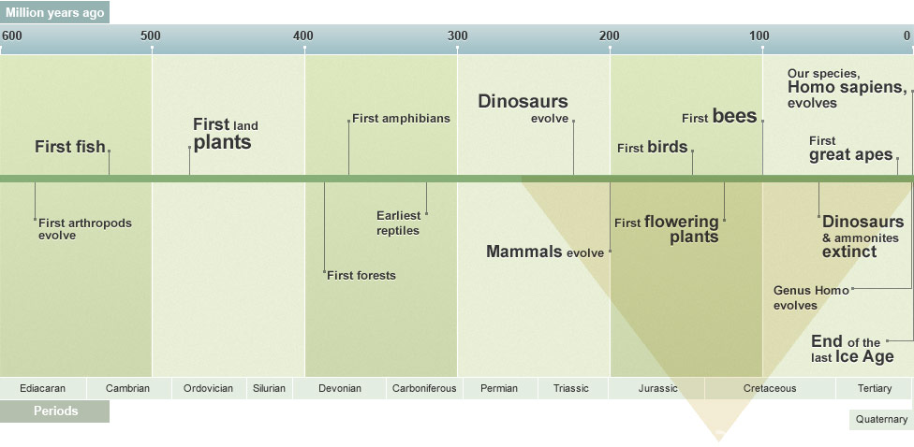
Development of the earth
The big question in evolution is: How did life begin on Earth?
Evidence: Fossil records show ancient species of organisms that once lived on Earth
Theories:
Biogenesis: life comes from other life
Abiogenesis: life comes from non-living material

Slide 5
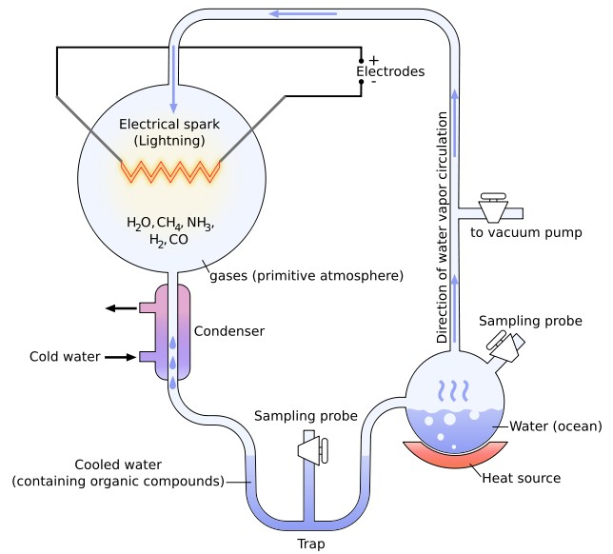
Development of Organic molecules
Origins of Life Experiments
Stanley Miller and Harold Urey
Problem: Simulate the conditions of early Earth to see if those conditions were able to produce organic molecules
Results: Amino acids, Sugars
and Nucleotides
accumulated in
the solution formed

Slide 6
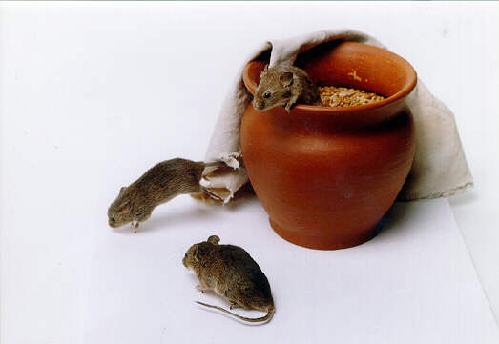
Development of Life
Early theories relied heavily on observations of the macroscopic world (what we can see with the naked eye)
Spontaneous Generation was an early belief that life could be produced from non-living matter (AKA: Abiogenesis)
Example: Dirty rags could produce mice

Slide 7
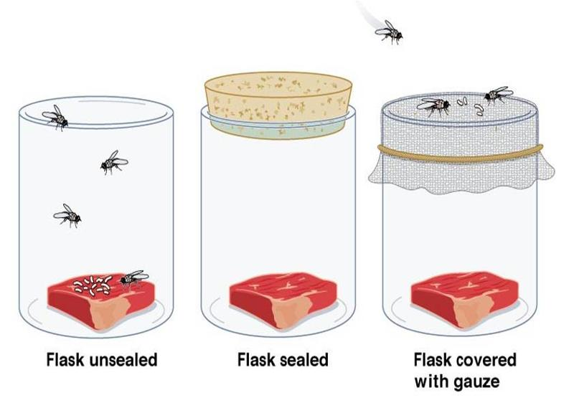
Development of Life
Francesco Redi
Problem: Disprove spontaneous generation (abiogenesis) of flies on rotting meat.
Results: Maggots only
developed on the flask that
was open to the flies. This
meant that the maggots
came from the flies, not
the meat

Slide 8
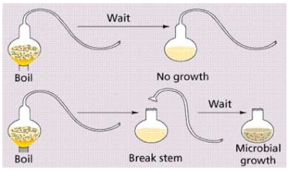
Development of Life
Louis Pasteur
Problem: Disprove the theory of spontaneous generation for microorganisms
Results: Microbial growth only
developed in the broth after it
was exposed to air that could
contain bacteria
Conclusion: Life can only come from other forms of life.

Slide 9
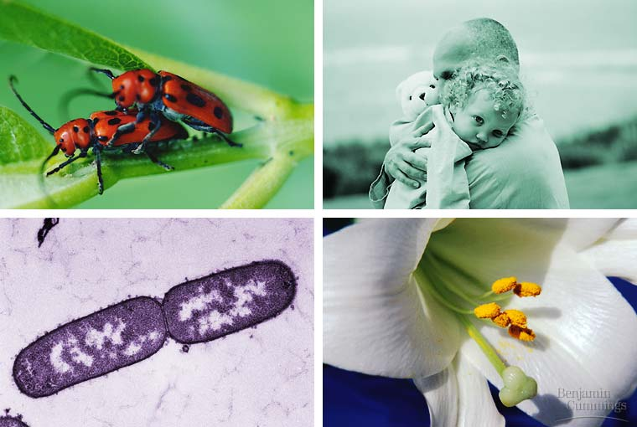
Development of Life
Now thanks to Redi and Pasteur, scientists believe that life can only come from other living organisms. This supports the current theory of biogenesis.

Slide 10
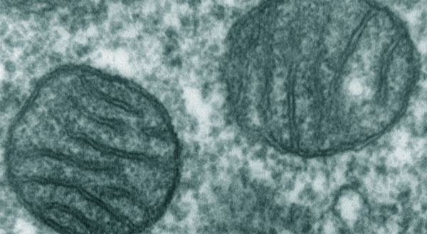
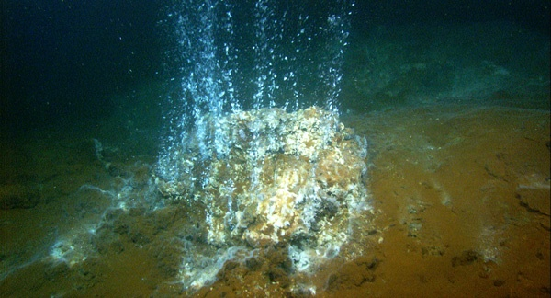
Development of Cells
Theories about the development of life claim that early environments on Earth contained what is considered a “primordial soup” of materials
Contained a “stew” of organic molecules
Contained amino acids that linked together to form proteins (building blocks of cells)
Contained basic nucleotides for the formation of RNA sequences

Slide 11
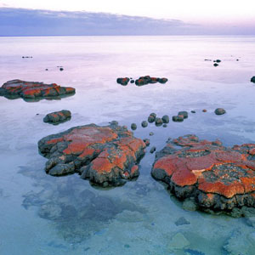
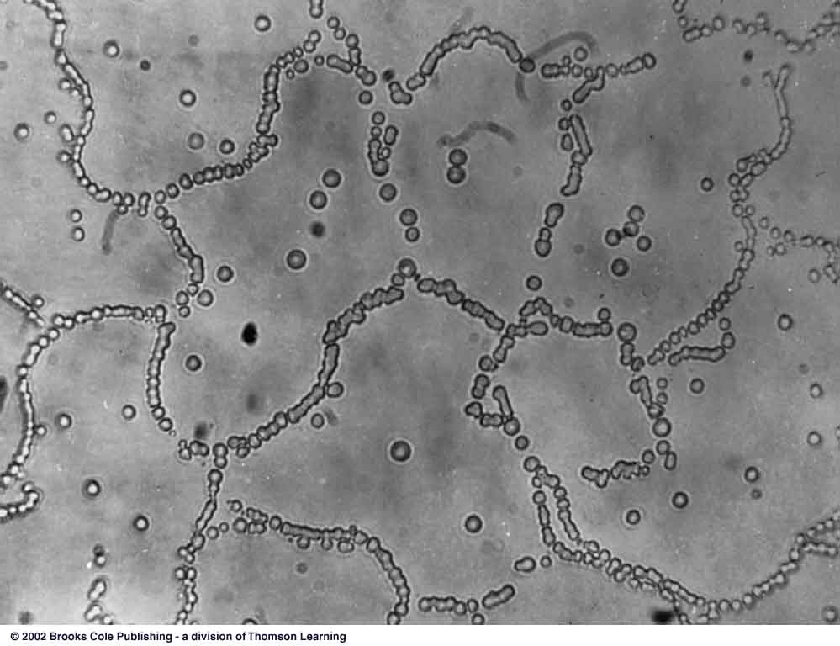
Development of Cells
1. The first evidence of life is from 2.2 billion years ago with heterotrophic, anaerobic bacteria that accumulated in the shallow oceans
2. Photosynthetic bacteria developed and
put oxygen into the
atmosphere

Slide 12
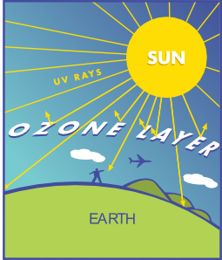
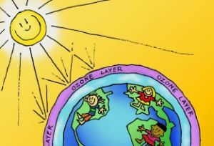
Development of Cells
3. An oxygen rich atmosphere is key to the development of more complex organisms like aerobic bacteria
4. Oxygen was converted to O₃ (ozone) by lightning giving the Earth the ozone layer
The ozone layer protects the Earth from solar radiation and allowed more complex organisms to develop

Slide 13
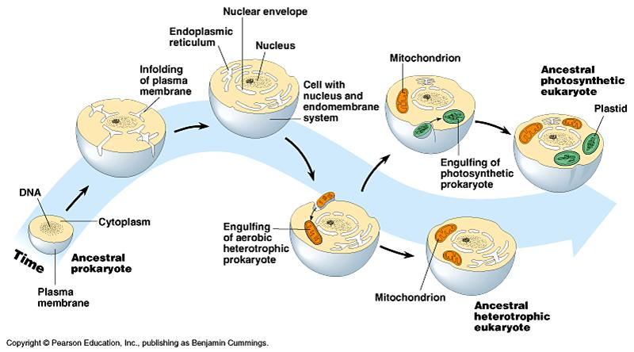
Development of Cells
5. The current theory for how eukaryotic cells developed is based upon the idea that they may have come from bacterial cells living in other bacterial cells ( a cell within a cell)
Endosymbiosis:
eukaryotic cells
developed through
symbiotic relationships
with prokaryotic cells.

Slide 14
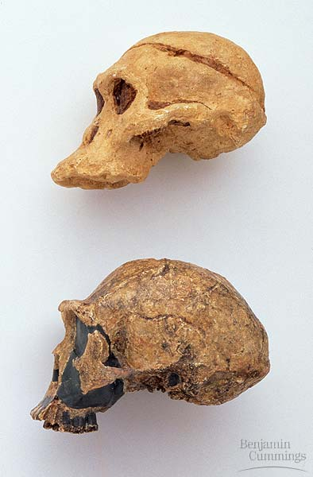
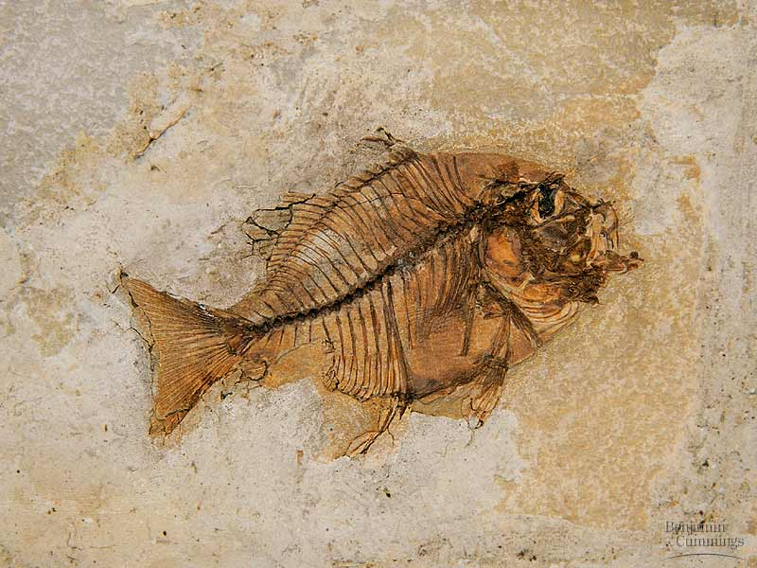
The History of Life
Scientists learn about the different types of organisms that have been on Earth by studying fossils (any evidence of a dead organism)
Fossils are usually found in sedimentary rock

Slide 15
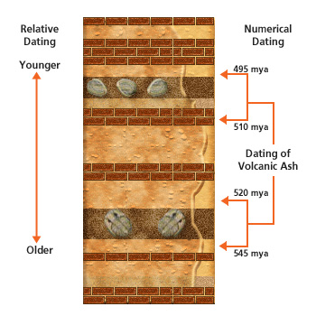
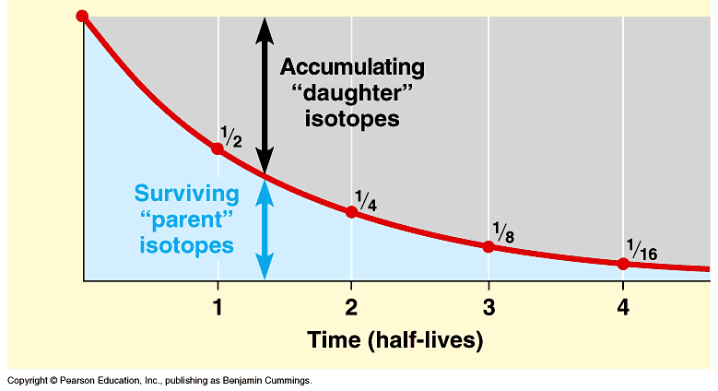
The History of Life
Methods for finding the age of fossils:
Relative dating: estimating the age of a fossil based on the order of rock layers around a fossil (Law of Superposition)
Radiometric dating: finding the specific age of a fossil or rock using radioactive isotopes with specific half-lives to give us absolute dating

Slide 16
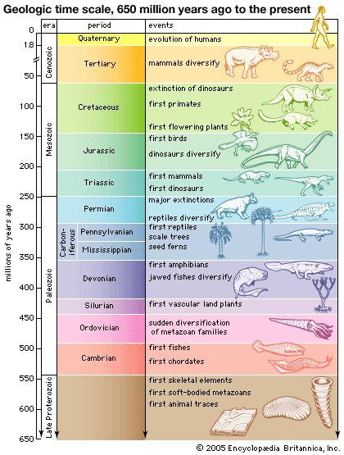
The History of Life
The Geologic Time Scale is
a calendar based on the
appearance of different type of
organisms throughout the
history of the Earth
4. Cenozoic Era
3. Mesozoic Era
2. Paleozoic Era
1. Precambrian Era

Slide 17
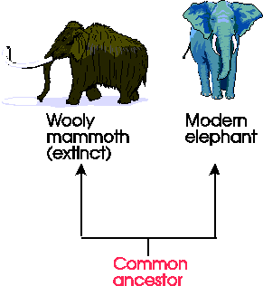
Evidence in the fossil record
1. Common ancestry
Similar organisms living today show a possible common ancestor in their past
2. Biochemistry
All living things are made of cells, and
have genetic information (DNA/RNA)
3. Extinction
99% of all species that have every lived are not alive today

Slide 18
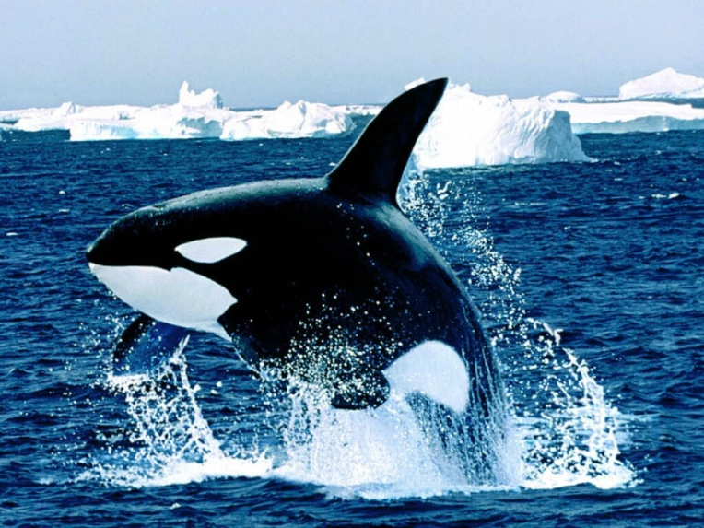
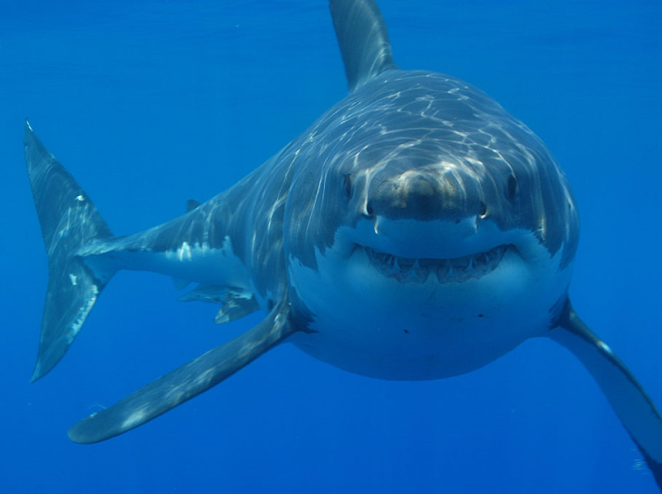
Evidence in the fossil record
4. Convergent evolution
Unrelated organisms adapt to similar environments and form similar features from those adaptations
(Example: sharks and whales are different genetically but have a similar body structure)

Slide 19
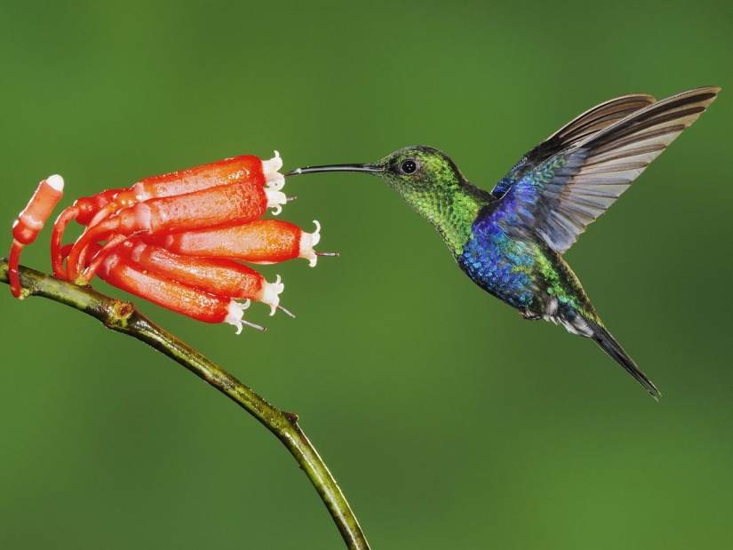
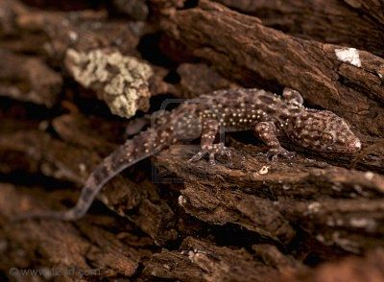
Evidence in the fossil record
5. Co-evolution
When 2 species evolve in response to changes in each other

Slide 20
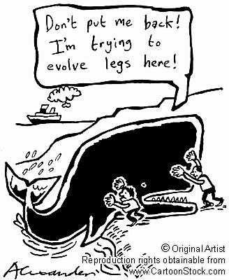
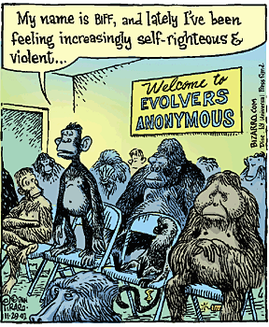
The Theory of Evolution

Slide 21
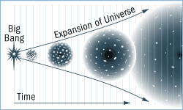
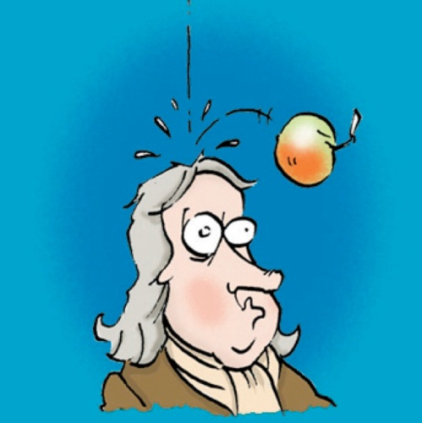
The Theory of Evolution
What is a theory?
A theory is a hypothesis that has been tested again and again, the results of the studies only support the hypothesis- they never refute it.
Scientific Theories
Big Bang
Gravity
Buoyancy
Evolution and Natural Selection

Slide 22
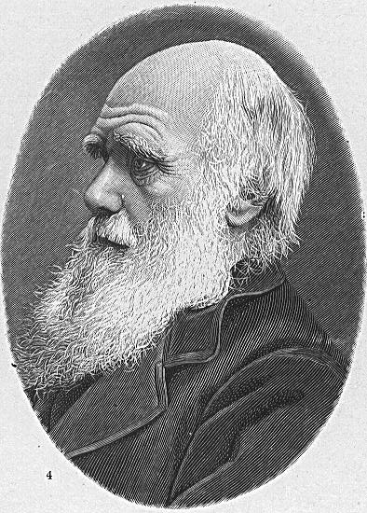
The Theory of Evolution
Evolution: the change in species over time
Charles Darwin (1809-1882)
Research began when he traveled as a naturalist aboard the H.M.S. Beagle
Traveled for 5 years collecting and drawing specimens from all of the areas they visited
One stop was to an
isolated set of islands
called the Galapagos
where he made key
observations to support
his theory

Slide 23
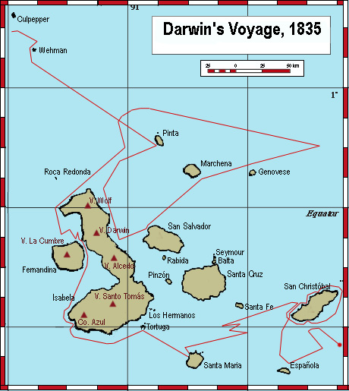
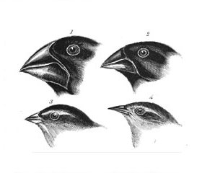
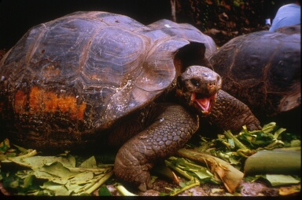
The Theory of Evolution
Darwin’s Observations
Most of the observations used to support the Theory of Evolution came from time spent at the Galapagos Islands
Organisms native to the islands had specific adaptations suited to their environment (Example: beaks of finches to match food source)
Animals living on different islands had once been members of the same species
Organisms better adapted to their environment were more likely survive and pass on their traits

Slide 24
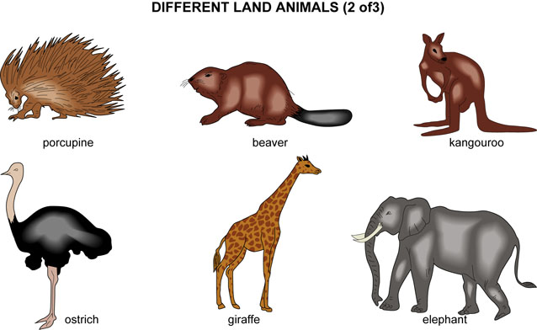
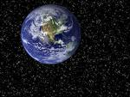
Why was Darwin so controversial?
Many believed that Earth was only a few thousand years old.
Most people believed that neither the planet nor the species that inhabited it had changed since the beginning of time.

Slide 25
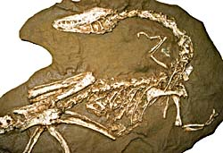
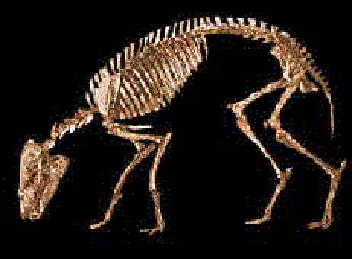
Why was Darwin so controversial?
During Darwin’s time, many fossils were being discovered which challenged the idea that plants and animals had not changed since Earth was formed.
Darwin’s theory further supported the unpopular facts presented in the fossil evidence that species had changed over time

Slide 26
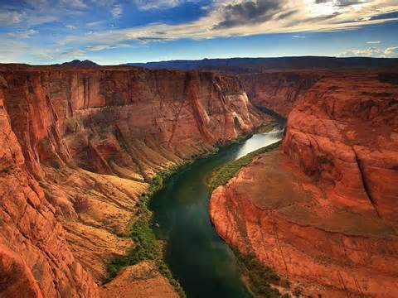
Contributions to Darwin’s Theory
1. Hutton and Lyell introduced the idea of gradualism which states that change can happen slowly over a long period of time. Most of their research focused on change in geological features.

Slide 27
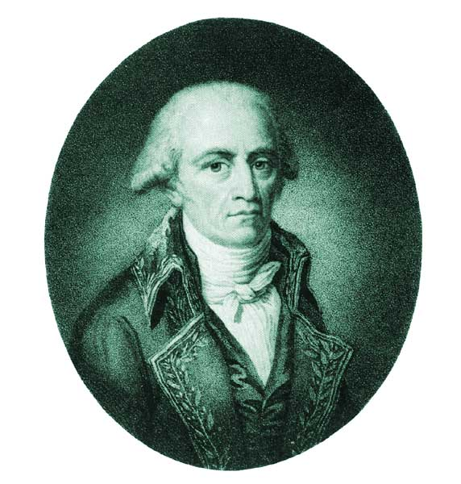
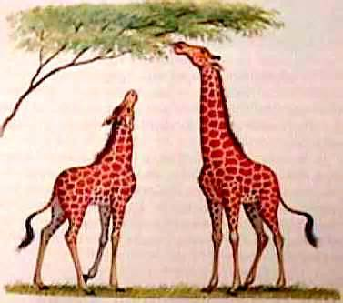
Contributions to Darwin’s Theory
2. Jean Baptiste Lamarck was one of the first to recognize that living things have changed over time. He focused his work on the idea that individual organisms can cause physical changes in a lifetime that are then passed on to their offspring.

Slide 28
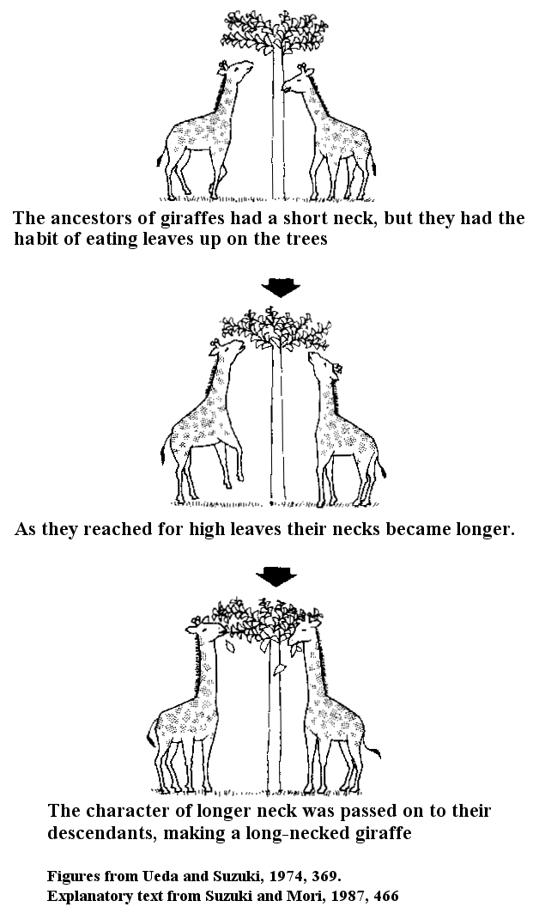
Contributions to darwin’s theory
Lamarck’s Theory of Evolution:
1. All organisms continually change
in order to reach perfection.
2. Organisms can alter their bodies
by use and disuse
3. He claims that these acquired
characteristics can be inherited

Slide 29
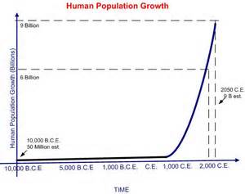
Contributions to darwin’s theory
3. Thomas Malthus concludes that if the human population continues to increase then there will be a point when there are not enough resources to support the population

Slide 30
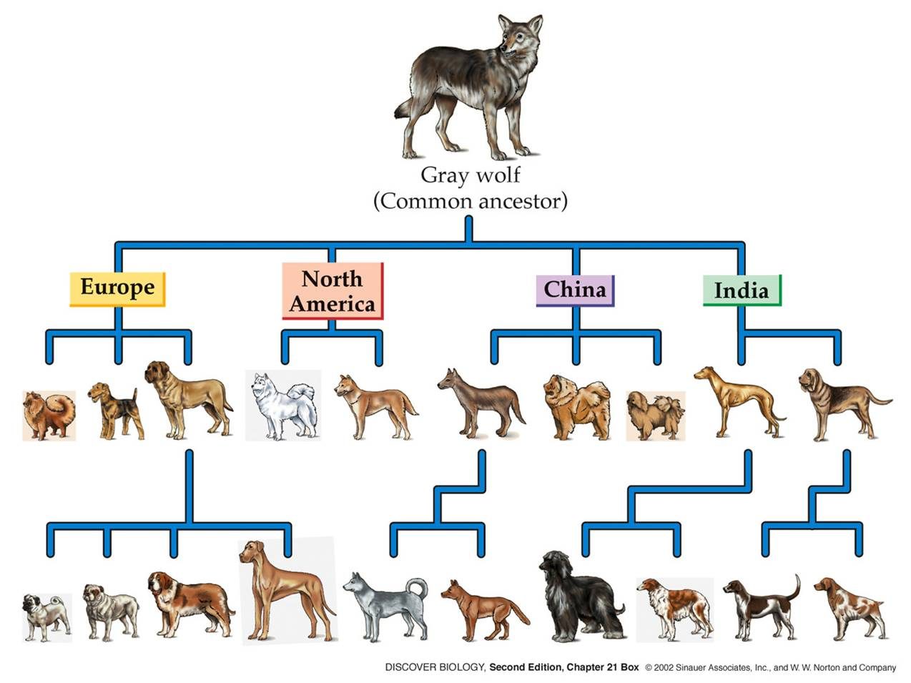
Contributions to darwin’s Theory
4. Artificial Selection: Darwin noticed accelerated change in species when organisms were bred for specific characteristics.

Slide 31
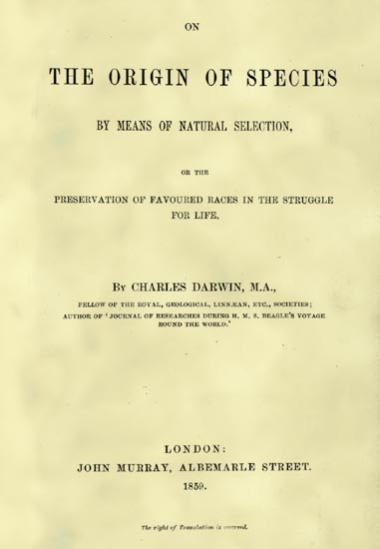
Darwin’s publication
Darwin was forced to publish when another scientist, Alfred Wallace, came up with a similar idea
Darwin’s book, Origin of Species, stirred up controversy for the next decade

Slide 32
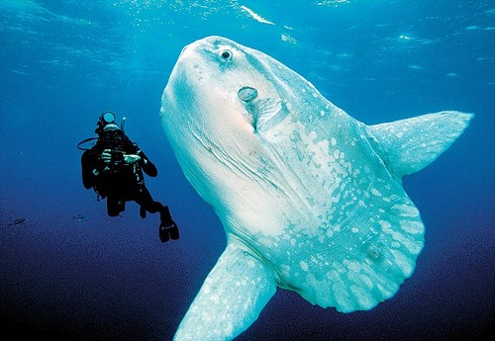
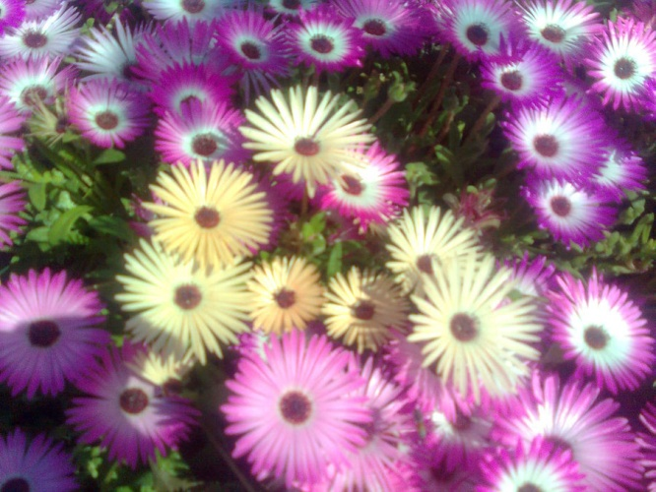
The Theory of Evolution
1. Natural Selection: Individuals better adapted (to escape, obtain food, hide etc.) are more likely to survive and pass on their genetic traits
The ocean sunfish will lay more than 3 million eggs
Two Basic Ideas:
Organisms usually produce more than enough offspring.
All individuals formed from sexual reproduction will be genetically different.
(Genetic variation)

Slide 33
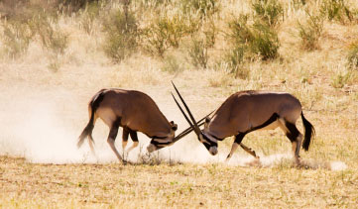
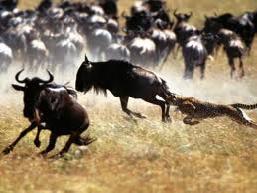
The Theory of Evolution
For natural selection to occur there must be a struggle for existence. Individuals and species compete for limited resources available in their environments and only some are successful.
2. Survival of the fittest: only those species best adapted for their environment survive and pass on genetic traits

Slide 34
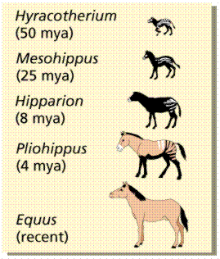
The Theory of Evolution
3. Descent with modification: all living species have descended (with changes) from other species
How?
Genetic mutations can increase variations that may become successful
Environments change so genes in populations shift with the need to adapt to different conditions

Slide 35
The English Peppered Moth
There must be genetic variation in order for natural selection to occur. There are two forms of the peppered moth prevalent in England.
typica
carbonaria

Slide 36
English Peppered Moths
The lighter colored moth is more difficult to spot against tree bark, while the darker moth stands out and makes easier prey.
Which of these two is a bird more likely to eat?

Slide 37
English Peppered Moths
At the beginning of the industrial revolution in England, coal burning produced soot that covered the countryside of some areas
Which of these two is a bird more likely to eat?
How did the population of peppered moths change over time?

Slide 38
Evidence for Evolution
Fossil Records
By comparing fossils from different rock layers, scientists can see how life has changed over time.
Hundreds of transitional fossils have been found which show in between stages of evolution. This is an “incomplete record” with many gaps

Slide 39
Evolution of the Horse

Slide 40
Evidence of Evolution
Anatomical Adaptations
Homologous structures: structures that are the same between different organism even though the functions may differ based on adaptations to the environment
Supports the idea
of a common ancestor

Slide 41
Evidence of evolution
Analogous structures: structures that are formed differently for different organism even though the function may be the same
Supports the idea that organism from different genetic backgrounds share an environment that they have adapted to in similar ways

Slide 42
Evidence for Evolution
Vestigial Structures
Anatomical structures that appear to have no present day use but may have been used in ancestral species
Human “tailbone”
Pelvic bones in whales and snakes

Slide 43
Vestigial structures in humans

Slide 44
Evidence for Evolution
Embryology
The study of similarities in organisms during embryonic stages of development

Slide 45
Evidence for Evolution
Biochemistry
The same DNA bases are used in all life forms
DNA sequences differ based on evolutionary relationships
Examples: Human DNA is 98% similar chimpanzees
Human DNA is 30% similar to a banana!

Slide 46
Evidence of Evolution
Predator-Prey Relationships
Examples: camouflage, mimicry
The Mimic Octopus (All Three Pictures!!)
Mimics: flatfish, sea snakes, jawfish, mantis shrimp, lionfish and others!

Slide 47
Evidence of Evolution
Structural Adaptations
Examples: long necks in giraffes,
webbed feet in a duck

Slide 48
Changes in Populations
Evolution and Natural Selection are changes in a species, NOT an individual
A population of a species may change due to environmental factors that shift the natural selection toward or away from a specific trait

Slide 49
Changes in Populations
Evolution Vocabulary
Variation: inheritable differences in DNA within a population
Gene Pool: all of the genes for a trait that are present in a population (represented by alleles)
Microevolution: the change in the frequencies of alleles within a population over time

Slide 50
Changes in Populations
Variation means that organisms within a population have traits that set them apart
Within the gene pool alleles for each variation are present but some may be more successful than others
Through microevolution, eventually the alleles in the population favor the trait that is more successful

Slide 51
Sources of Genetic Variation
1. Mutations : a change in DNA
2. Genetic Drift- random changes due to small population size
3. Migration / Gene Flow: individuals move into and out of a population such that genes come and go

Slide 52
Sources of Genetic variation
4. Non-random mating: individuals choose their mates based on specific traits (think about a peacock); this a type of natural selection called sexual selection
5. Natural Selection

Slide 53
Changes in Populations
The opposite of evolution is genetic equilibrium.
Genetic equilibrium: allele frequency stays the same
5 Conditions Required to maintain equilibrium
Random Mating
Large Population
No movement in or out of population
No mutations
No Natural Selection
Can you think of a population that would not evolve?

Slide 54
Changes in populations
If genetic equilibrium is maintained frequencies can be predicted in a population using the Hardy-Weinberg equation
p² + 2pq + q² = 1
P = dominant allele p² = homozygous dominant frequency
Q = recessive allele q² = homozygous recessive frequency
2pq = heterozygous frequency
If the frequency of one allele is known, the frequency of the other can be determined using [ p + q = 1]

Slide 55
Changes in populations

Slide 56
Changes in populations
Video explanation of Hardy-Weinberg equation
A population of salamanders have two phenotypes: spotted or striped. If striped is dominant to spotted and there are 50 spotted salamanders out of a total population of 300 what are the genotype and allele frequencies?

Slide 57
Patterns of evolution

Slide 58
Changes in Populations
Natural Selection graphs for polygenic traits:
Changes in traits within a population can cause a genetic drift towards a specific appearance or adaptation

Slide 59
Patterns of Natural Selection
Dotted- before natural selection
Solid- after natural selection
the average individual is favored (more likely to survive)
Stabilizing Selection

Slide 60
Patterns of Natural Selection
Dotted- before natural selection
Solid- after natural selection
one of the extreme forms is favored (more likely to survive)
Directional Selection

Slide 61
Patterns of Natural Selection
Dotted- before natural selection
Solid- after natural selection
both of the extreme forms are favored (more likely to survive)
Disruptive Selection

Slide 62
Changes in Populations
A genetic drift toward a specific trait or an isolation of a part of a species can lead to the development of a new species
Speciation: changes leading to formation of a new species

Slide 63
Patterns of Natural Selection
The development of a species, when a portion of the population becomes isolated from the rest of the population due to geographic separation is an example of….
Geographical Isolation

Slide 64
Rana aurora
Rana boylii
Breeds from January- March
Breeds from March - May
These two frogs are unable to mate and as
a result are two different species due to …
Reproductive Isolation
Taken from http://www.bio.miami.edu/dana/dox/macroevolution.html

Slide 65
Changes in Populations
Isolating mechanisms that can lead to speciation:
Reproductive Isolation
Behavioral Isolation
Geographic Isolation
Temporal (time) Isolation

Slide 66
Rate of Speciation
Extinction :
species disappear from the Earth
usually followed by the appearance of
new species, why?
Gradualism
Punctuated Equilibrium
“slow”
“rapid change followed by long periods of equilibrium”

Slide 67
Patterns of Evolution
The pattern where many different species are linked to one common ancestor …
Divergent Evolution

Slide 68
Patterns of Evolution
Do these organisms share traits in common?
Where are all of these organisms found?
Why do these organisms share similar traits?
This is called… Convergent Evolution

