Slide 1
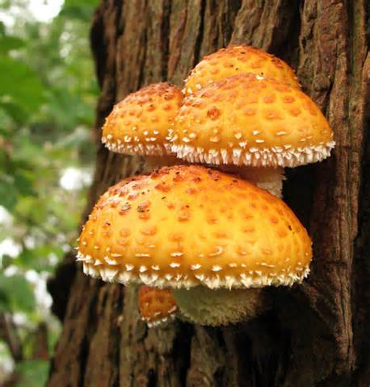
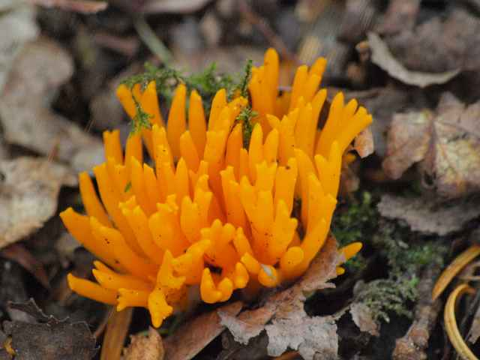
Fungi
Basic characteristics, types of fungi and reproduction

Slide 2
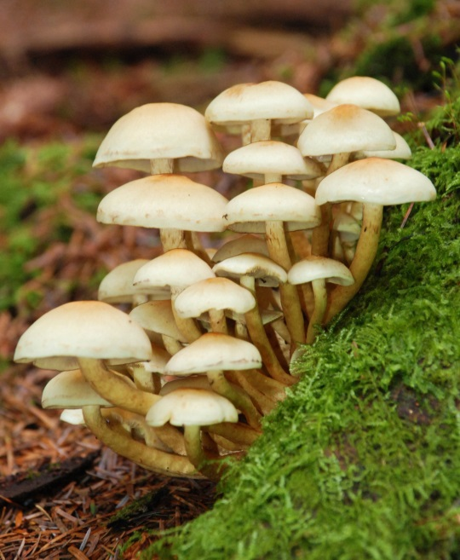
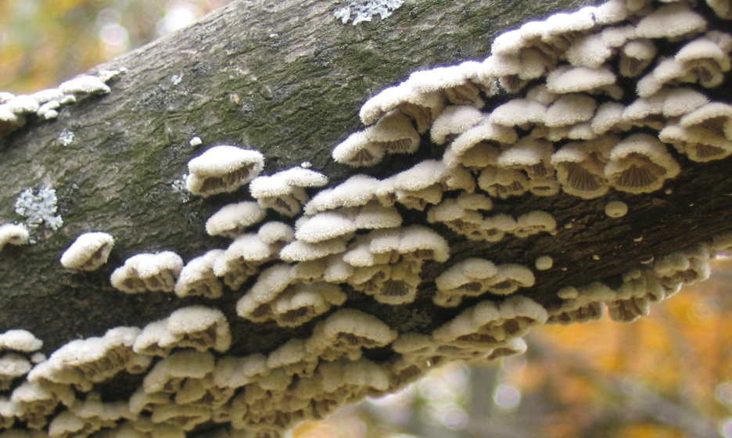
Kingdom Fungi
Eukaryotic
Heterotrophic
Multicellular (except for yeast)
Have cell walls

Slide 3
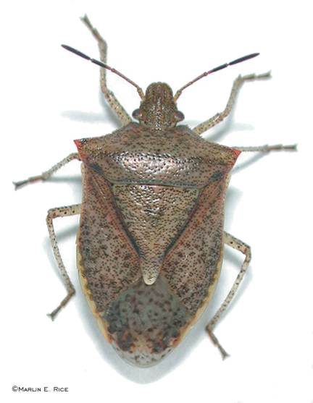
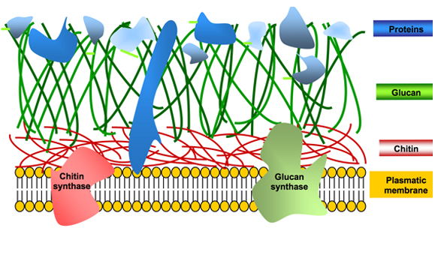
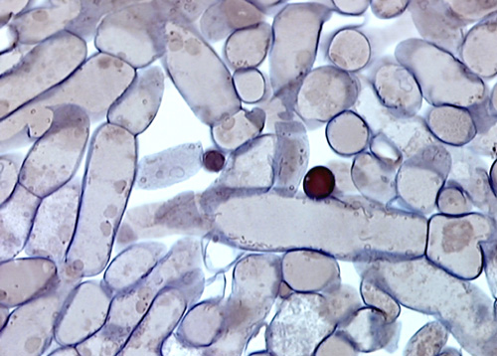
Fungi Structure
Cell walls of fungi are made of chitin
Chitin is the same material that makes up the exoskeleton in insects

Slide 4
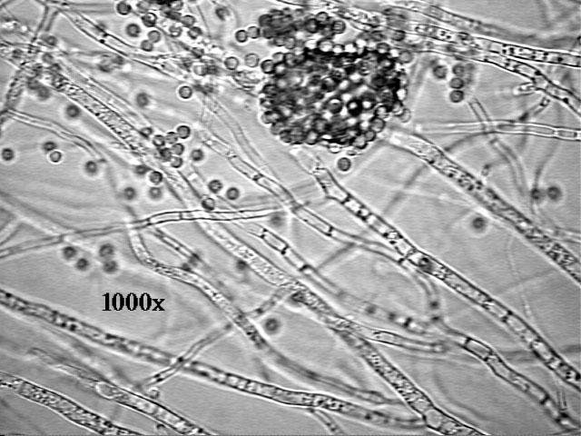
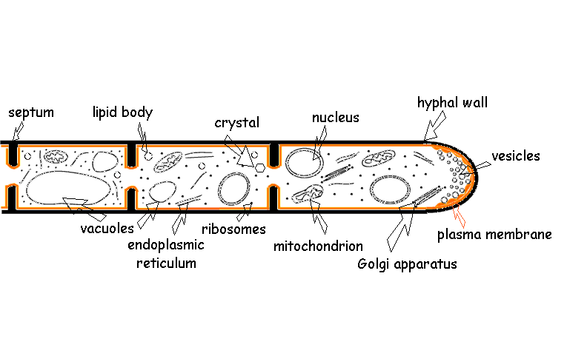
Fungi Structure
Most fungi are made up of a structure called hyphae
Hyphae: thread-like filaments

Slide 5
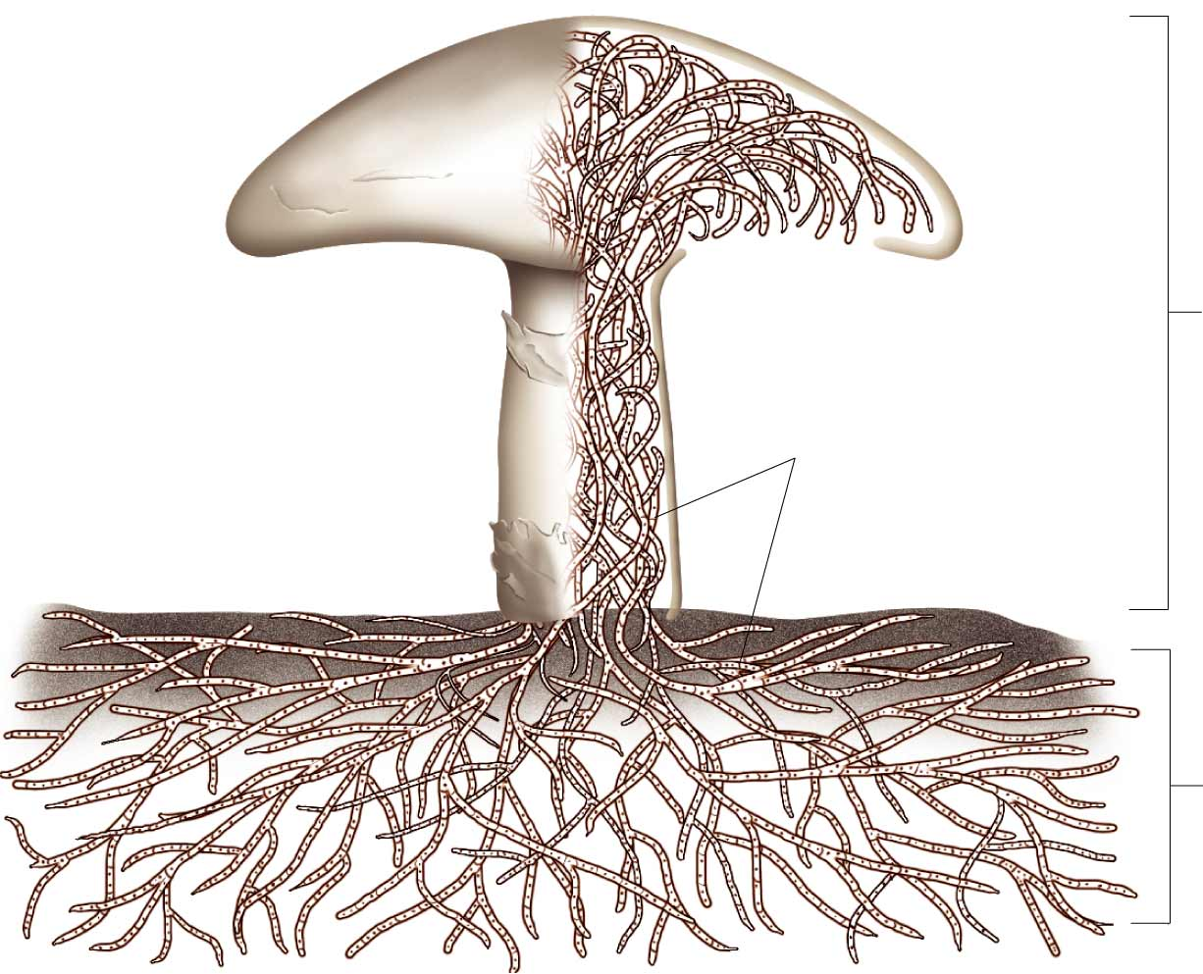
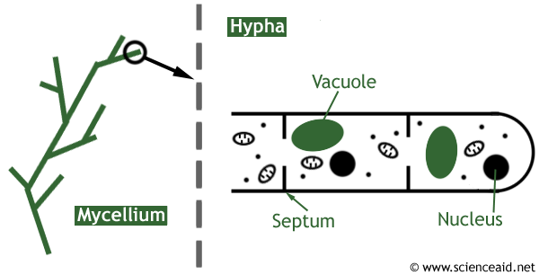
Fungi Structure
A network of hyphae is called mycelium
Functions: to provide an anchor and assist in digestion

Slide 6
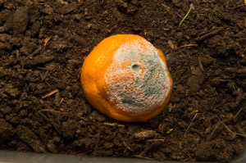
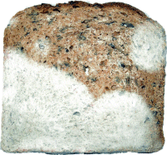
Fungi Nutrition
Fungi digest food through “extracellular digestion”
They secrete digestive enzymes to break down food and then absorb it

Slide 7
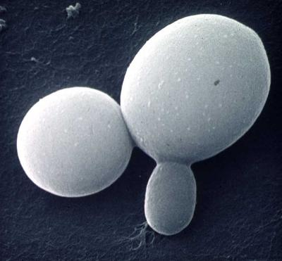
Fungi Reproduction
Fungi can reproduce both asexually and sexually
Asexual reproduction occurs through budding or fragmentation and spores
Budding requires a small piece
of fungi to break off and become its
own organism

Slide 8
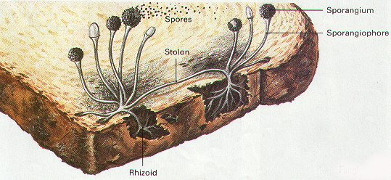
Fungi Reproduction
Sexual reproduction in fungi occurs through the creation of haploid cells called sporangium. The sporangium are then fertilized through the connection of two individual fungi by a stolon

Slide 9
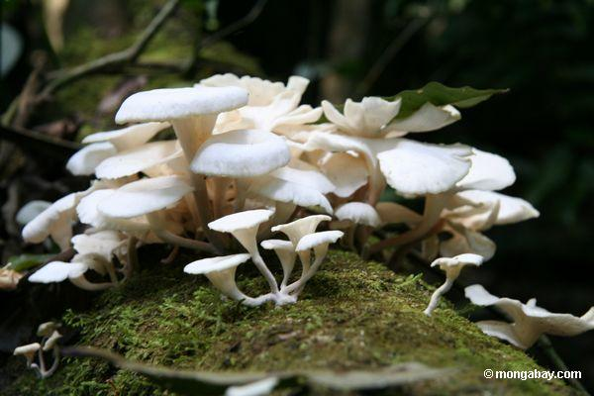
Fungi Relationships
Fungi often work closely with other species in their environment to fulfill different roles or niches
Saprobes are decomposers
that break down unwanted
or dead organic material in
the environment

Slide 10
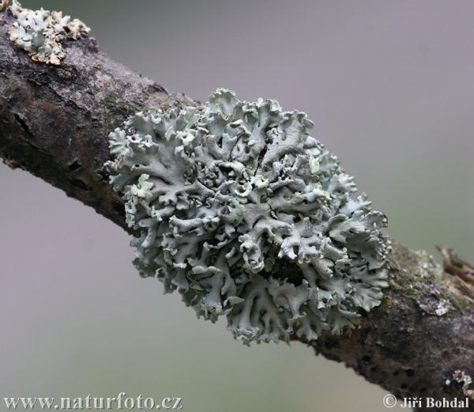
Fungi Relationships
Fungi can form mutualism with other species where both species benefit from the relationship
Lichens: algae and fungi
joined together to provide
each other with necessary
nutrients from their
environment

Slide 11
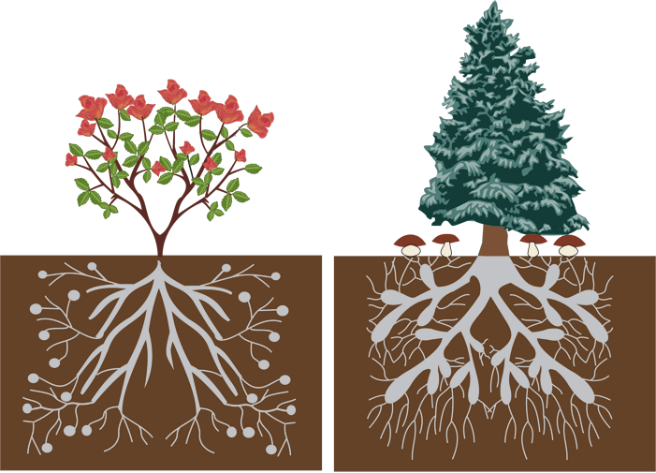
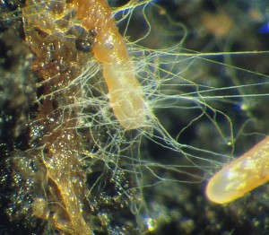
Fungi Relationships
Mycorrhiza: mutual relationship between plant roots and fungi where the plant increases the area it is able to absorb water from while the fungi get necessary carbon from the plant.

Slide 12
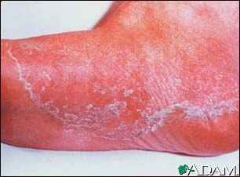
Fungi Relationships
Fungi can also be parasites, living in a relationship with another species that harms the other species
Athlete’s Foot: a fungal infection that feeds off of skin cells

Slide 13
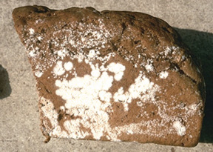
Fungi Diversity
Groups of fungi are classified according to how they look, reproduce, and what kind of spores they create
Molds: fungi that grow on food products like meat, bread, fruits, etc.
Called Zygomycota

Slide 14
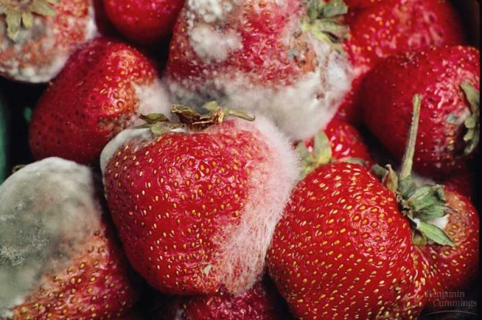
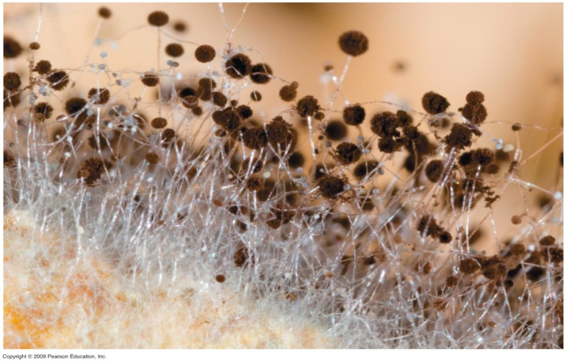
Fungi Diversity
Zygomycota species are divided into two parts:
Rhizoids that act as roots and
anchor the fungi
Stolons that act as stems and
push the spores up for dispersal
to spread the mold

Slide 15
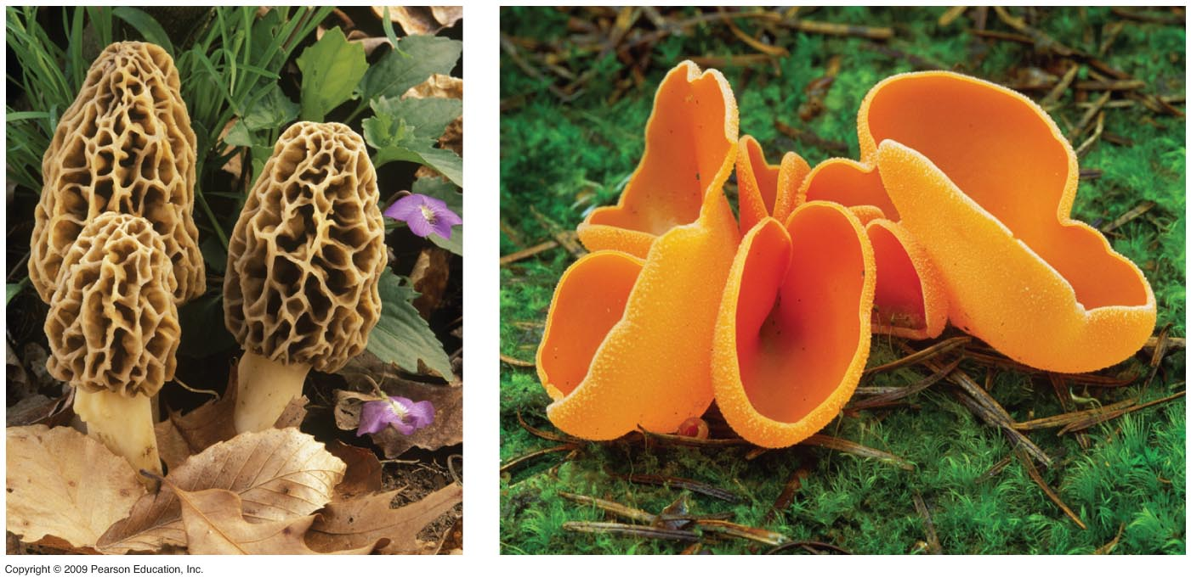
Fungi Diversity
Sac Fungi: fungi that contain a sac for producing and distributing spores
Called Ascomycota

Slide 16
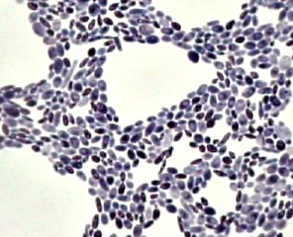
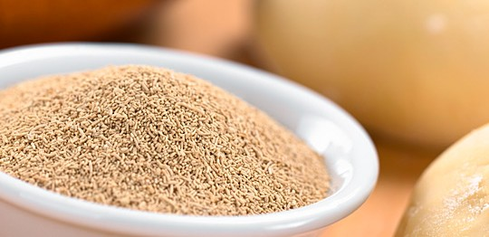
Fungi Diversity
Yeast: unicellular fungi that create spores called ascospores in sacs similar to sac fungi
Ascospores become a dry
powder used in baking that can
be activated in water
Reproduce asexually through
budding once activated

Slide 17
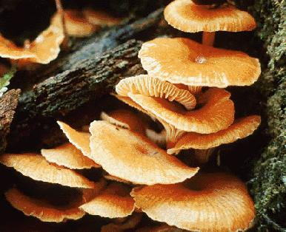
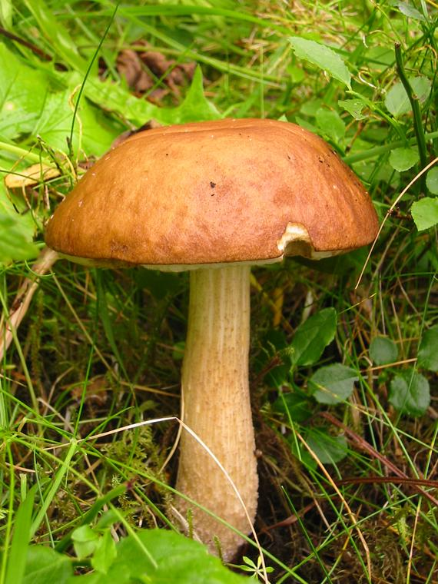
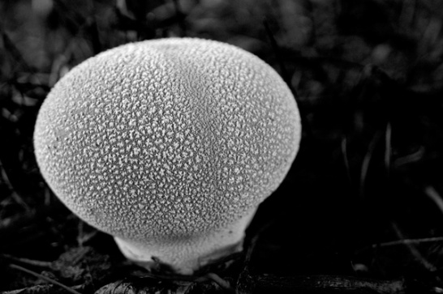
Fungi Diversity
Club Fungi: the most recognizable type of fungi are club fungi that reproduce in a club-like structure
Called Basidiomycota
Includes mushrooms,
shelf fungi, and puff balls

Slide 18
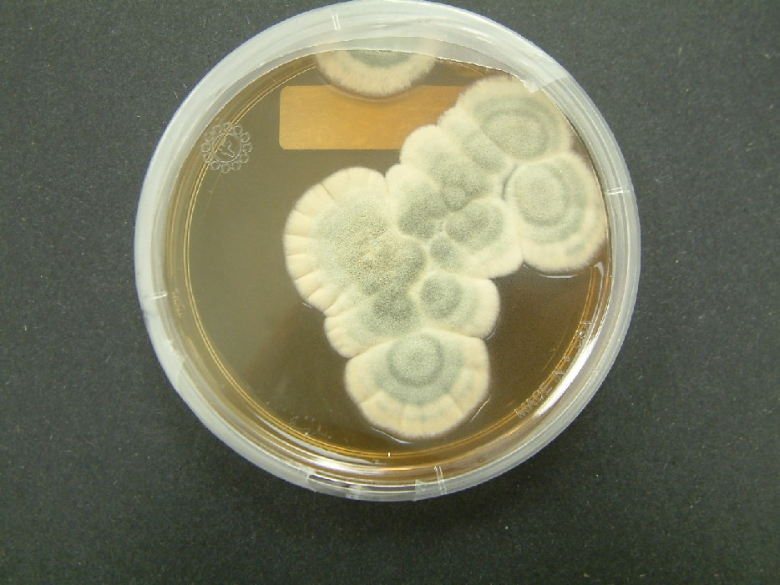
Fungi Diversity
Imperfect Fungi: considered “imperfect” because they do not have the ability to reproduce sexually
Called Deuteromycota
Includes Penicillium a common
fruit mold that was used to create
the first antibiotics

Slide 19
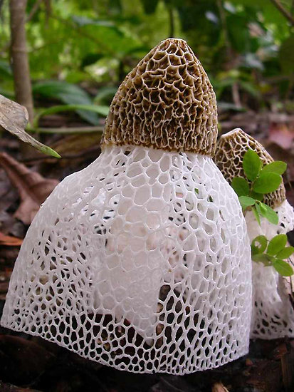
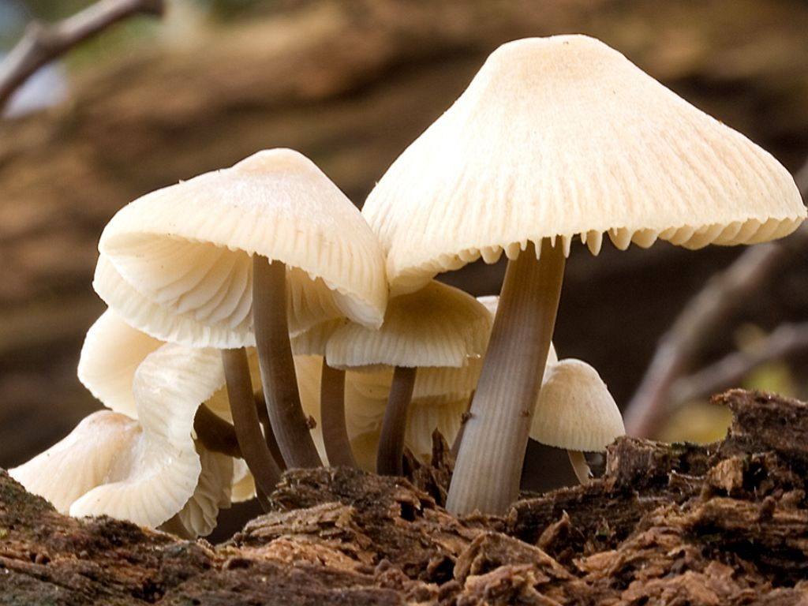
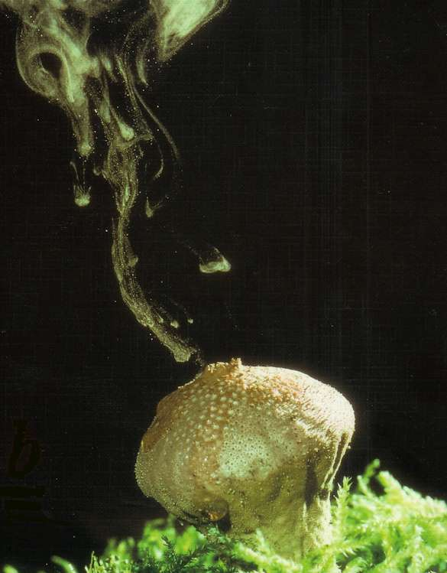
Fungi Diversity
Fungi can be found in various environments and show a great diversity in their structures, types of reproduction, and roles within their environment.
Fungal growth video

