Slide 1
Human Health & Disease
Response to Pathogens and Immunity

Slide 2
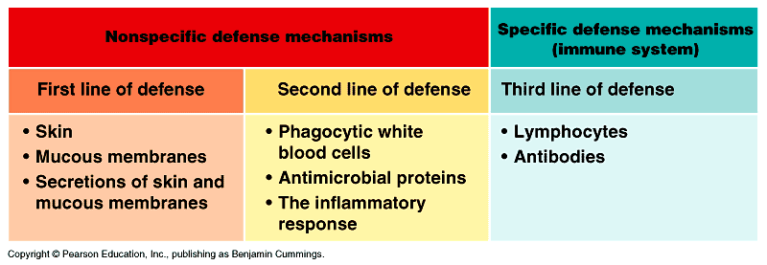
Immune System
Controls your body’s reaction to infections by creating white blood cells that destroy any foreign matter

Slide 3
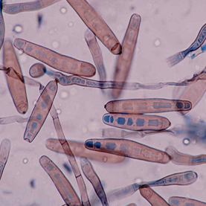
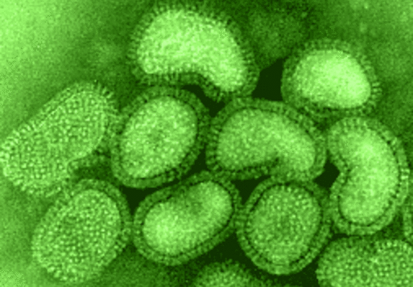
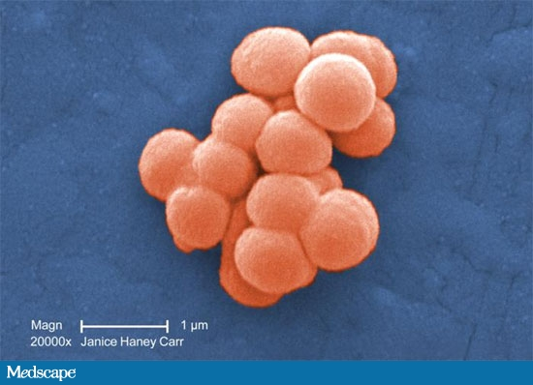
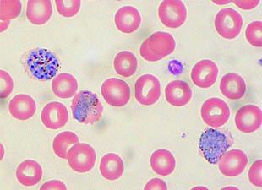
Immune System
Pathogen: anything that causes disease
→Examples: Bacteria, Viruses, Protists, or Fungi
H5N1 Influenza Virus
Fungal Meningitis
Staphylococcus
Malaria Protist Parasite

Slide 4
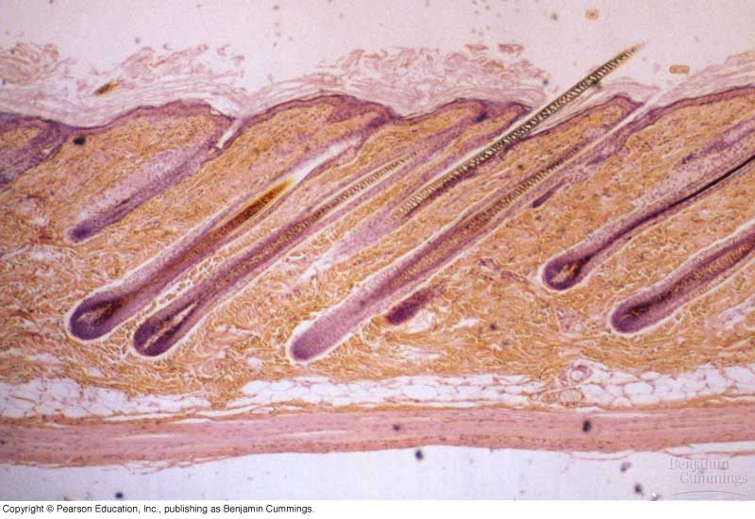
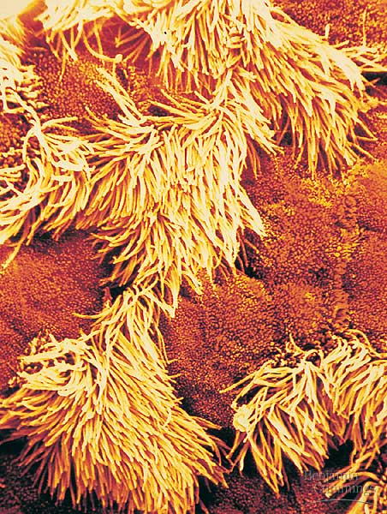
Non-Specific Defense
1st line of defense: skin and mucous membranes
Skin acts as a barrier between vital tissues in your body and your environment
Mucous membranes in your respiratory system and digestive system attempt to catch any foreign materials before they enter vital tissues

Slide 5
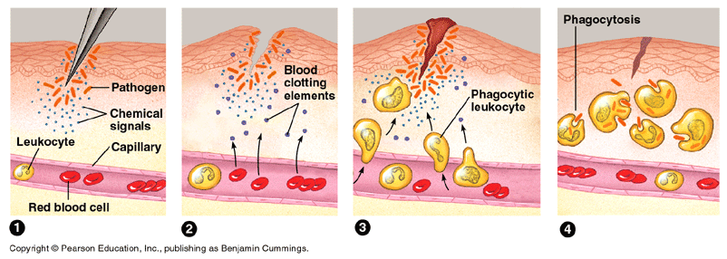
Non-Specific Defense
2nd line of defense: The inflammatory response handles any foreign material that break through the skin barrier

Slide 6
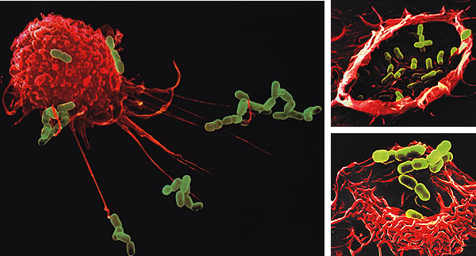
Non-Specific Defense
Phagocytes are specialized cells found within the blood that recognize and attack foreign cells like bacteria
One liter of your blood contains as many as 6 billion phagocytes!!

Slide 7
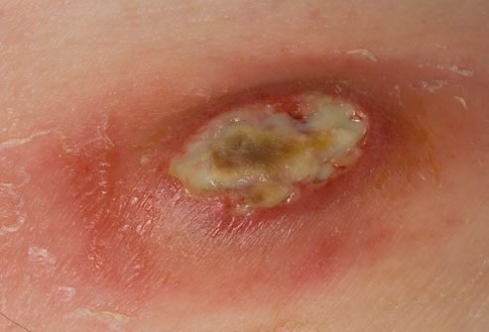
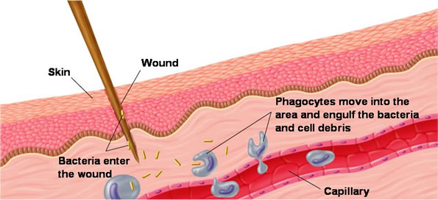
Non-Specific Defense
The result of phagocytes attacking may be the production of puss at an infection site.
White blood cells (leukocytes) are a type of phagocyte that contributes to the healing process after a cut.

Slide 8
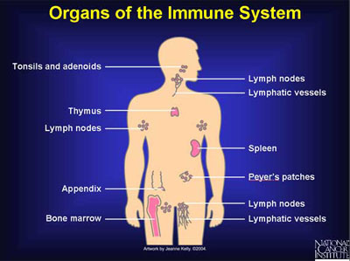
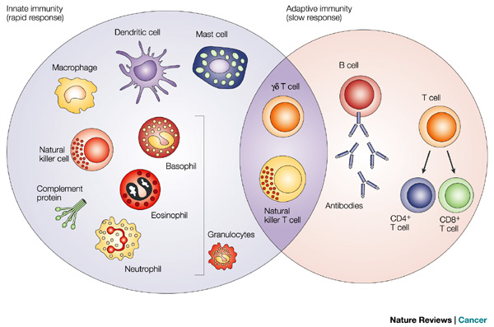
Specific Defense
3rd line of defense: Immune System Response
Consists of a series of specialized cells that attack foreign material
Immune System Cells

Slide 9
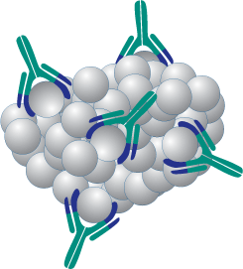
Immune System
Antigens: any foreign material
Antibodies: proteins that recognize and
bond to an antigen to neutralize or mark it
Antigen
Antibodies

Slide 10
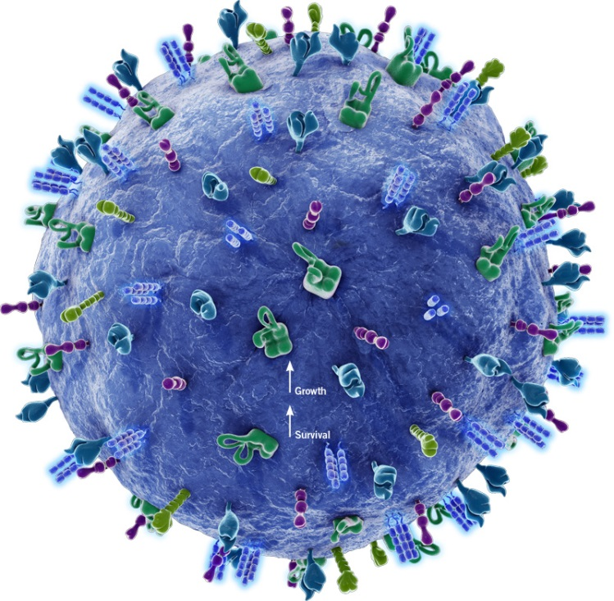
Immune System
B lymphocytes (“B” cells)
- make plasma cells that
release antibodies
- make memory cells that will
recognize the antigen in the
future
Memory cells- these cells remember the antigen and make it unlikely the body will be infected by it again.

Slide 11
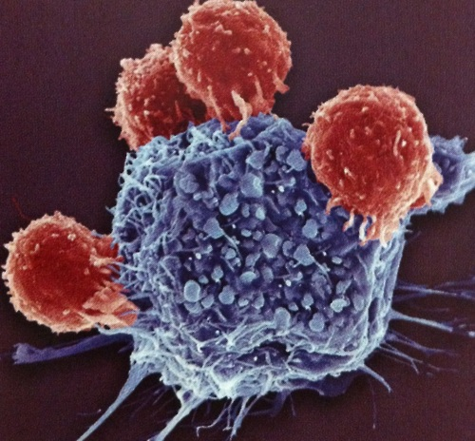
Immune System
T lymphocytes (“T” cells)- kill a body’s cells that have been invaded by a virus or other pathogen
Helper T cells activate
B cells or killer T cells
Cytotoxic “killer” T cells
destroy infected cells

Slide 12
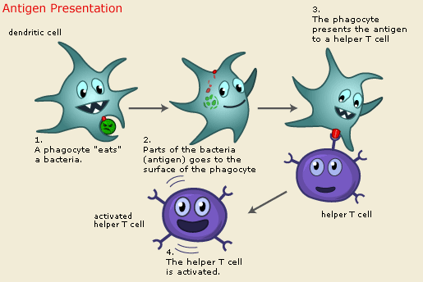
Immune System

Slide 13
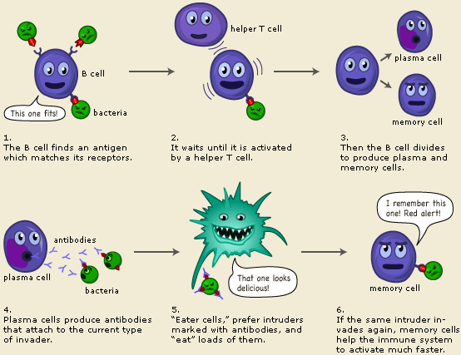
The Big Picture

Slide 14
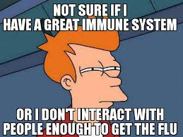
Immunity
Immunity means that your body has the tools available to fight off an attack from a pathogen before you feel any negative effects
It does not mean that
your body never encounters
that pathogen again

Slide 15
Immunity
You can get immunity from certain pathogens in 2 ways:
1)Active Immunity: requires your body encountering the pathogen and an immune system reaction
2) Passive Immunity: antibodies injected or passed down from another source

Slide 16
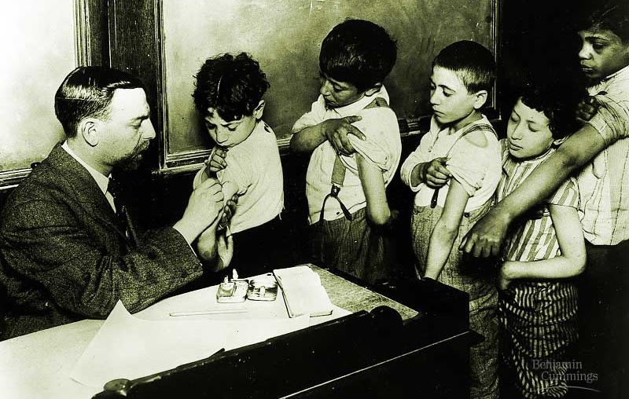
Active Immunity
You get sick. Your body fights off the antigen and in the process creates memory B cells and antibodies.
You are injected with a
mild form of the pathogen,
known as a vaccine.

Slide 17
Active Immunity
Vaccines are prepared injections of a weakened or killed microorganism that causes disease or an agent meant to look like a disease causing pathogen
First developed in 1796 by Edward Jenner while trying to find a cure for the smallpox disease. He took the puss from a victim of smallpox and placed it into the cut on an 8 year old boy…the boy never got the disease.
Now vaccines have been used to nearly eradicate diseases like cholera and anthrax (Pasteur), polio (Jonas Salk), measles, mumps and rubella. Before enrolling in public school vaccinations for several diseases are now required

Slide 18
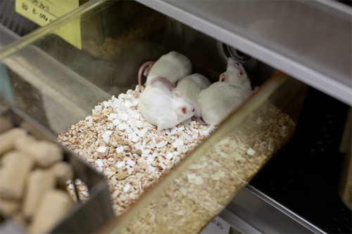
Passive Immunity
Injection of antibodies in the form of immunoglobulin to provide temporary treatment for severe infections, immune deficiencies or those with autoimmune diseases.
Treatments last 2-3 months and can be given multiple times
Recent studies done at UNC research centers have discovered that immunoglobulin treatments on mice can reverse Type I diabetes onset

Slide 19
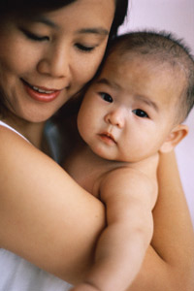
Passive Immunity
Antibodies can be shared between a mother and her child during pregnancy and while breast feeding
These antibodies may only
last the first few years of
development and are a weaker
form of antibodies created
through active immunity

Slide 20
Immune Response Differences

