Slide 1
Kingdom Diversity

Slide 2
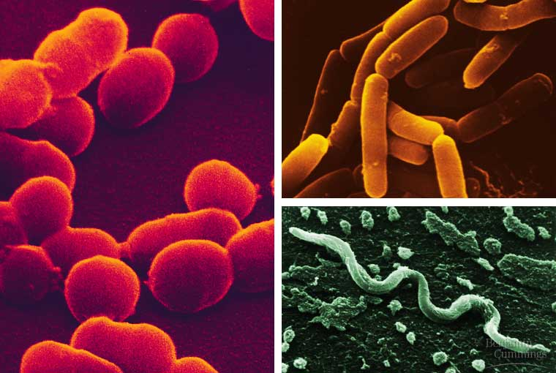
Modern Classification of Organisms
Linnaeus used a 5 kingdom system to classify organisms:
Monera – all prokaryotes (bacteria)

Slide 3
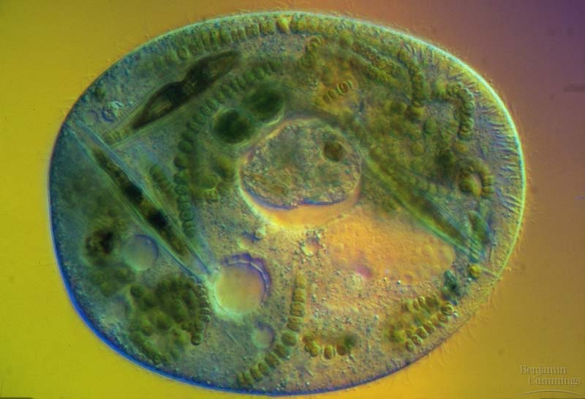
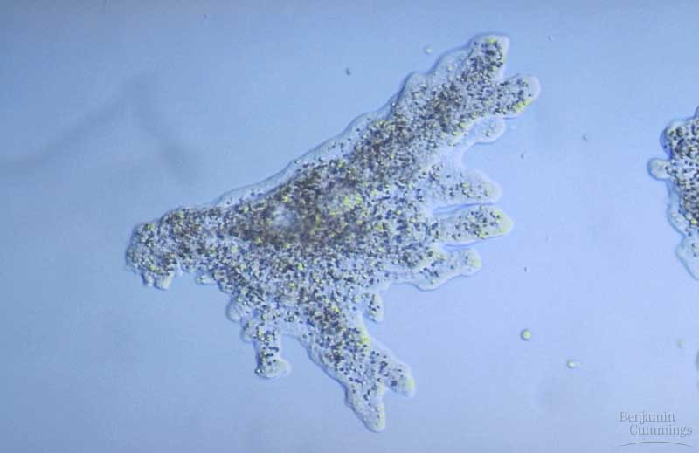
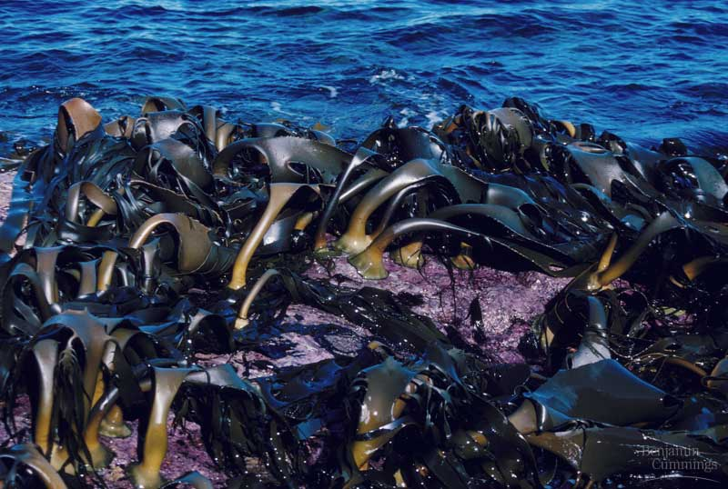
Modern Classification of Organisms
Protista – unicellular eukaryotes and multicellular algae, can be heterotrophic or autotrophic and may or may not have cell walls made of cellulose
Example: amoeba, protozoa

Slide 4
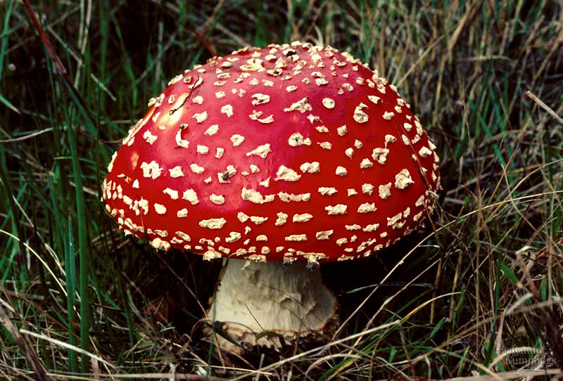
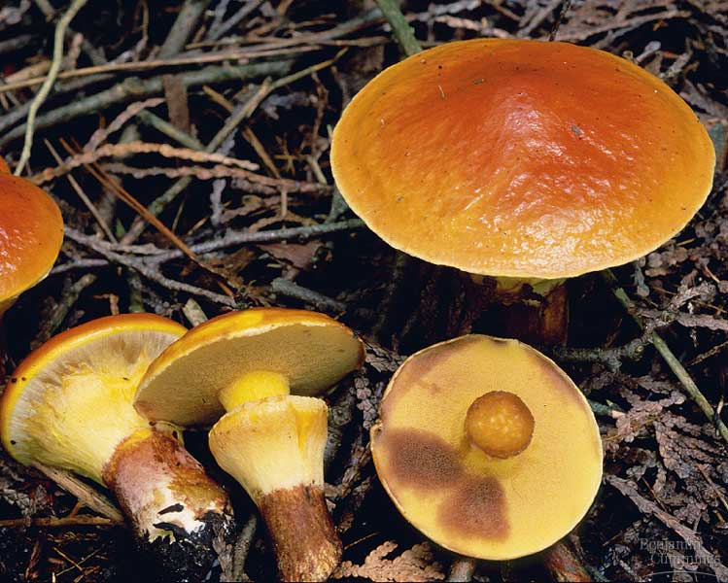
Modern Classification of Organisms
Fungi – multicellular, heterotrophic decomposers, have cell walls that contain chitin

Slide 5
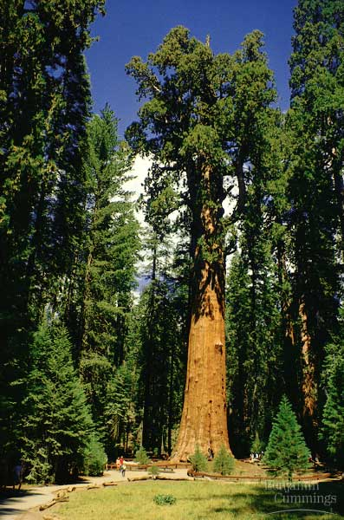
Modern Classification of Organisms
Plantae – multicellular autotrophs, contain cell walls that are made of cellulose

Slide 6
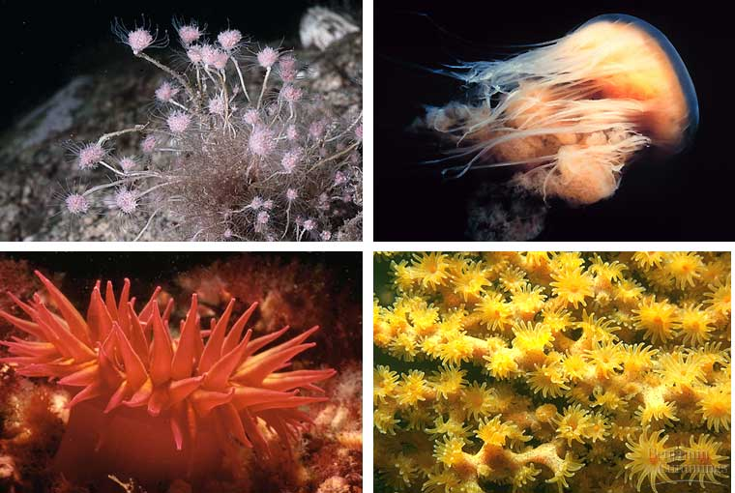
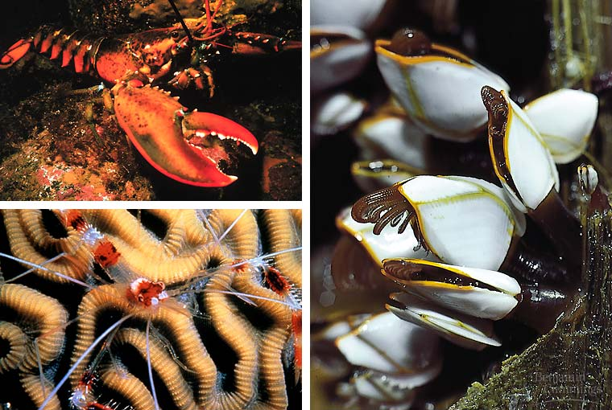
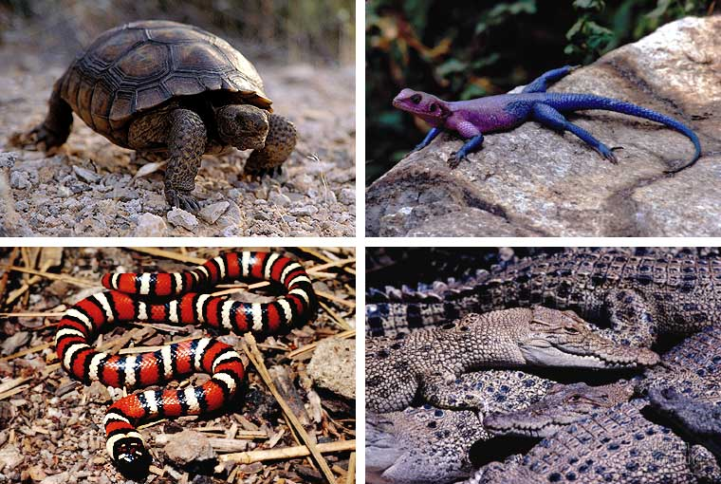
Modern Classification of Organisms
Animalia – multicellular, heterotroph consumers

Slide 7
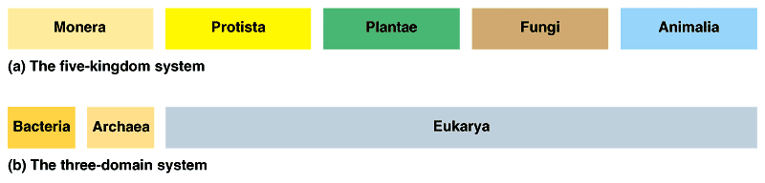
Modern Classification of Organisms
Recently a larger taxon has been included, the Domain
The previous kingdoms have been adjusted to fit into the 3 domains:

Slide 8
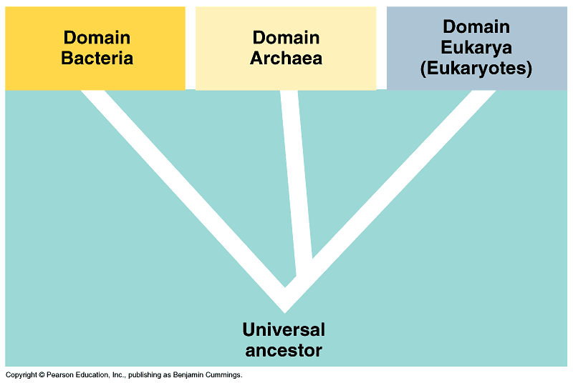
Domain Bacteria – includes the “regular” Monerans, or eubacteria
Domain Archaea – includes the Monerans called the archaebacteria
Domain Eukarya – includes protists, fungi, plants, and animals

Slide 9
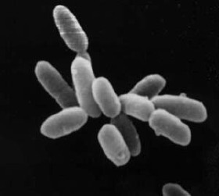
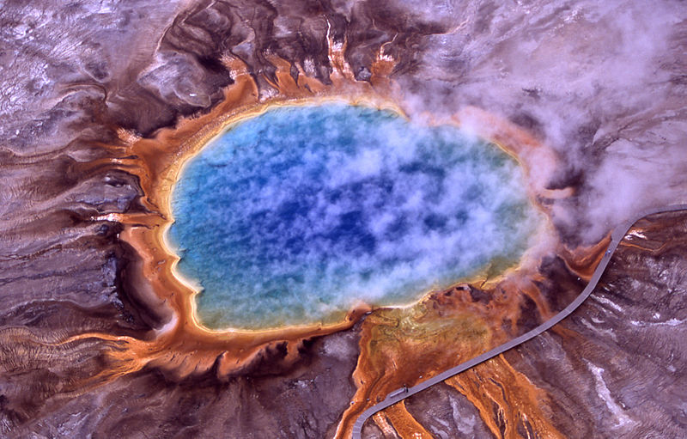
Modern Classification of Organisms
Kingdom Archaebacteria
Prokaryotic, autotrophic organisms with cell walls made up of a thin layer of protein
Halobacteria
Most are found in harsh, seemingly unlivable environments such as hot springs or deep sea vents

Slide 10
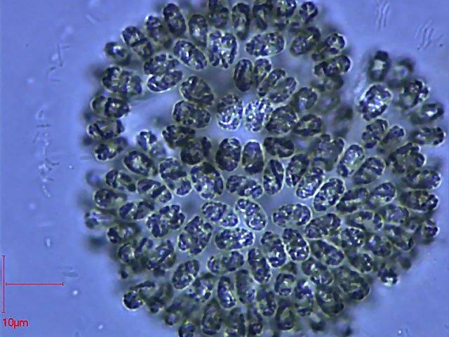
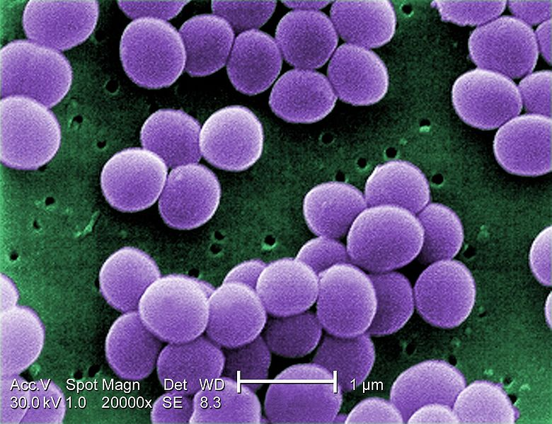
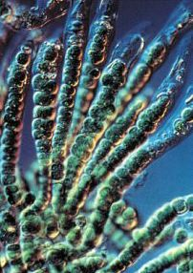
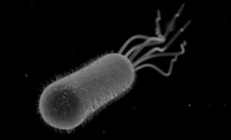
Modern Classification of Organisms
Kingdom Eubacteria
Prokaryotic, autotrophs or heterotrophs with cell walls made of peptidoglycan

Slide 11
Compare and Contrast Prokaryotes vs. Eukaryotes
Cell Type | Membrane bound organelles | Ribosomes | DNA structure | Size
Prokaryote | no | yes | unorganized | small
Eukaryote | yes | yes | Well organized | larger

