Slide 1
Class Opener…
What are the four types of organic molecules?
What type of organic molecule is an enzyme?
What are cells?
What are two different groups of cells?
How do scientists view cells?

Slide 2
Microscopes
Care and Use of Compound Microscopes

Slide 3
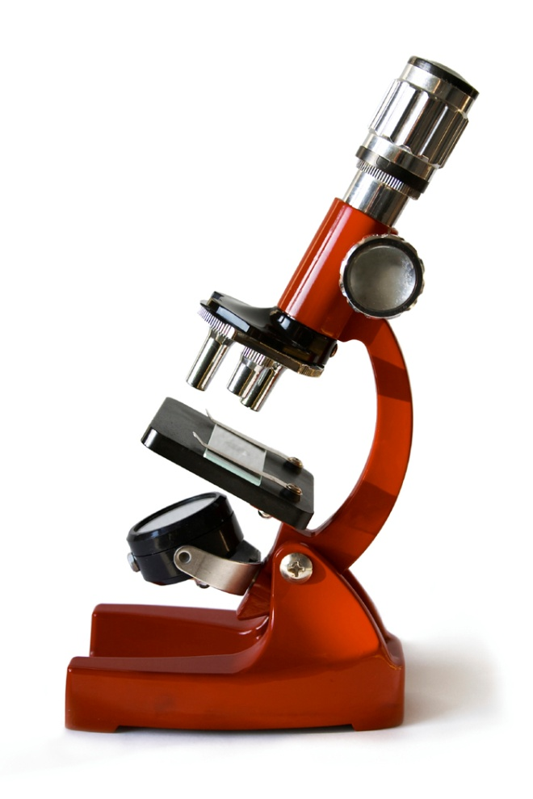
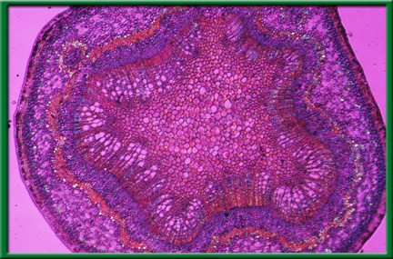
Types of Microscopes
Compound light microscopes use a series of lenses to refract light.

Slide 4
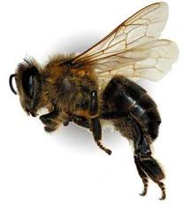
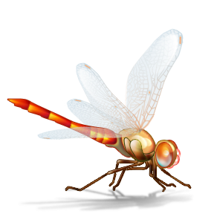
Types of Microscopes
Stereoscopic Dissecting- uses binocular vision to view larger specimen

Slide 5
Types of Microscopes
Electron Microscope- uses a beam of electrons to view extremely small objects like atoms; there are 2 types:
Scanning- scans the 3D surface of the object
Transmission- sees within a thin slice of the object

Slide 6
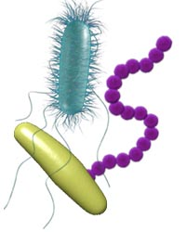
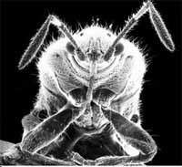
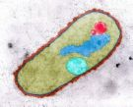

Slide 7
Introduction to the Microscope
Care
Parts
Focusing
Notes:
Students will have their microscopes out, for reference as we go through each of the steps. As an introduction, students will be asked what kinds of things they can do with this tool.

Slide 8
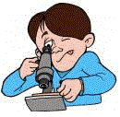
Microscope Care
Always carry with 2 hands
Only use lens paper for cleaning
Do not force knobs
Always store covered
Keep objects clear of desk and cords
Notes:
Teacher demonstrates how to hold the microscope, where the lens paper is located and how to use it. Students will be invited to turn the knobs and observe the stage as it moves up and down. Teacher will demonstrate how to store the microscope.

Slide 9
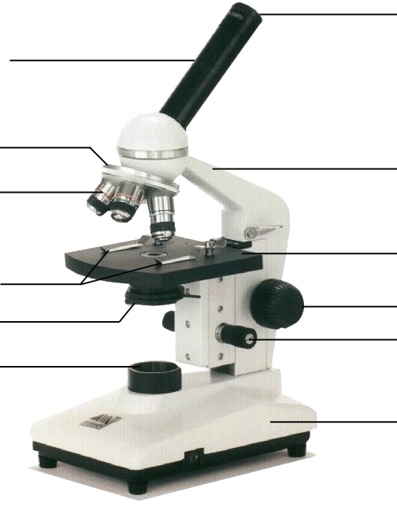
Microscope Parts
Eyepiece
Body Tube
Revolving Nosepiece
Arm
Objective Lens
Stage
Stage Clips
Coarse Focus
Diaphragm
Fine Focus
Light
Base
Notes:
This is the exact version of the microscope used in class. Students will be identifying the parts on the microscopes at their desks as we go along and what their functions are.

Slide 10
Using the Microscope
Place the Slide on the Microscope
Use Stage Clips
Click Nosepiece to the scanning (shortest) setting
Look into the Eyepiece
Use the Coarse Focus
Notes:
Give students a slide from the “common things” set, each student will practice focusing and changing objectives.

Slide 11
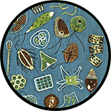
Using High Power
Follow steps to focus using low power
Click the nosepiece to the longest objective
Do NOT use the Coarse Focusing Knob
Use the Fine Focus Knob to bring the slide
What can you find on your slide?
Notes:
Have students exchange slides so they can look at different things, walk them through using the high power objective to focus slides. Emphasize not using the coarse objective during this process, as it will crack the slides.

Slide 12
For each observation
START OVER with step one for each NEW observation!

Slide 13
Magnification
Your microscope has 3 magnifications: Scanning, Low and High. Each objective will have written the magnification. In addition to this, the ocular lens (eyepiece) has a magnification. The total magnification is the ocular x objective
Eyepiece=10x
Scanning=4x Low=10x High=40x

Slide 14
Drawing Specimens
Make detailed drawing of exactly what you see! Make sure the specimen is drawn to scale.
LABEL what you are observing AND the TOTAL magnification.
LABEL any structures to the side and connect to a line.

Slide 15
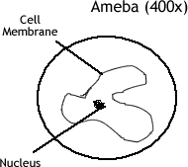
Example

