Slide 1
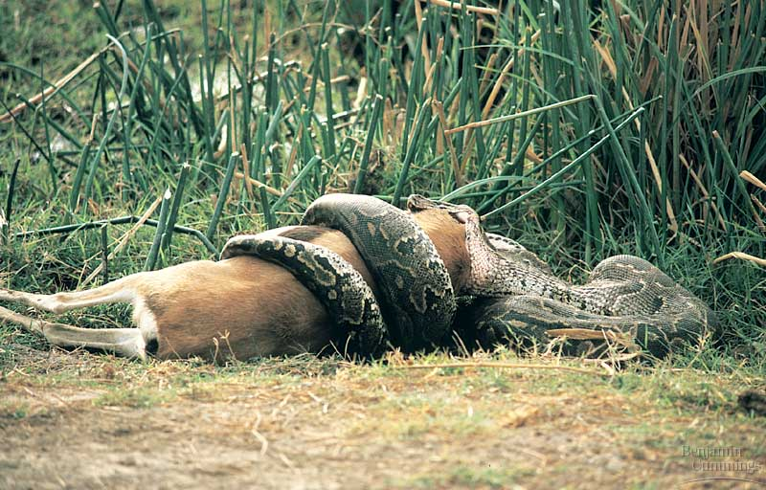
Nutrition

Slide 2
Nutrients
All organisms need certain materials for proper functioning
These nutrients are obtained by eating from the 5 basic food groups

Slide 3
Carbohydrates
Are needed for energy
Examples include: sugar, starch, fiber
In which food group(s) will you find carbohydrates?
fruits, vegetables, grains

Slide 4
Fats
Are needed for cushioning, insulation, cell membranes, long-term energy
Examples include: lard, oils, phospholipids
In which food group(s) will you find fats?
dairy, protein

Slide 5
Proteins
Are needed for metabolism, immunity, structure, cell transport
Examples include: enzymes, antibodies, muscles, hemoglobin
Proteins are have their own food group.

Slide 6
Minerals
Are inorganic substances
Calcium – bone/tooth formation, nerve & muscle function
Potassium – pH and water balance, nerve function
Iron – component of hemoglobin
Sodium - pH and water balance, nerve function

Slide 7
Vitamins
Are organic substances required in small amounts
Vitamin D – promotes bone growth, aids in absorption of Ca and P; can be made by skin
Folic acid – involved in nucleic acid and amino acid metabolism; can be made by colon bacteria

Slide 8
Water
Chemical reactions (digestion)
Dissolving materials for cell entry (“universal solvent”)
Maintaining body temperature (water has high heat capacity)
Must be replaced constantly. The body loses about 2.5 L daily through urination, sweating, & breathing.

Slide 9
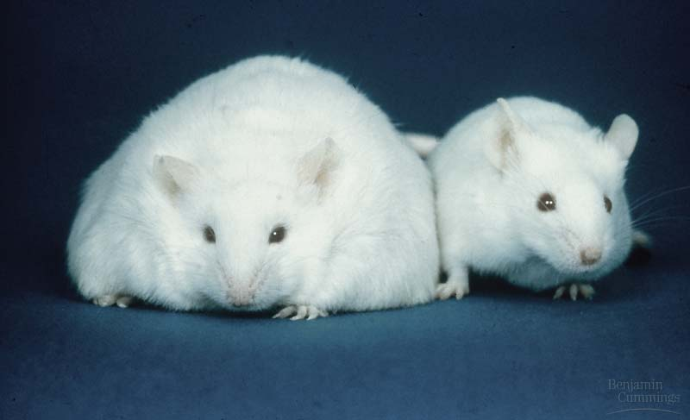
Why do you need a healthy diet?
It decreases the likelihood of obesity, which is linked to:
Heart disease
High blood pressure (hypertension)
Diabetes

Slide 10
What does a healthy diet look like?
Meals that are balanced between food groups
Daily calorie intake of 2,000-2,500
Water intake to prevent dehydration and replaced water lost by normal daily activities

