Slide 1
Protists
Characteristics, Reproduction, and Types

Slide 2
What is a Protist?
The most diverse eukaryotic kingdom with 200,000+ species
Contains both unicellular and multicellular species
Contains both autotrophs and heterotrophs
Very hard to define

Slide 3
What is a Protist?
Eukaryotic organism
Can be similar to fungi, plants or animals depending on the species
Almost always live in water

Slide 4
Types of Protists
Animal-like Protists
Called Protozoans (zo- meaning animal)
All are unicellular heterotrophs
Classified according to how they move

Slide 5
Protozoans
1. Ciliophora
Move and feed using cilia (hairlike projections) from their plasma membrane.
Contain contractile vacuoles that help the organism regulate water balance in their environment
Example: Paramecium

Slide 6
Protozoans
Paramecium Structure

Slide 7
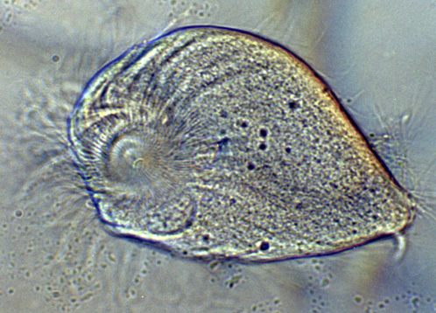
Protozoans
2. Zooflagellates
Move by whipping one or more flagella (whip-like structure)
Example: Trychonympha

Slide 8
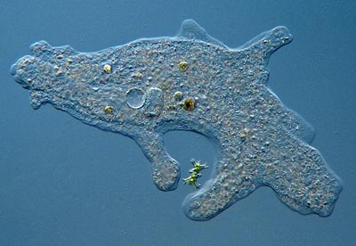
Protozoans
3. Rhizopoda
Feed using pseudopods (“false feet”) represented by cytoplasmic extensions
Example: Amoeba

Slide 9
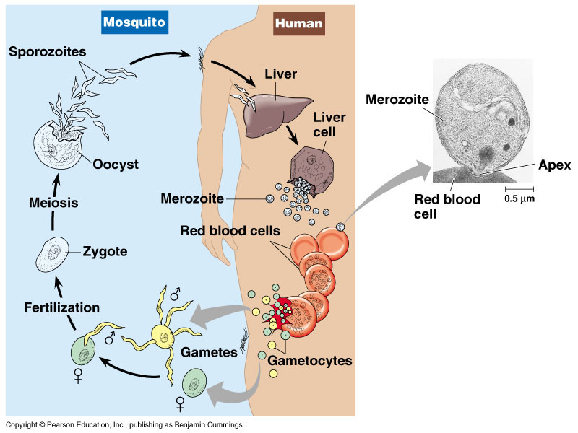
Protozoans
4. Sporozoans
Parasitic protists that live within other organisms
Are harmful to their host organism
Example: Plasmodium which causes Malaria

Slide 10
Types of Protists
Plant-like Protists
Called Algae
Contain photosynthetic pigments and have cell walls like a plant
Produce more than 2/3 of the Earth’s oxygen
Include Phytoplankton (photosynthesizing protists)

Slide 11
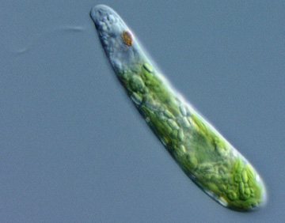
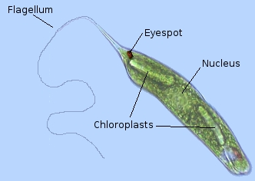
Algae
1. Euglenophyta
Move by using a flagella
Are both autotrophic and heterotrophic (mixotrophic)
Have an eyespot to detect light
Example: Euglena

Slide 12
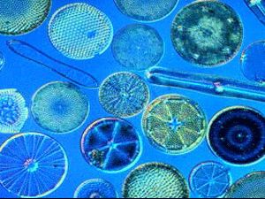
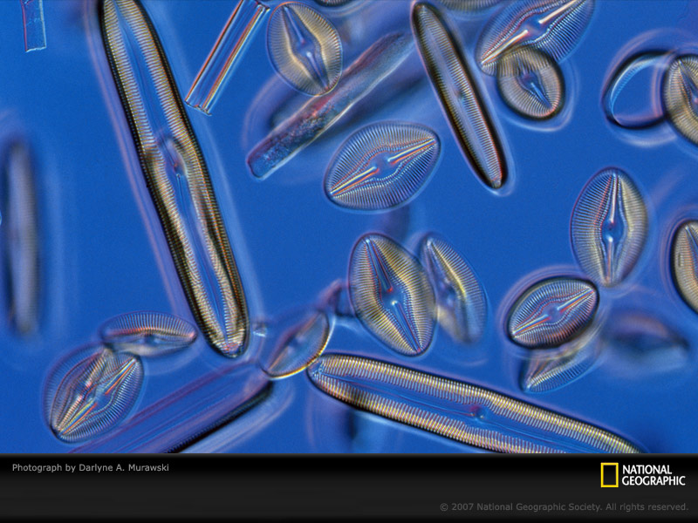
Algae
2. Bacillariophyta
Have shells made of silica
Come in a variety
of shapes
Example: Diatoms

Slide 13
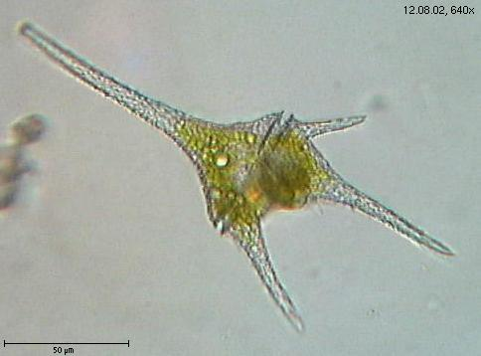
Algae
3. Dinoflagellates
Unicellular protists that range
in size from tiny to 2mm in diameter
Some can produce their own light through bioluminescence
Some are parasitic and can be toxic to other species

Slide 14
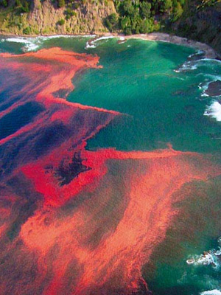
Algae
Dinoflagellates can grow in blooms when conditions are right
Example: Pfiesteria
Pfiesteria blooms cause an
event called the “red tide” that
creates a neurotoxin resulting
in muscle paralysis in species
affected

Slide 15
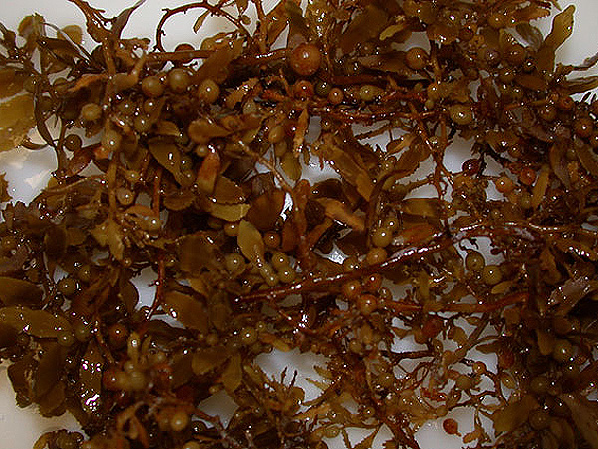
Algae
4. Phaeophyta
Also known as “brown algae”
Largest and most complex
group of algae
Example: Kelp, Sargassum

Slide 16
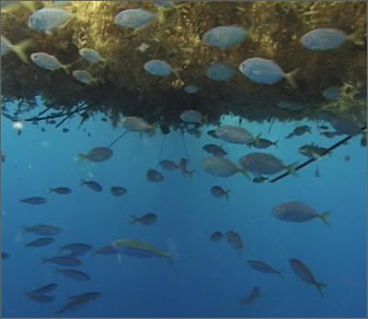
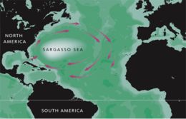
Algae
Sargasso Sea
An area in the mid-Atlantic where currents have created a collecting basin for large populations of sargassum

Slide 17
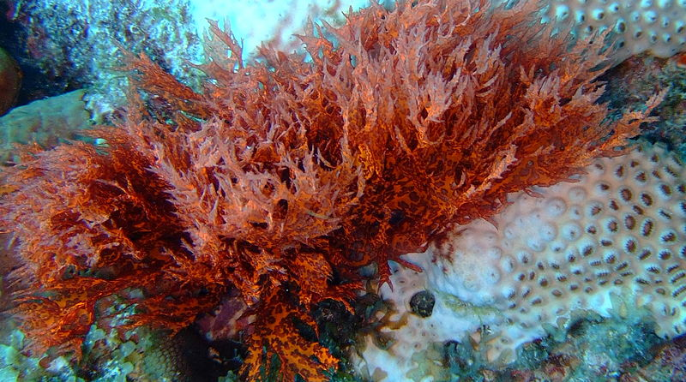
Algae
5. Rhodophyta
Also known as “red algae”
Found in deep, rocky waters

Slide 18
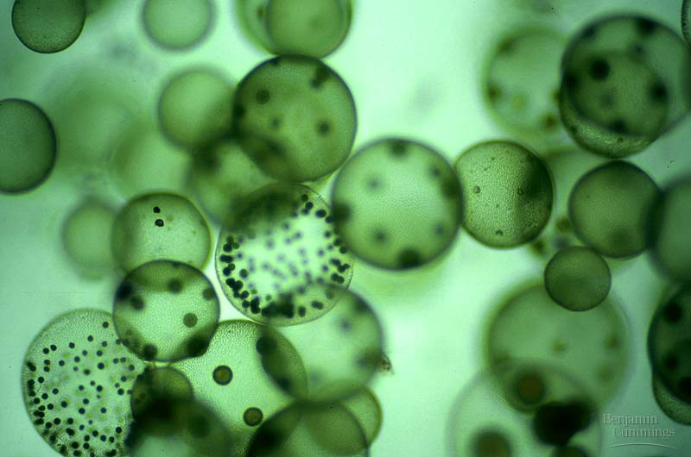
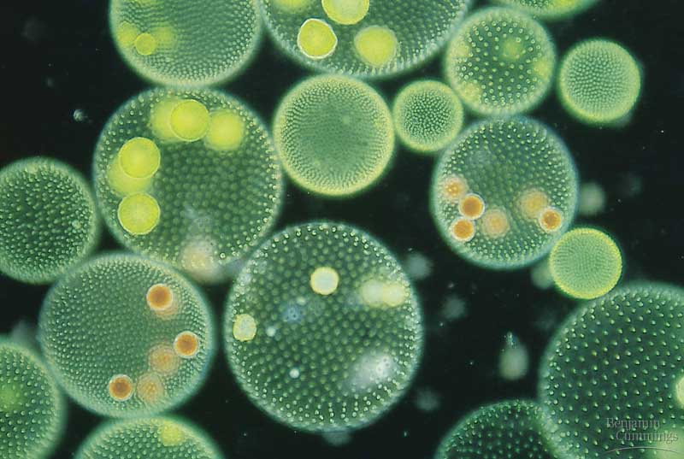
Algae
6. Chlorophyta
Also known as “green algae”
Can be unicellular or multicellular
Example: Volvox
Volvox forms colonies

Slide 19
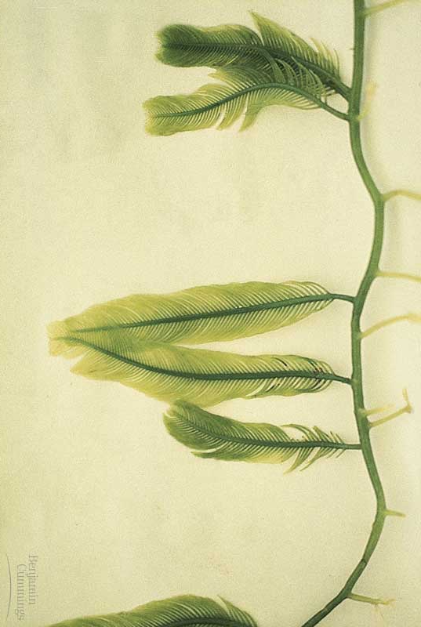
Algae
Green algae are often considered the ancestors to plants because of 3 key similarities:
Contain chlorophyll
Have cell walls
Exhibit alternation of
generations like modern
day ferns

Slide 20
Types of Protists
Fungus-like Protists
Heterotrophic
Feed on decaying organic matter
Decomposers

Slide 21
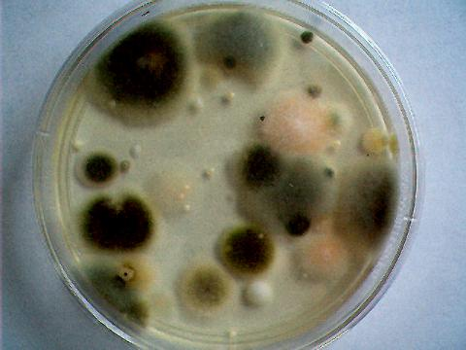
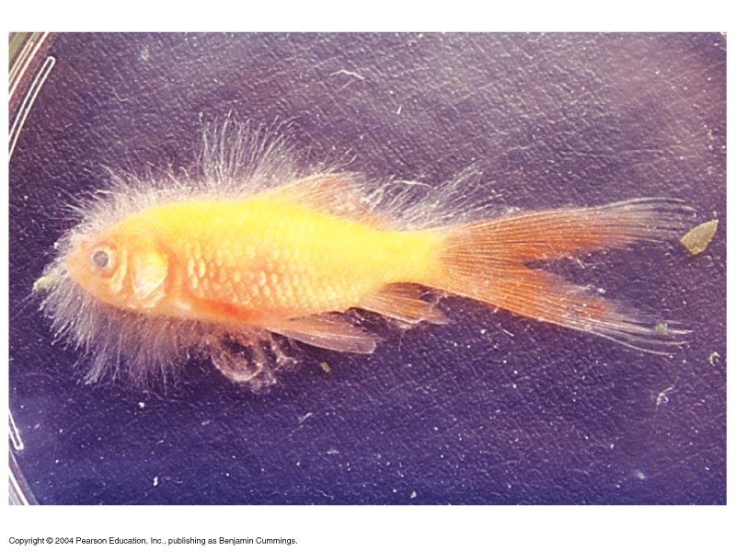
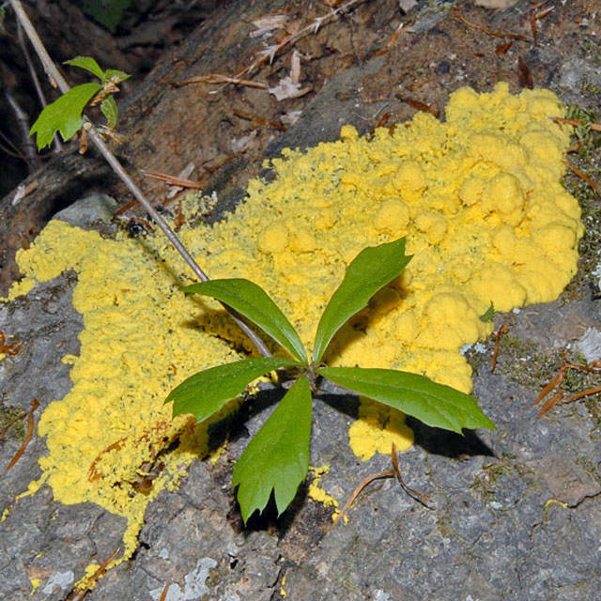
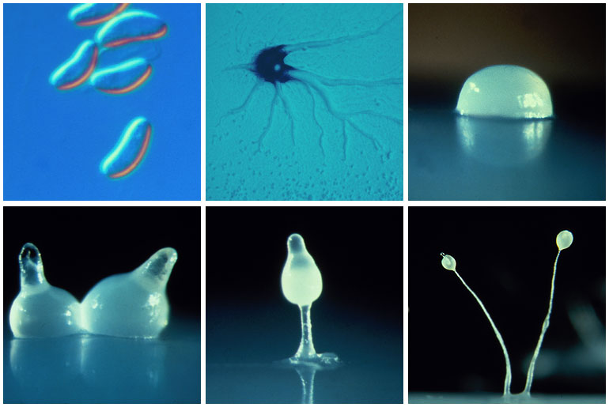
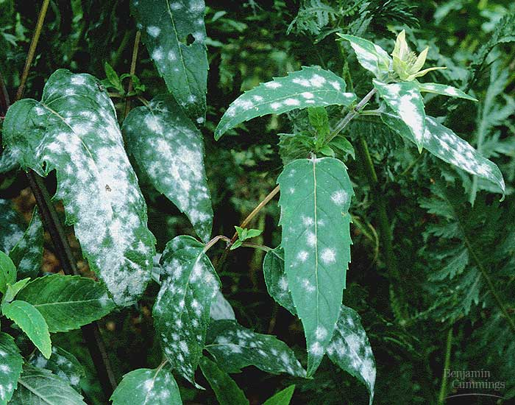
Fungus-like Protists
Examples:
Water molds
Slime molds
Downy mildews

