Slide 1
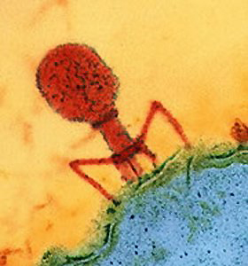
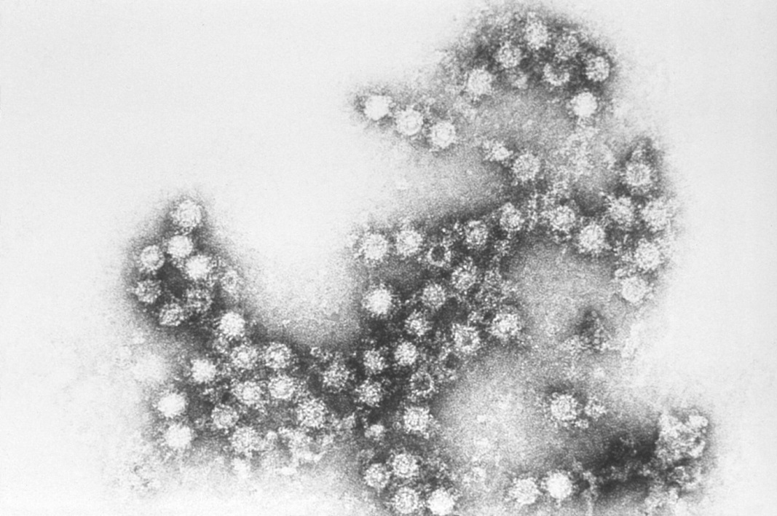
Viruses

Slide 2
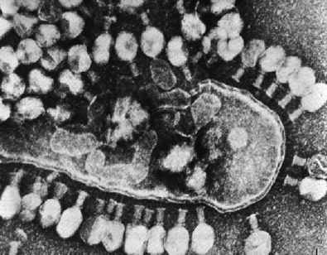
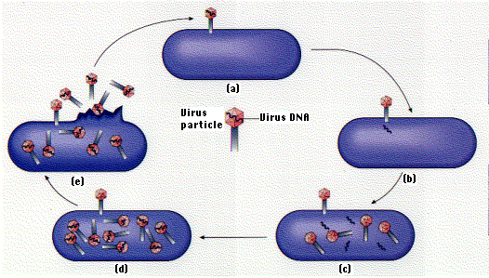
Viral Structure
Viruses are considered non-living particles because:
They are not made of cells
They do not carry out metabolism
Viruses can reproduce, but only inside a host cell

Slide 3
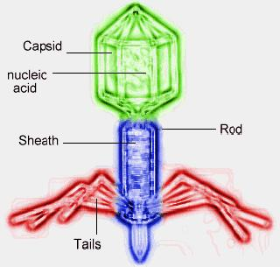
Viral Structure
Viruses have an inner core of RNA or DNA
Their outer coat
is made up of
proteins called
a capsid

Slide 4
Viral Structure
The arrangement of the protein capsid determines the shape of the virus that then determines the type of host cell that the virus infects

Slide 5
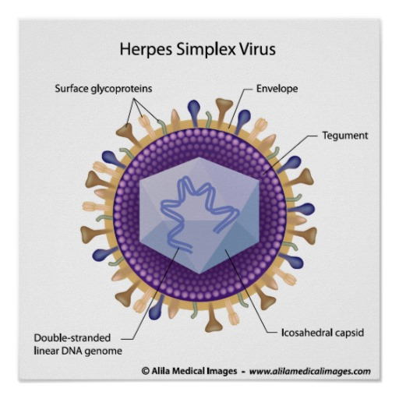
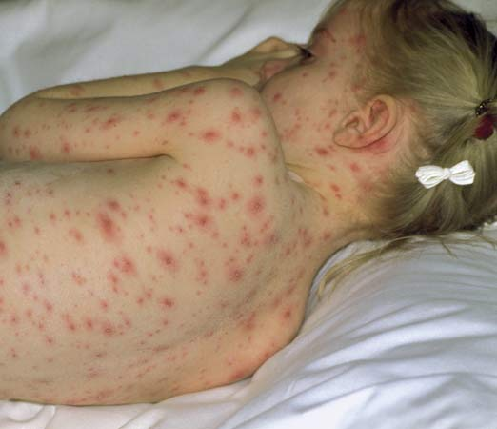
Host Cells
Viruses are species specific and cell type specific
Chickenpox is caused by the Varicella virus that attacks human T-cells and skin cells causing its signature itchy rash

Slide 6
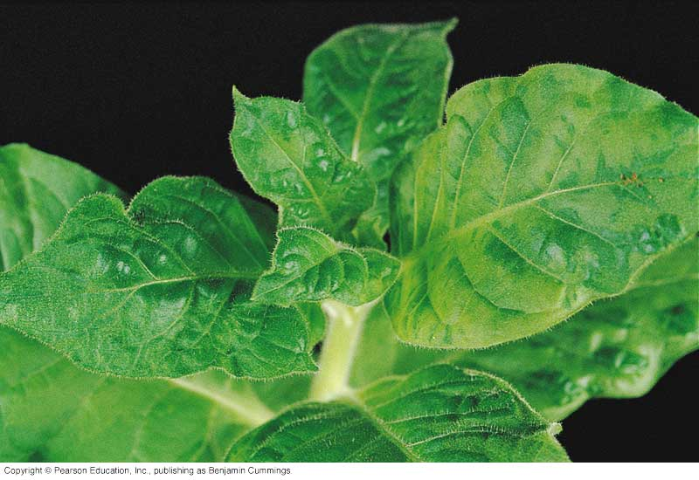
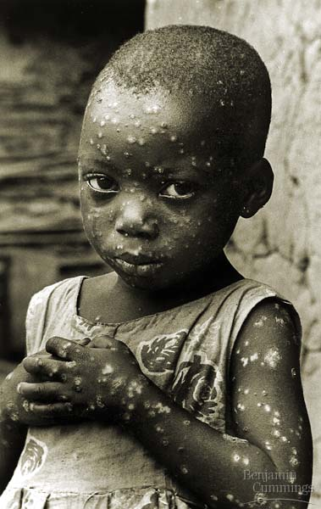
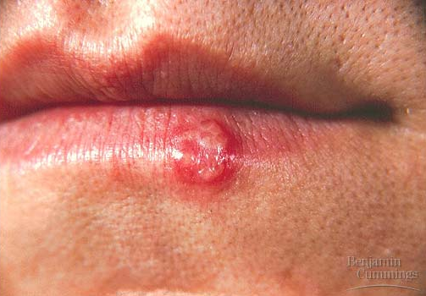
Viral Infections

Slide 7
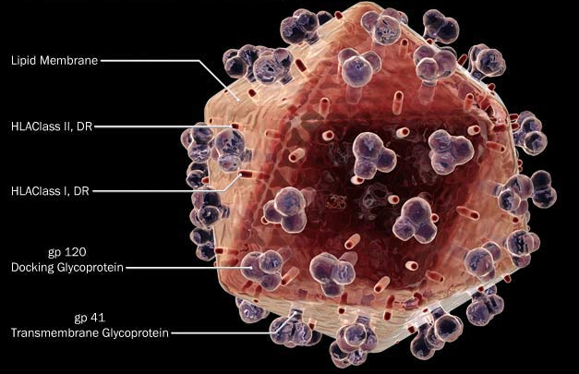
Viral Infections
Retroviruses are a strand of viruses that contain RNA instead of DNA
They contain an enzyme called reverse transcriptase that converts RNA into DNA to
infect cells
Examples: HIV,
Influenza
(Common flu)

Slide 8
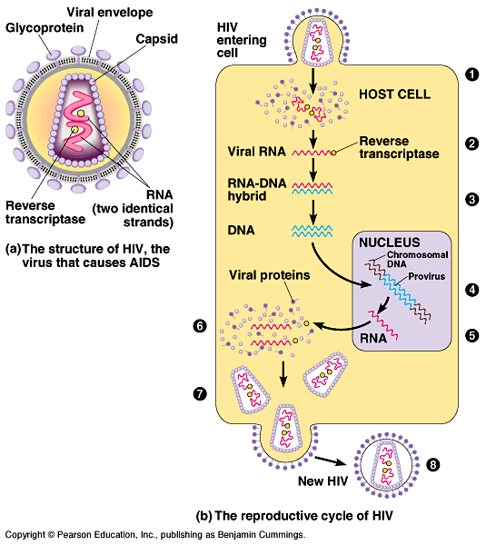
Retrovirus Reproduction

Slide 9
Viral Replication
There are 2 types of viral cycles:
Lytic Cycle
Virus attaches to host
Viral nucleic acid enters host
Replication of new virus parts
Assembly of new viruses
Lysis (bursting) of host cell to release new viruses

Slide 10
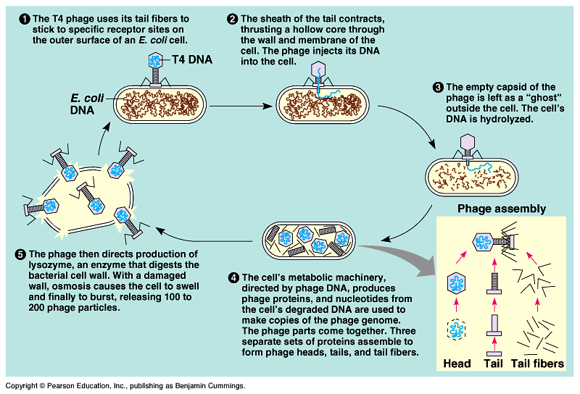
Viral Replication

Slide 11
Viral Replication
Lysogenic Cycle
Virus attaches to host
Viral nucleic acid enters host
A provirus forms when viral DNA joins the host DNA
Host cell replication copies the virus DNA along with the host

Slide 12
Viral Replication

Slide 13
Viral Replication
Diseases which show symptoms quickly are in the lytic cycle.
Diseases which take a long time to occur are in the lysogenic cycle.

